Slide 1
2022 Belleza Latina Pageant
Click here for Video recording
Fill out the Belleza Latina Interest Form
Miss Galaxia
Follow our Belleza Latina Insta Page
Join the Contestant Group chat

Slide 2
Meeting Agenda
Introductions
Icebreaker
Pageant Info
Paint & Sip

Slide 3
Contact Info
If you are interested in participating, please reach out
to Andy or Marilu!
isabelac@ksu.edu
(620) 212 – 9623
Marilurodriguezmele@ksu.edu
(620)287-3963

Slide 4
Icebreaker

Slide 5
What is Belleza Latina?
The Belleza Latina is the annual scholarship pageant hosted by HALO and co-hosted by UPC. The pageant is not strictly based on beauty, but rather professionalism, elegance, and self-expression.

Slide 6
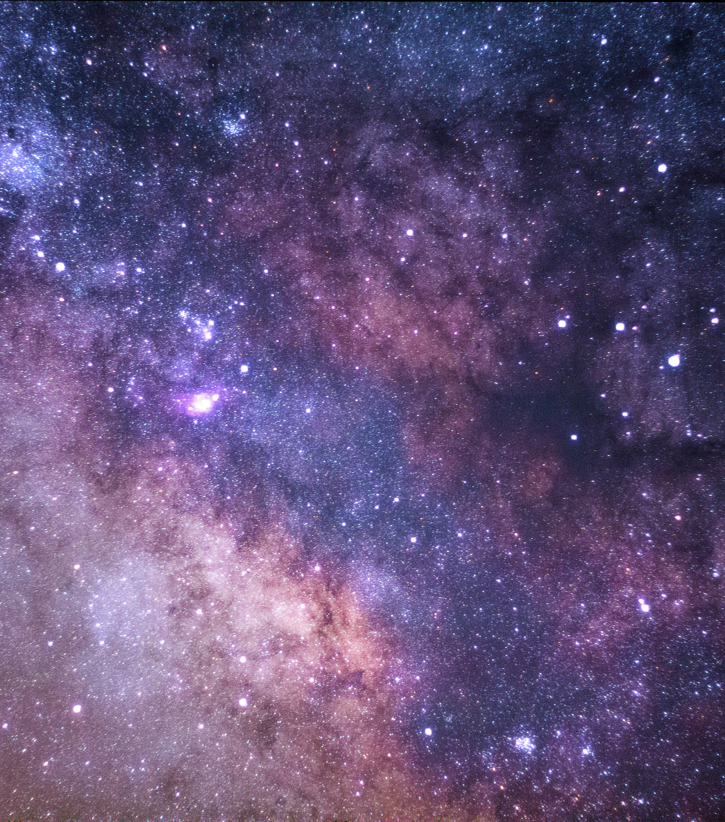
The Basics?
Time Commitment
You are expected to spend at least 4-6 hours weekly going to practice and/or being involved with either BLP meetings or events.
Experience
No experience is required!
Again, the pageant is not purely based on looks. We want our contestants to express themselves freely and professionally.
Purpose
This pageant focuses on our girls and their personal growth, we want this pageant to help represent you!

Slide 7
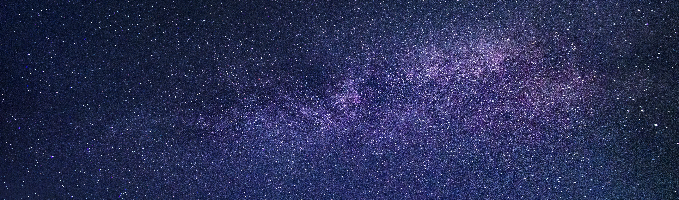
Forum Hall Dates
Jan 25th, 7am – 10pm
Feb 1st, 7am – 10pm
March 1st , 10am – 10pm
March 5th, 10am – 10pm
March 7th, 10am –10pm
March 8th, 10am – 10pm
March 12th, 10am – 10pm
March 14th, 10am – 10pm
March 15th, 10am – 10pm
March 16th, 10am – 10pm
March 19th, 10am – 10pm
March 21st, 10am – 10pm
March 28th, 10am – 10pm
April 9th, 10am – 10pm
April 13th, 2pm – 5pm
April 16th, 10am – 10pm
April 17th, 4pm – 10 pm
April 18th, 5pm – 10pm
April 19th, 10am – 10pm
April 21st, 10am – 10pm
You are required to attend two practices a week
Contestants are strongly encouraged to attend all Forum rehearsals.
You are awarded points for attending rehearsals

Slide 8
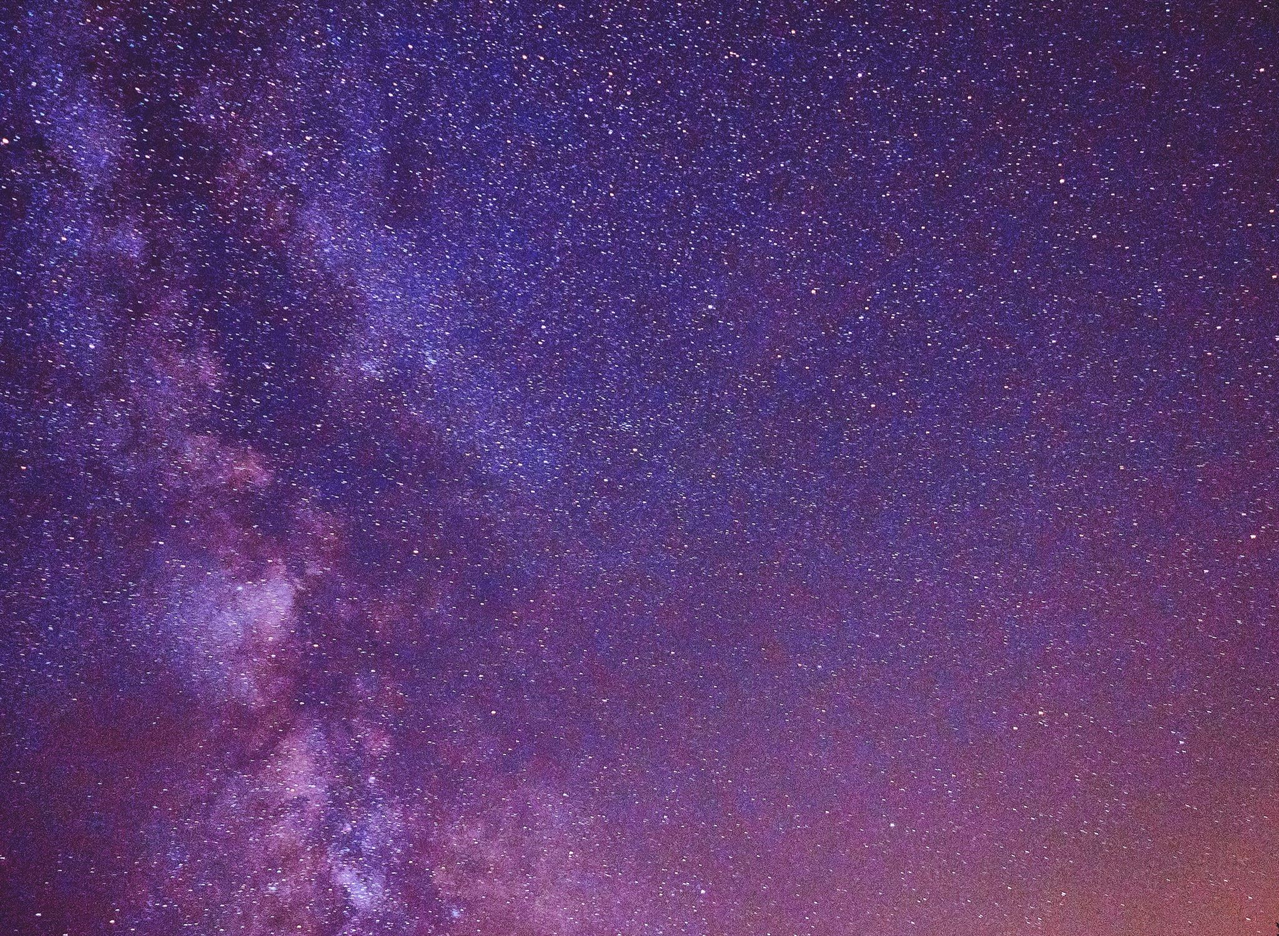
What are the categories?
Introduction
Attire: contest color choice of dress
Small personal bio
Girls showcase dance that was learned through the semester
Swimwear
Attire: bikini not required – as long as you look like you're going to the beach, wear what highlights you (in assigned color)
Talent
Showcase a hidden talent that you have. Wow the audience and our judges with a talent that we help you develop throughout the semester.
Elegance
Attire: formal
Girls will choose a platform to run on or something to bring awareness to.
Girls will record a voiceover sharing their hobbies, passions, and interest.
Q & A
Attire: elegance attire
Girls will answer one secret question.
Notes:
Veronica and Lourdes

Slide 9
Point System
Earn points by
- Attending practices
- Participating in community service projects
- Helping with fundraisers
- Being prepared for upcoming deadlines
- Showing up with needed materials
Notes:
Veronica and Lourdes

Slide 10
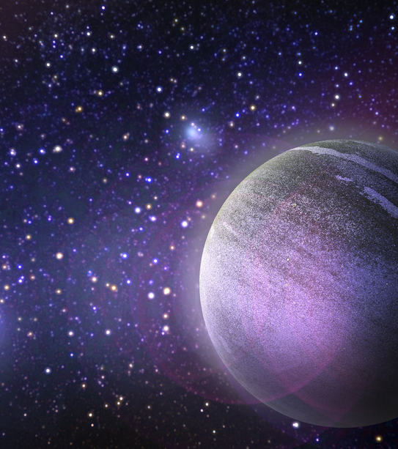
Financial Concerns
HALO will try again this year to pay for the contestant's intro dresses.
Contestants will be responsible for heels, jewelry, and any extra items they would like to involve in their own portions of the pageant.
Career closet
This year we will try to get a sponsor to do the girls' hair and/or makeup for the pageant, but it is not yet confirmed.
We will conduct multiple fundraisers throughout the upcoming semesters for the pageant. Will require the contestants to be present.

Slide 11
Scholarships
Contestants will be competing for a chance to win 1 of 2 scholarship awards: (Final Scholarship amounts still TBD)
1st Place - $1000
Runner-up - $500

Slide 12
Contestant Application
FAQ: ​
Can I apply early?​
Yes! If you apply early, you can start getting point before the other contestants!
Due: Sunday, December 4th @11:59pm
Questions on the application:
Head shot
Name
WID
Grade
GPA
Major
Hometown
Short bio
Why do you want to be in the pageant?
School & work schedule for next semester

Slide 13
Contestant Application/Contract Form
Contestant Application/Contract Form
We will send this to you through email in PDF Form so that you can either print it out and sign it or you can electronically sign it and email it back
Your signature MUST BE in cursive NOT printed.
Minimum of 4 contestants are required to have the pageant.

