Slide 1
Spring 2024 Officer Orientation
Presented by the Department of Student Engagement

Slide 2
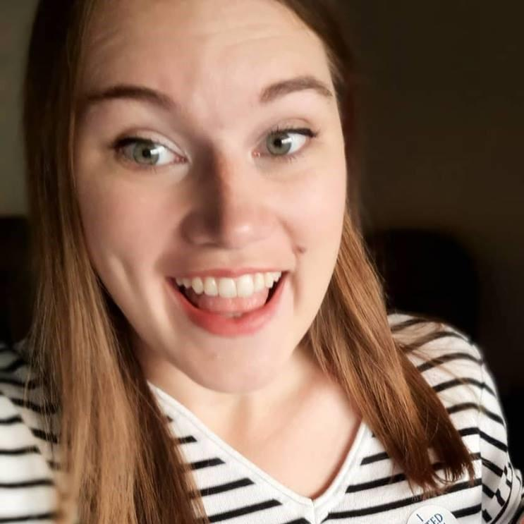
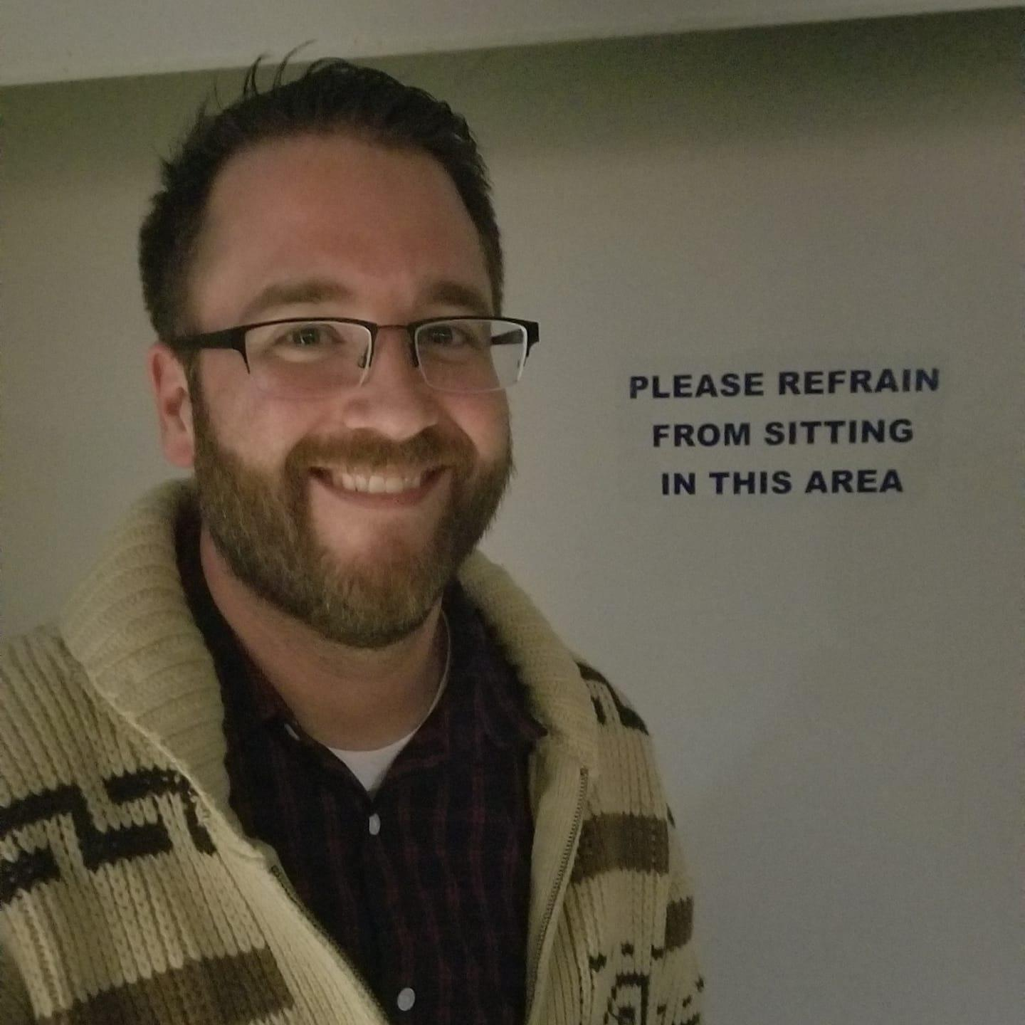
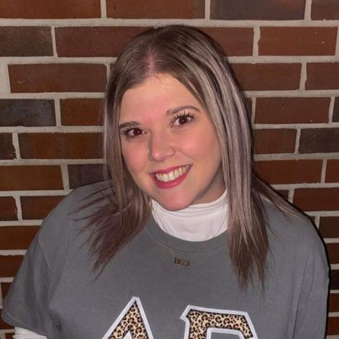
Department of Student Engagement (DSE)
Kelsey Tempas
Director
tempask@erau.edu
Chris Swann-Gunlefinger
Assistant Director
swannguc@erau.edu
Molly Webb
Assistant Director
webbm3@erau.edu
Notes:
How presentation will benefit audience: Adult learners are more interested in a subject if they know how or why it is important to them.
Presenter’s level of expertise in the subject: Briefly state your credentials in this area, or explain why participants should listen to you.

Slide 3
DSE Mission Statement
The Department of Student Engagement will provide intentional programs and services for holistic growth and skill development, resulting in personal and professional success and contributing to the meaningful co-curricular experience of Embry-Riddle Prescott students.
Notes:
How presentation will benefit audience: Adult learners are more interested in a subject if they know how or why it is important to them.
Presenter’s level of expertise in the subject: Briefly state your credentials in this area, or explain why participants should listen to you.

Slide 4
Recognized Student Organizations (RSOs)
The formal name for all clubs and orgs on campus
Recognition = university oversight and support
OVERSIGHT
Faculty and staff advisors
Appropriate use of university facilities
Review and approval of approved activities
SUPPORT
Faculty and staff advisors
Use of university facilities and resources
Notes:
How presentation will benefit audience: Adult learners are more interested in a subject if they know how or why it is important to them.
Presenter’s level of expertise in the subject: Briefly state your credentials in this area, or explain why participants should listen to you.

Slide 5
Types of RSOs
Sponsored Student Organizations
General Student Organizations
Fraternity and Sorority Life (FSL) Chapter
Student Government Association (SGA) Service Organization
Notes:
How presentation will benefit audience: Adult learners are more interested in a subject if they know how or why it is important to them.
Presenter’s level of expertise in the subject: Briefly state your credentials in this area, or explain why participants should listen to you.

Slide 6
Requirements for Recognition
Registration
Membership
Student Leadership
Guiding Documents
Advisors
Notes:
How presentation will benefit audience: Adult learners are more interested in a subject if they know how or why it is important to them.
Presenter’s level of expertise in the subject: Briefly state your credentials in this area, or explain why participants should listen to you.

Slide 7
Requirements for Recognition
REGISTRATION
All RSOs must re-register their organization each year within the published dates during the Spring semester
Notes:
How presentation will benefit audience: Adult learners are more interested in a subject if they know how or why it is important to them.
Presenter’s level of expertise in the subject: Briefly state your credentials in this area, or explain why participants should listen to you.

Slide 8
Requirements for Recognition
MEMBERSHIP
RSOs must maintain at least five active members currently enrolled as students at Embry-Riddle Aeronautical University – Prescott.
Community members (Non-ERAU Prescott student and over the age of eighteen) are permitted to participate within ERAU Prescott RSOs, pending the completion of a Community Member Agreement. ERAU Prescott students must make up at least sixty percent of a RSO’s total membership.
Membership records are to be maintained and kept up to date through the RSO’s Eagle Life page.
Notes:
How presentation will benefit audience: Adult learners are more interested in a subject if they know how or why it is important to them.
Presenter’s level of expertise in the subject: Briefly state your credentials in this area, or explain why participants should listen to you.

Slide 9
Requirements for Recognition
STUDENT LEADERSHIP
RSOs must have at least two officers - a chief executive (i.e. president) and a financial officer (i.e. treasurer).
These officers, and any others, must be enrolled as students at ERAU Prescott, in good academic and conduct standing, and accurately listed in the RSO’s Eagle Life page.
Notes:
How presentation will benefit audience: Adult learners are more interested in a subject if they know how or why it is important to them.
Presenter’s level of expertise in the subject: Briefly state your credentials in this area, or explain why participants should listen to you.

Slide 10
Requirements for Recognition
GUIDING DOCUMENTS
If the RSO’s policies at the local or parent organization level conflict with University policies, the University’s policies will supersede.
RSOs may update their guiding documents, following the process outlined in the current guiding documents, at any time.
Notes:
How presentation will benefit audience: Adult learners are more interested in a subject if they know how or why it is important to them.
Presenter’s level of expertise in the subject: Briefly state your credentials in this area, or explain why participants should listen to you.

Slide 11
Requirements for Recognition
RSOs must maintain a functional and current set of guiding documents, uploaded through the RSO’s EagleLife page, which must contain the following:
A list of officers and their duties, a method of selecting those officers, and a process of amending the guiding documents.
"This organization is a recognized student organization at Embry - Riddle Aeronautical University - Prescott and adheres to all campus policies as set forth by the Department of Student Engagement and ERAU Prescott administration."
"Embry-Riddle does not permit discrimination or harassment in its programs and activities on the basis of race, color, national origin, sex, gender identity, gender expression, sexual orientation, disability, veteran status, predisposing genetic characteristic, age, religion, pregnancy status or any other characteristic protected by University policy or state, local, or federal law and therefore eligibility for membership or appointed or elected student officer positions may not be limited on any of the above qualities."
Notes:
How presentation will benefit audience: Adult learners are more interested in a subject if they know how or why it is important to them.
Presenter’s level of expertise in the subject: Briefly state your credentials in this area, or explain why participants should listen to you.

Slide 12
Requirements for Recognition
ADVISORS
CAMPUS LEVEL ADVISOR
A campus level advisor assists RSOs with those functional areas common to all organizations, regardless of mission, purpose, etc. These areas include, but are not limited to, general organizational operations, meeting procedures, event planning, by-law and constitution revisions, officer transitions, budgeting and finance, risk management, and the use of Eagle Life.
CONTENT ADVISOR
A content advisor is an individual with both an interest and expertise in the organization’s mission or purpose and a willingness to support the RSO as a subject matter expert. RSOs are not limited in the number of content advisors they may select. All content advisors must be listed on the RSO’s Eagle Life page. Content advisors not affiliated with ERAU Prescott must complete the Community Member Agreement form and may receive access to Eagle Life by contacting the Department of Student Engagement.
Only required for Departmentally Sponsored and FSL RSOs, but optional for everyone.
Notes:
How presentation will benefit audience: Adult learners are more interested in a subject if they know how or why it is important to them.
Presenter’s level of expertise in the subject: Briefly state your credentials in this area, or explain why participants should listen to you.

Slide 13
Spring 2024 RSO Event Policies
ALL EVENTS, on and off-campus, must be submitted through Eagle Life for review at least 7 days prior to the event
Many events require more time (14 days)
Facilities work orders must be submitted at least 10 days prior to the event
Event Technology requests must be submitted at least 10 days prior to the event
On campus events with alcohol must be submitted at least 3 weeks prior to the event date to allow time for additional review
All event requests will be reviewed by student engagement staff and/or campus safety to ensure appropriate risk management procedures and/or safety protocols are followed
A certified food handler must be present for the duration of any event with non-professionally prepared, temperature-controlled food
Notes:
How presentation will benefit audience: Adult learners are more interested in a subject if they know how or why it is important to them.
Presenter’s level of expertise in the subject: Briefly state your credentials in this area, or explain why participants should listen to you.

Slide 14
Spring 2024 Athletic Facility Event Policies
Event requests for Athletic Facilities must be submitted at least 14 days in advance
Reservations are limited to 2 hours
If you need to cancel your reservation, contact DSE no later than 4:00 PM the day of the event, Monday – Friday or no later than 4:00 PM Friday for a weekend event
No-show without providing notice:
1st offense: Next athletic facility reservation cancelled
2nd offense: All athletic facility reservations for the next 30 days cancelled / no new requests approved for 30 days
3rd offense: All athletic facility reservations for semester cancelled / no new requests approved / potential organizational conduct charges
Notes:
How presentation will benefit audience: Adult learners are more interested in a subject if they know how or why it is important to them.
Presenter’s level of expertise in the subject: Briefly state your credentials in this area, or explain why participants should listen to you.

Slide 15
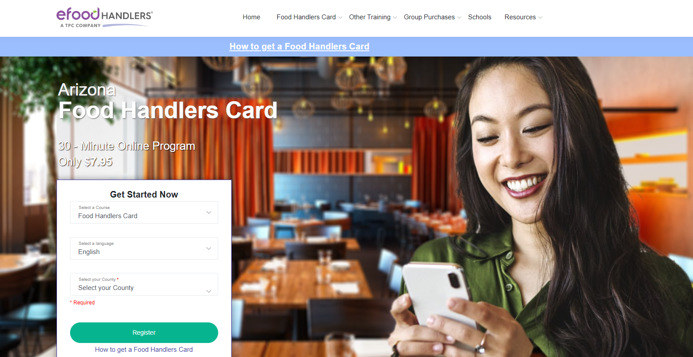
Food Handler Certifications
https://www.azfoodhandlers.com
Notes:
How presentation will benefit audience: Adult learners are more interested in a subject if they know how or why it is important to them.
Presenter’s level of expertise in the subject: Briefly state your credentials in this area, or explain why participants should listen to you.

Slide 16
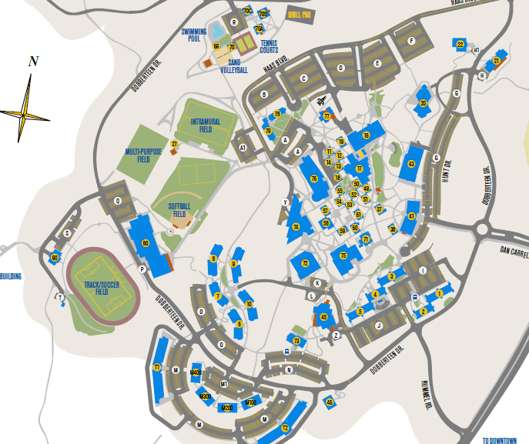
Reservable Spaces
Classrooms
Eagle Gym (smaller)
Activity Center (bigger)
Rec Fields
Volleyball Court
Pool and Field Ramadas
Quad/Amphitheater
Courtyard
Tabling locations
Lower Hangar
DLC Auditorium
Chapel
Women’s and Diversity Center
Notes:
How presentation will benefit audience: Adult learners are more interested in a subject if they know how or why it is important to them.
Presenter’s level of expertise in the subject: Briefly state your credentials in this area, or explain why participants should listen to you.

Slide 17
Rec Fields
“Rec field 1” “Intramural Field”
“Turf Field”
“Rec field 2”
Please do not request the “Lower Fields” as we will not know which field(s) you actually need
Notes:
How presentation will benefit audience: Adult learners are more interested in a subject if they know how or why it is important to them.
Presenter’s level of expertise in the subject: Briefly state your credentials in this area, or explain why participants should listen to you.

Slide 18
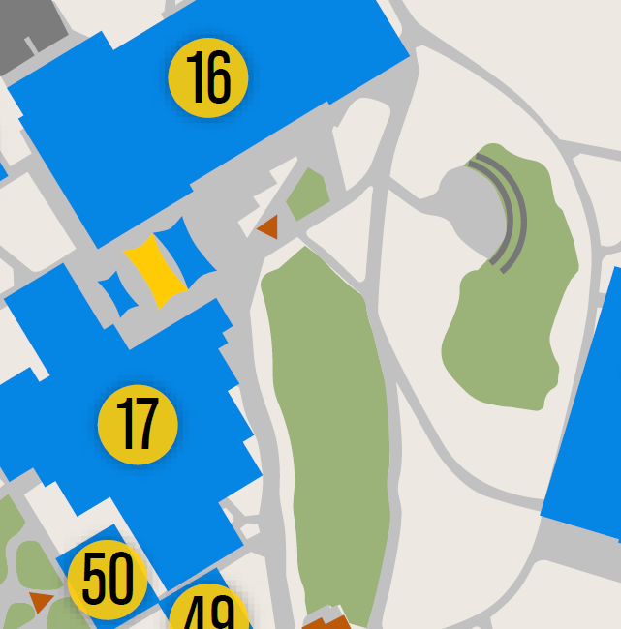
Quad / Amphitheater
The grass and the amphitheater
Not the covered area with the stage
This is not a tabling location
Facilities work order needed for tables, etc.
Media work order needed for sound / pa system
Notes:
How presentation will benefit audience: Adult learners are more interested in a subject if they know how or why it is important to them.
Presenter’s level of expertise in the subject: Briefly state your credentials in this area, or explain why participants should listen to you.

Slide 19
Courtyard
Covered area with the stage and shade sails
Not the grassy area
This is not a tabling location
Dinning tables and chairs may be there (metal, round)
Facilities work order needed for anything else (including grills)
Media work order needed for sound / pa system
Notes:
How presentation will benefit audience: Adult learners are more interested in a subject if they know how or why it is important to them.
Presenter’s level of expertise in the subject: Briefly state your credentials in this area, or explain why participants should listen to you.

Slide 20
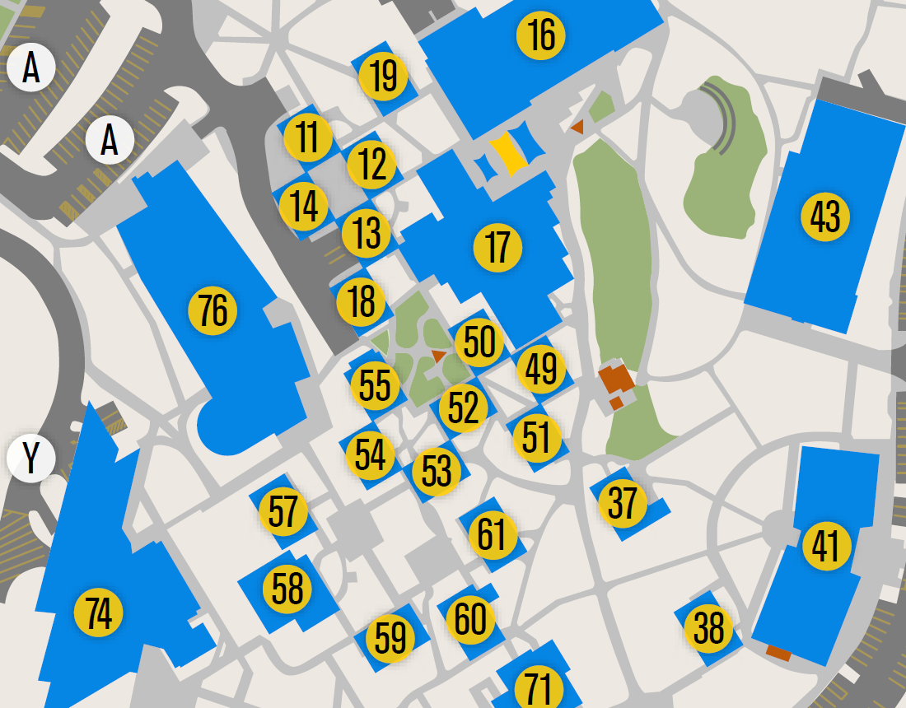
Tabling Spaces
Student Union Entry Way (2 spots)
Student Union Exterior (3 spots)
Library (1 spot)
AC1 (1 spot)
Tables must be checked out from and returned to DSE everyday you table.
Notes:
How presentation will benefit audience: Adult learners are more interested in a subject if they know how or why it is important to them.
Presenter’s level of expertise in the subject: Briefly state your credentials in this area, or explain why participants should listen to you.

Slide 21
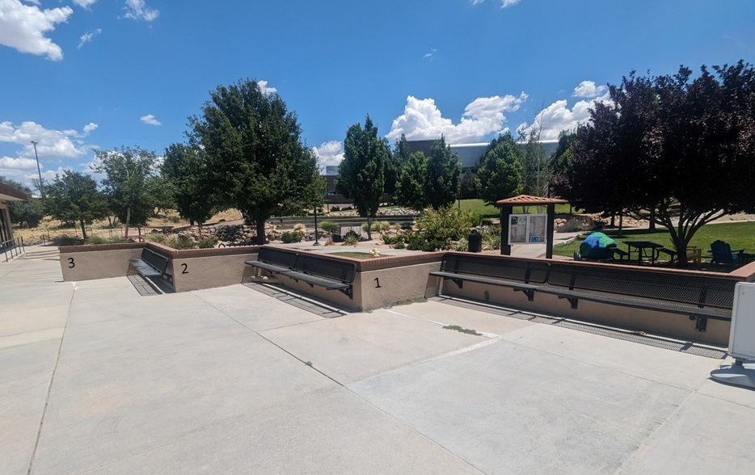
Student Union Exterior Tabling Spaces
Spaces are numbered.
The bench is the back of the space
Notes:
How presentation will benefit audience: Adult learners are more interested in a subject if they know how or why it is important to them.
Presenter’s level of expertise in the subject: Briefly state your credentials in this area, or explain why participants should listen to you.

Slide 22
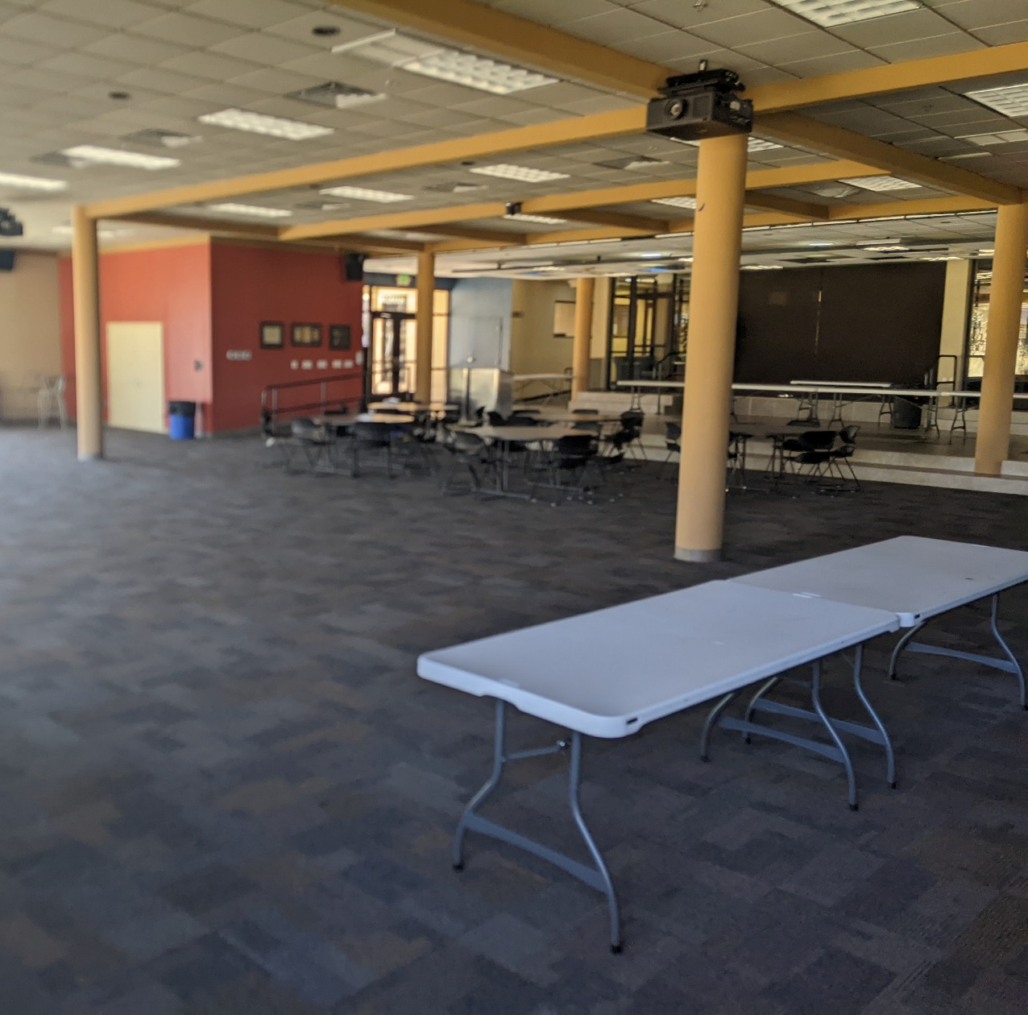
Lower Hangar
Facilities work order needed for tables, etc.
There is no “default setup”
Self-service, plug and play for audio and video.
Media work order still needed for a microphone.
Notes:
How presentation will benefit audience: Adult learners are more interested in a subject if they know how or why it is important to them.
Presenter’s level of expertise in the subject: Briefly state your credentials in this area, or explain why participants should listen to you.

Slide 23
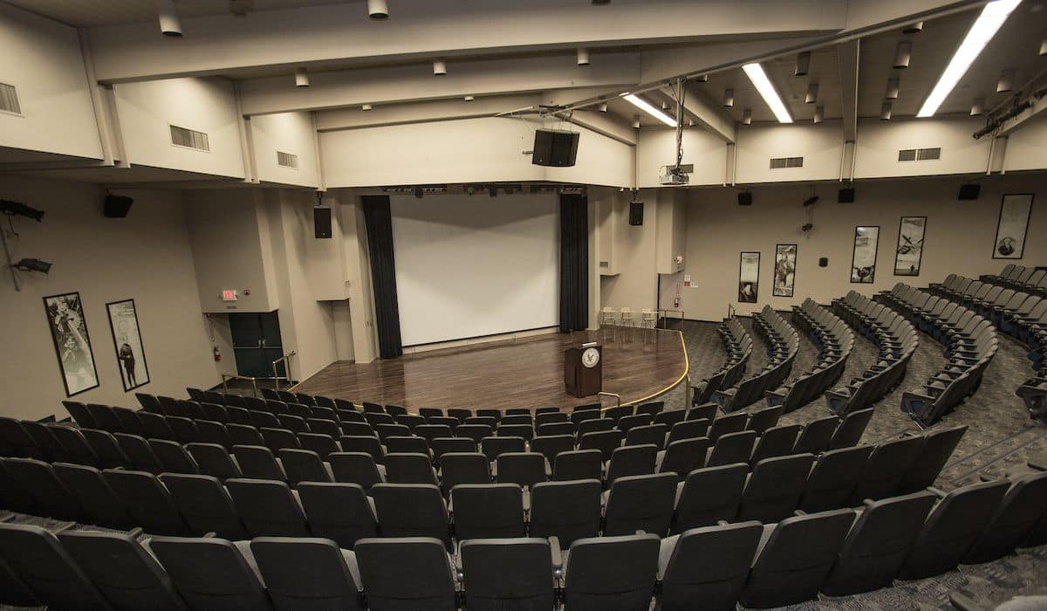
DLC Auditorium
Self service for basic projection, sound, lights
Media requests needed for more complicated requests
Generally not much facilities setup, unless you need something specific
MEDIA WORKORDER IS REQUIRED TO MOVE THE PODIUM
Notes:
How presentation will benefit audience: Adult learners are more interested in a subject if they know how or why it is important to them.
Presenter’s level of expertise in the subject: Briefly state your credentials in this area, or explain why participants should listen to you.

Slide 24
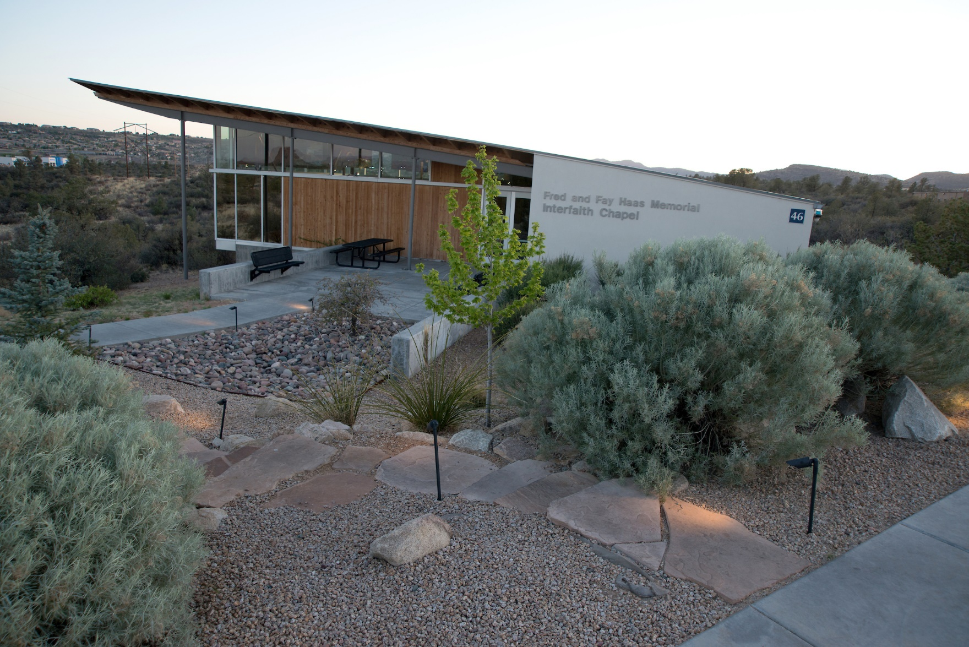
Chapel
Available evenings and weekends
Self service setup
Put things back as you found them when finished
NOW SELF SERVICE FOR AUDIO AND VIDEO!
Notes:
How presentation will benefit audience: Adult learners are more interested in a subject if they know how or why it is important to them.
Presenter’s level of expertise in the subject: Briefly state your credentials in this area, or explain why participants should listen to you.

Slide 25
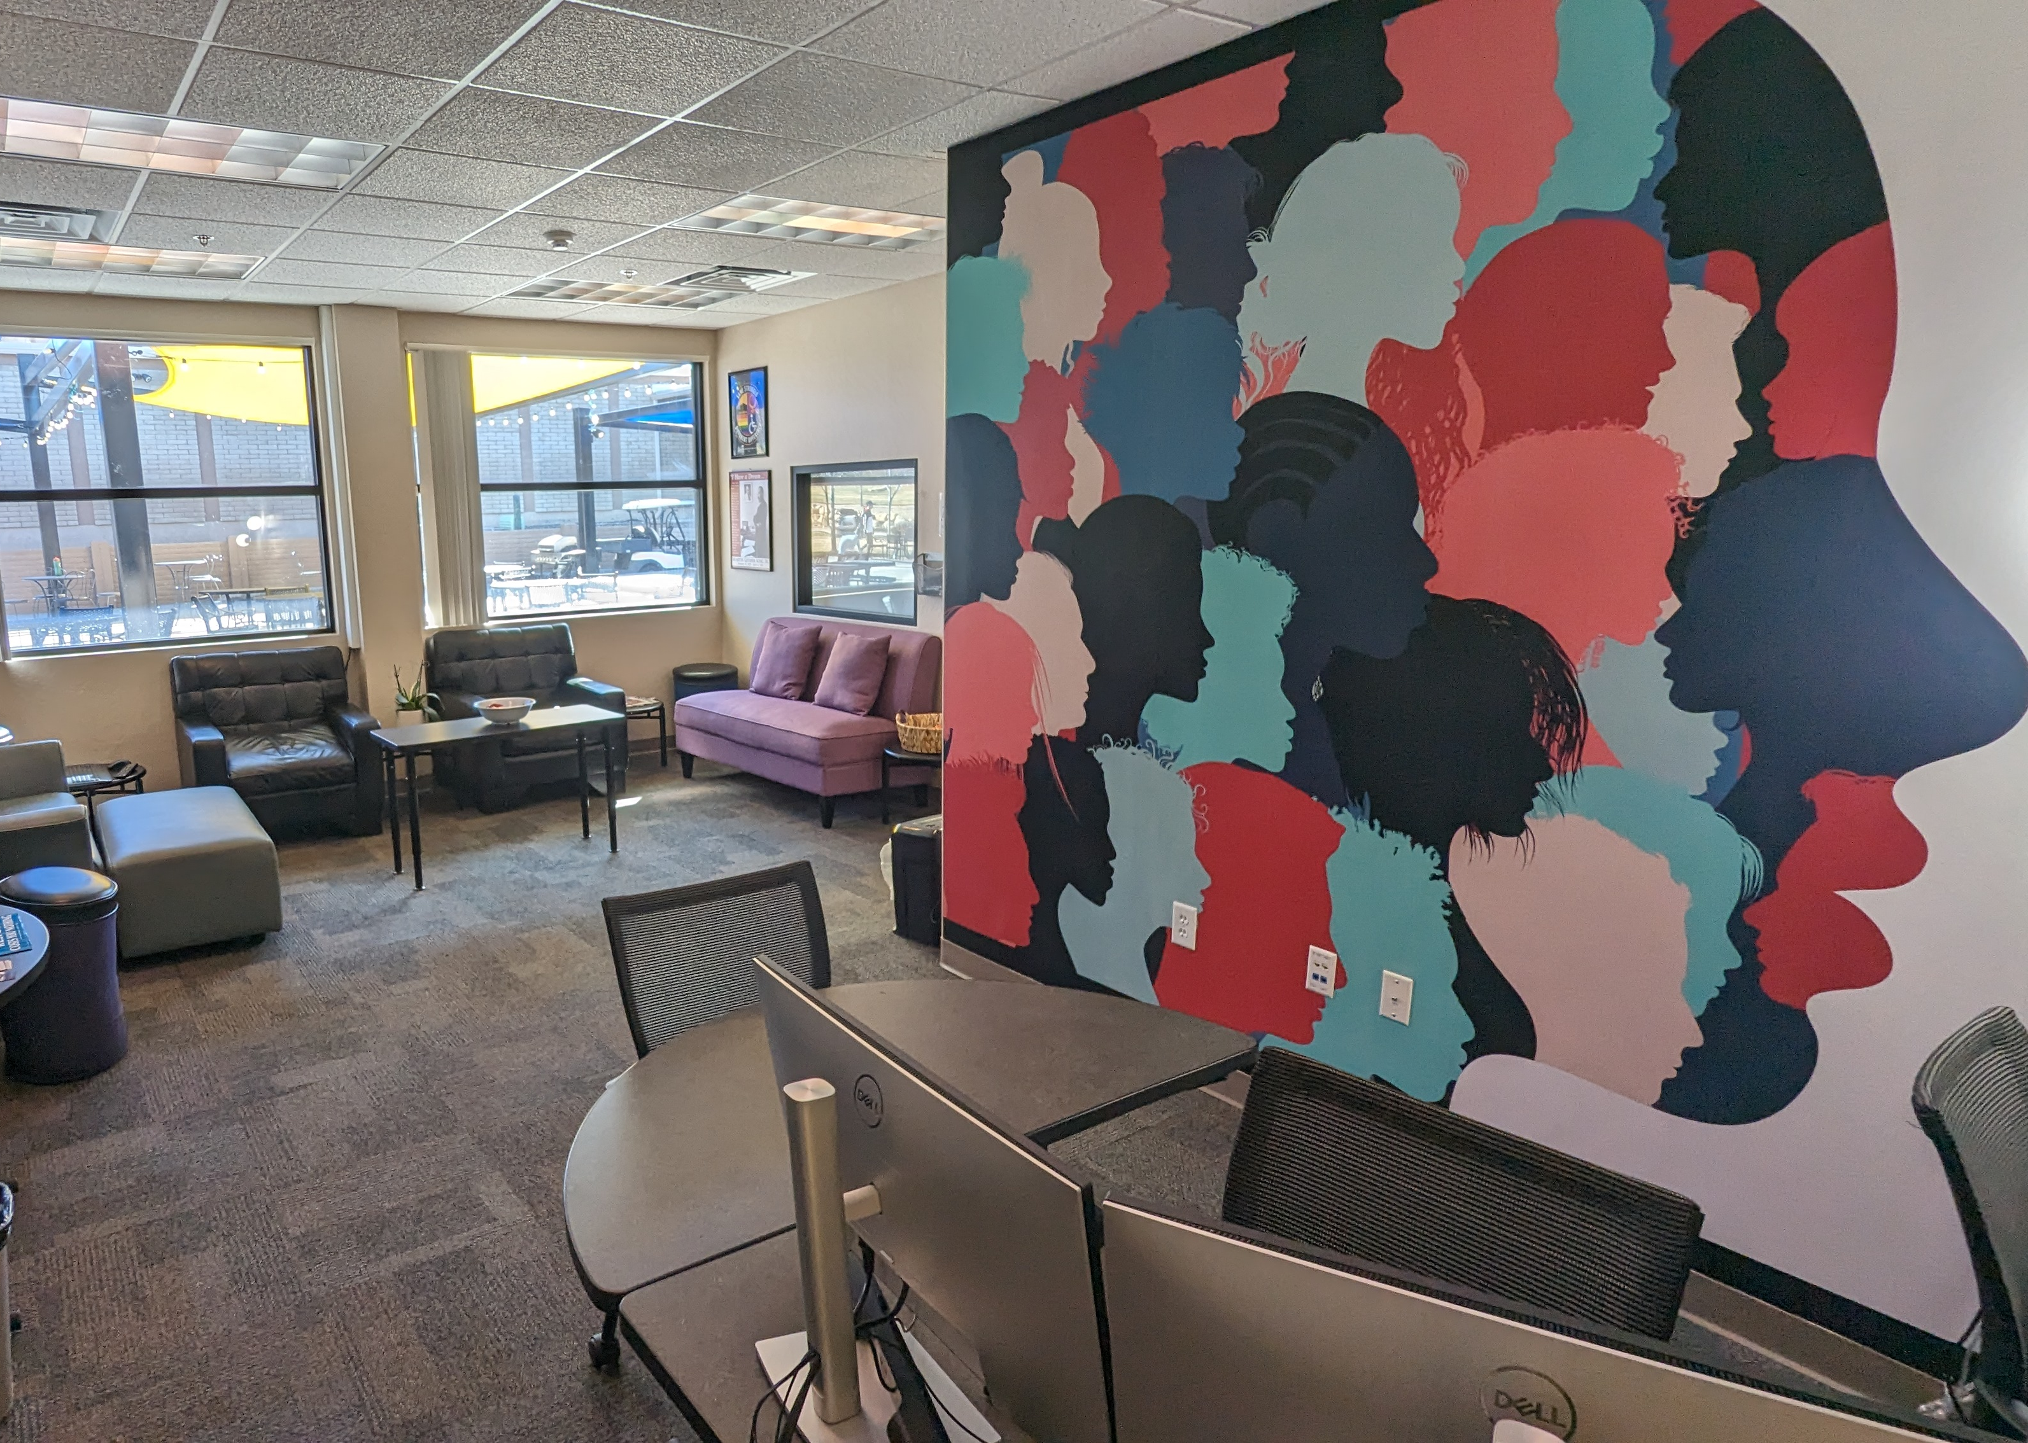
Center for Diversity and Inclusion
Available nights and weekends
Open to everyone
Casual club meeting and hangout / work space
2 computers available for use
Big screen available for presentations and streaming
Notes:
How presentation will benefit audience: Adult learners are more interested in a subject if they know how or why it is important to them.
Presenter’s level of expertise in the subject: Briefly state your credentials in this area, or explain why participants should listen to you.

Slide 26
Facilities work orders
ERNIE
Departments
Facilities Management
- Prescott Campus
“Make a Maintenance Request (ReADY)”
“Event Support Request”
Layout may be required – any drawing you can produce will work, but we can help you create a detailed and to-scale layout for major event spaces on campus.
Must be submitted at least 10 days prior
DSE Point of Contact can help!
Notes:
How presentation will benefit audience: Adult learners are more interested in a subject if they know how or why it is important to them.
Presenter’s level of expertise in the subject: Briefly state your credentials in this area, or explain why participants should listen to you.

Slide 27
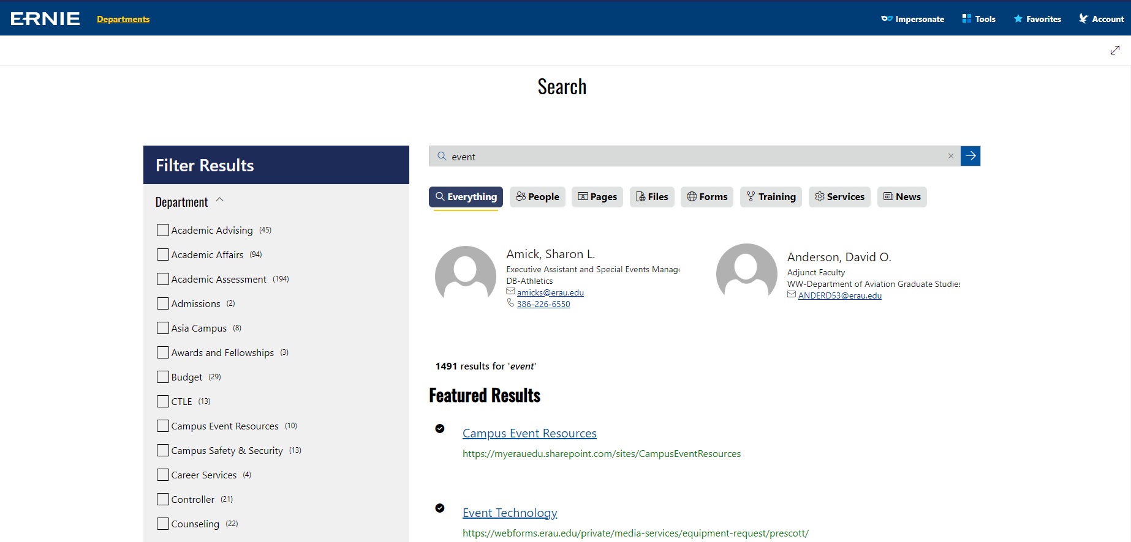
Media Services Request (Event Technology Work Order)
ERNIE
Search for “event” or “events”
Select “Event Technology”
Complete the form
Select “Event Technology”
Must be submitted at least 10 days prior
DSE Point of Contact can help!
Notes:
How presentation will benefit audience: Adult learners are more interested in a subject if they know how or why it is important to them.
Presenter’s level of expertise in the subject: Briefly state your credentials in this area, or explain why participants should listen to you.

Slide 28
Posting Policy
Where CAN I post?
Bulletin boards on exterior of buildings
Brick walls with blue painters’ tape only
Where CAN’T I post?
Anywhere else
DO NOT POST on glass surfaces
DO NOT scatter fliers (or any other printed materials) on tables anywhere on campus
What needs to be on my flyer?
Take down date (or event date) no more than one month in advance
Contact information (email or phone number)
When can I post?
AFTER your event has been approved in Eagle Life
Notes:
How presentation will benefit audience: Adult learners are more interested in a subject if they know how or why it is important to them.
Presenter’s level of expertise in the subject: Briefly state your credentials in this area, or explain why participants should listen to you.

Slide 29
Posting Policy Violations
1st Offense: 1 warning per semester with 1 week grace period to correct any issues / remove or update fliers
2nd Offense: fliers taken down immediately, org may be subject to conduct
Notes:
How presentation will benefit audience: Adult learners are more interested in a subject if they know how or why it is important to them.
Presenter’s level of expertise in the subject: Briefly state your credentials in this area, or explain why participants should listen to you.

Slide 30
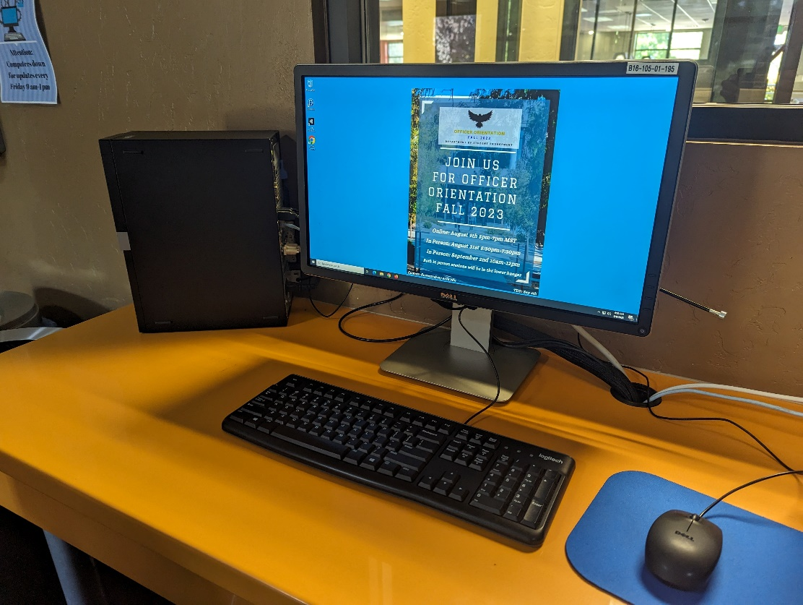
Other Advertising Methods
Desktop Wallpaper
Point of contact: Debbie Celebucki (celebucd@erau.edu)
Events must be approved in Eagle Life before submitting wallpaper
Wallpaper must include:
Organization name
Contact information with ERAU email
Date, time, and location of event
Format requirements
JPEG
Notes:
How presentation will benefit audience: Adult learners are more interested in a subject if they know how or why it is important to them.
Presenter’s level of expertise in the subject: Briefly state your credentials in this area, or explain why participants should listen to you.

Slide 31
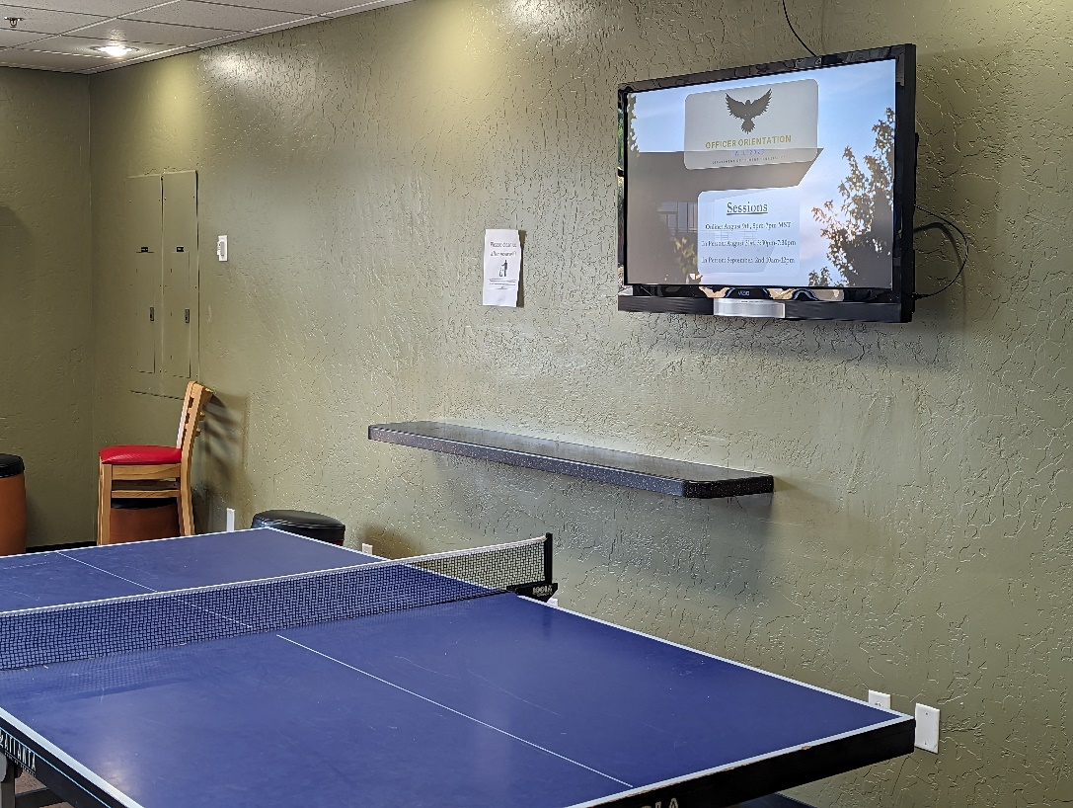
Other Advertising Methods
Student Union Pool Room TVs
Email advertisement to prdse@erau.edu
Events must be approved in Eagle Life before submitting an advertisement
Ads will be run up to 2 weeks before the event
Advertisement must include:
Organization name
Contact information with ERAU email
Date, time, and location of event
Format requirements
Landscape orientation
8.5 X 11 is OK
PNG or JPG
Notes:
How presentation will benefit audience: Adult learners are more interested in a subject if they know how or why it is important to them.
Presenter’s level of expertise in the subject: Briefly state your credentials in this area, or explain why participants should listen to you.

Slide 32
Other Advertising Methods
Housing and Residence Life bulletin boards
Staff will post in residence halls for you
Up to 35 locations
Deliver fliers to residence life office
Chalking
Student Engagement office has chalk available
Paint the Rock!
SGA has spray paint available
Notes:
How presentation will benefit audience: Adult learners are more interested in a subject if they know how or why it is important to them.
Presenter’s level of expertise in the subject: Briefly state your credentials in this area, or explain why participants should listen to you.

Slide 33
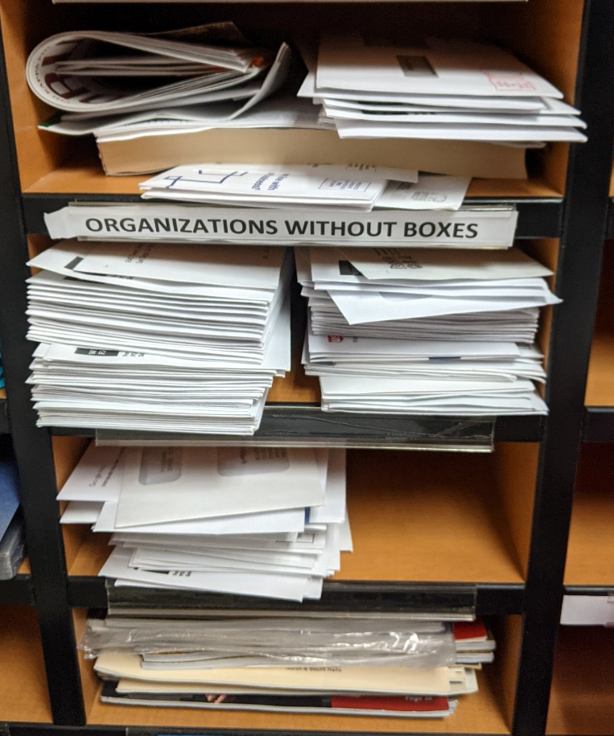
Mail
Student org mailboxes are in the Student Union room 123
Pick up your mail, please!
If you get mail sent to campus, please request a box
Notes:
How presentation will benefit audience: Adult learners are more interested in a subject if they know how or why it is important to them.
Presenter’s level of expertise in the subject: Briefly state your credentials in this area, or explain why participants should listen to you.

Slide 34
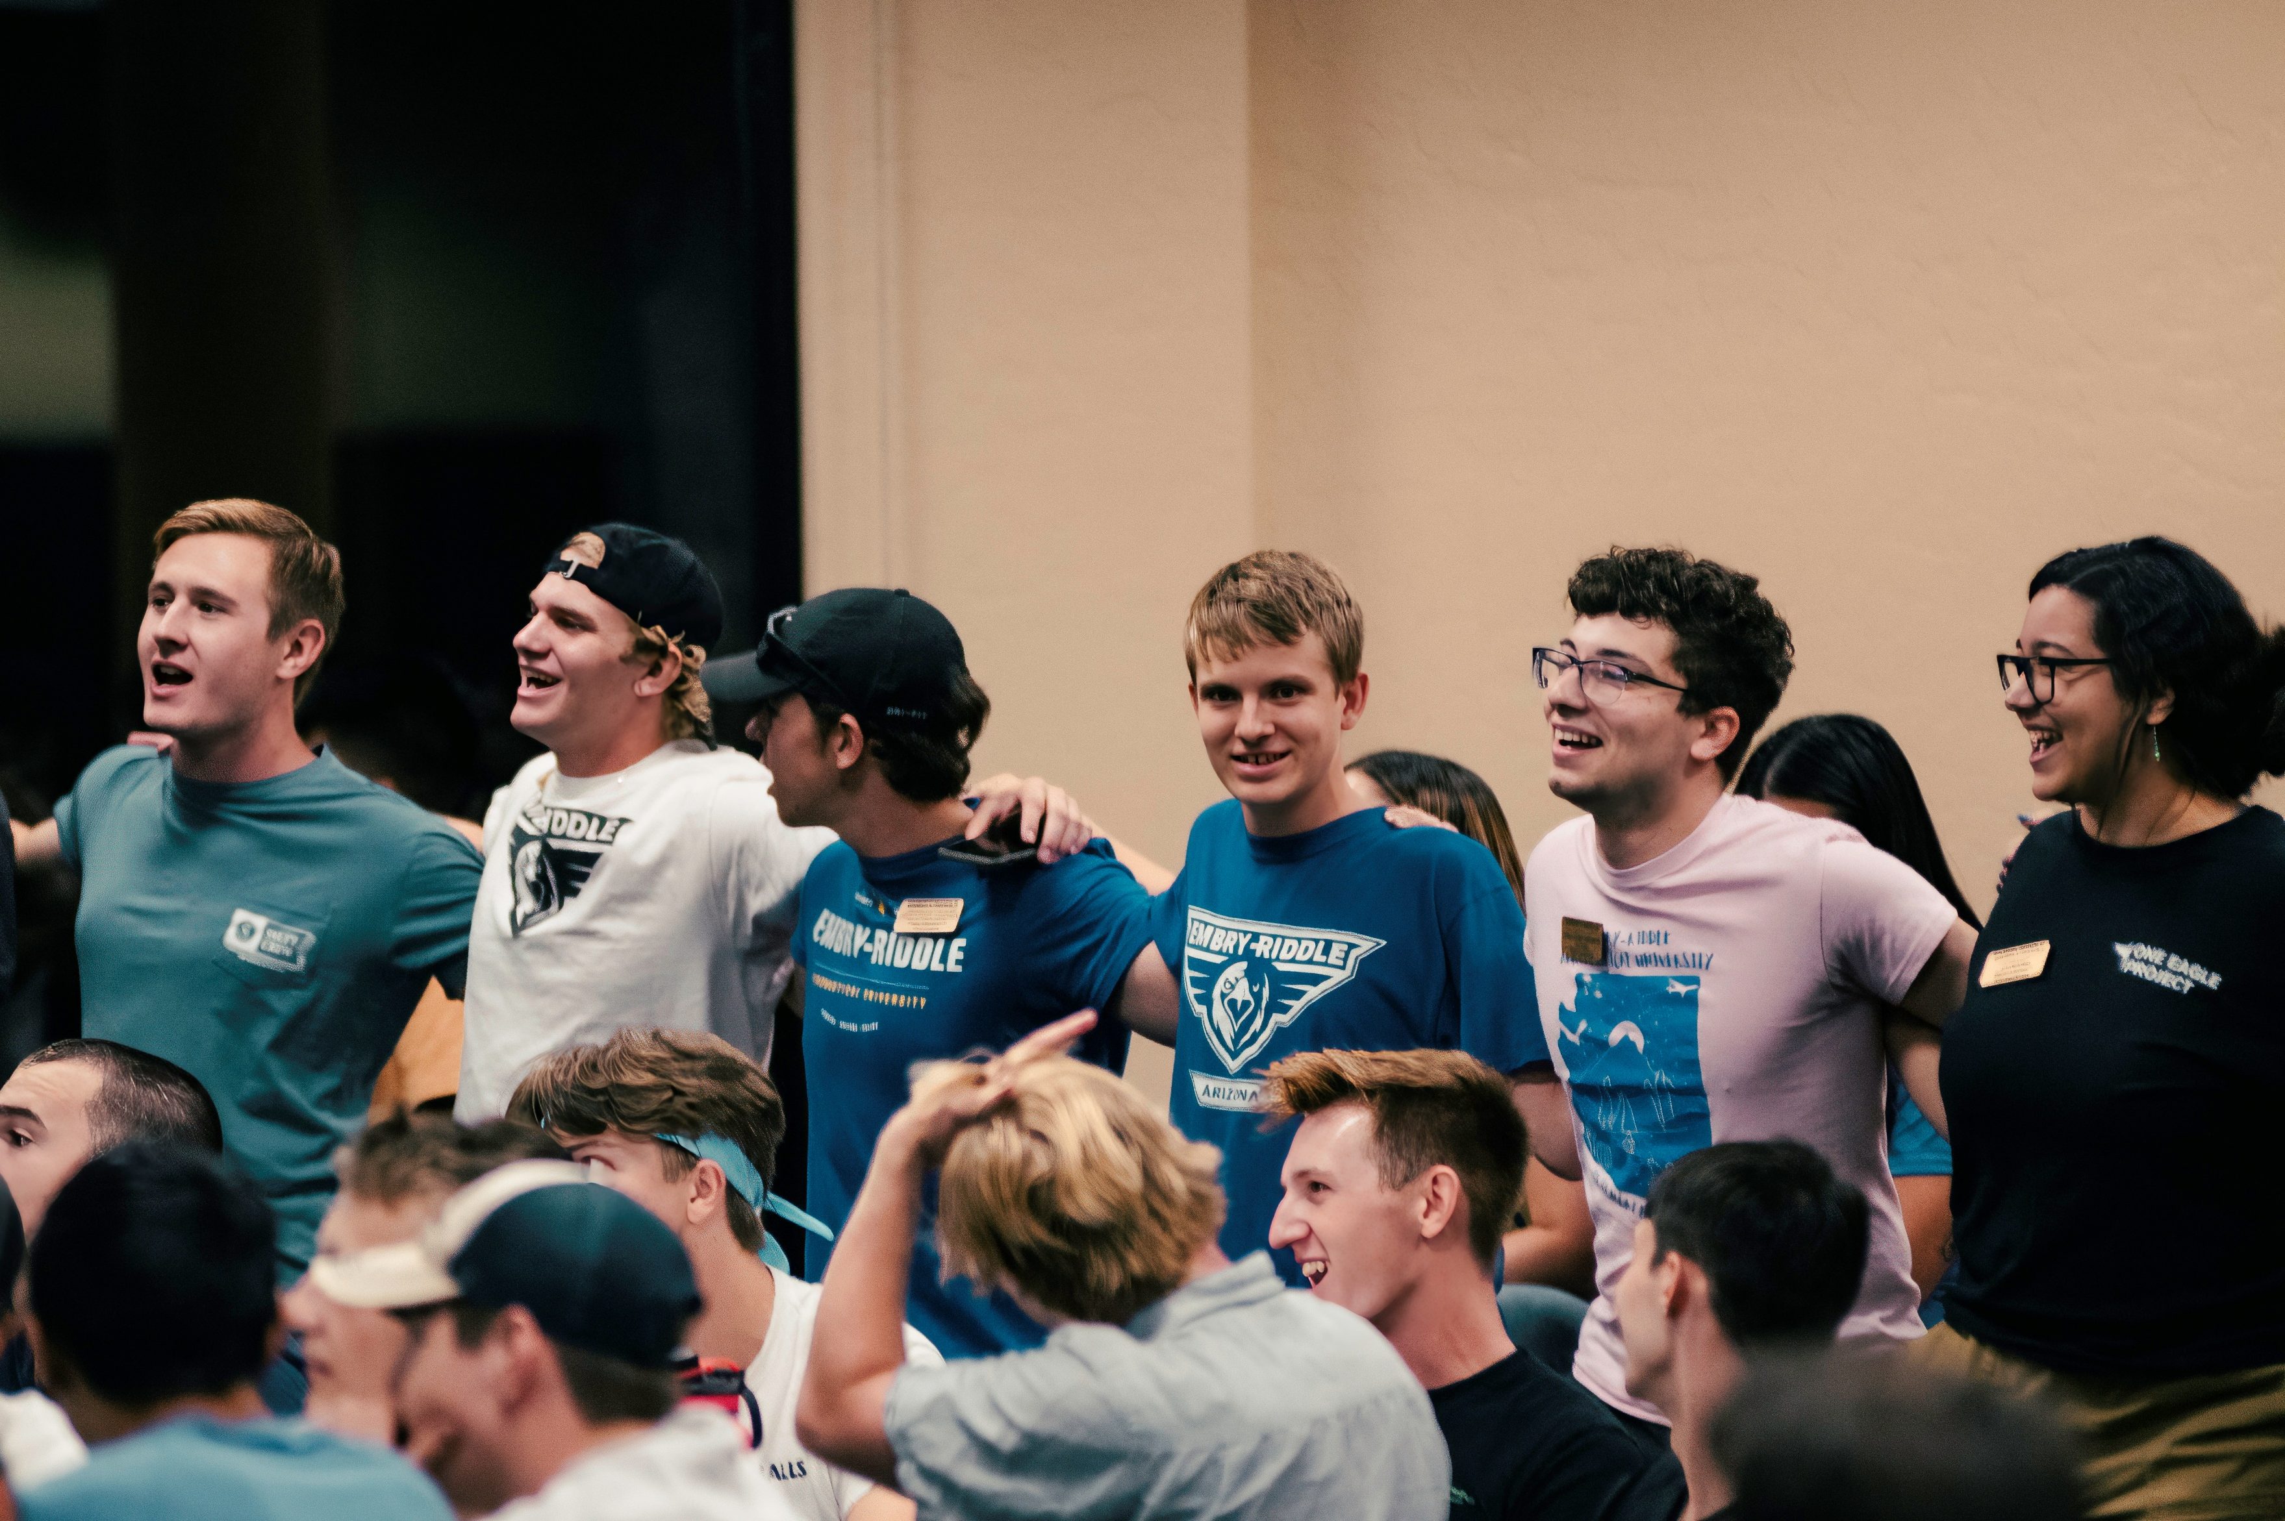
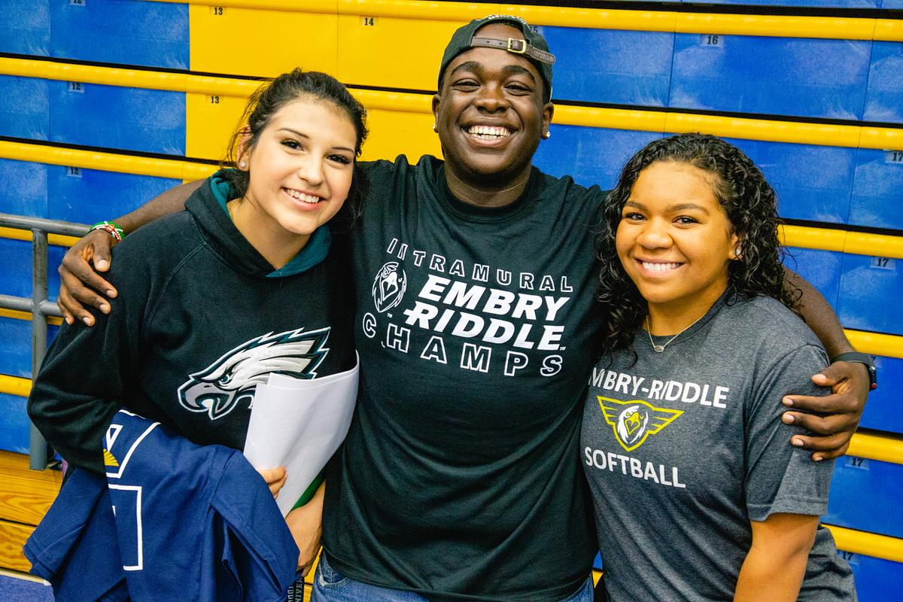
Organization fair
Thursday, January 25 6:00– 8:oo PM
Lower hangar
Notes:
How presentation will benefit audience: Adult learners are more interested in a subject if they know how or why it is important to them.
Presenter’s level of expertise in the subject: Briefly state your credentials in this area, or explain why participants should listen to you.

Slide 35
SGA Funding
Contact SGA Treasurer Makayla Gill
prsgatre@erau.edu
760-987-7247
Notes:
How presentation will benefit audience: Adult learners are more interested in a subject if they know how or why it is important to them.
Presenter’s level of expertise in the subject: Briefly state your credentials in this area, or explain why participants should listen to you.

Slide 36
Sga RSO Grants

Slide 37
Proposal Process
There were be one SGA Grant process this semester.
For more information on the proposal process please visit EagleLife > Org Resources > Financial Resources > SGA RSO Grant Requests
Here you will find an info sheet, templates and the grant request form!
Proposal Presentations will be February 13th and 14th @6-9pm in a maze building most likely
Grant form are due on February 8th @11:55pm on EagleLife!
Each day it is late is a 25% reduction to the amount you can request from grants
Yes, Saturday and Sunday each count as days that are late even though they are not the "work week"
Notes:
DSE can endorse funding requests if the club doesn't have a faculty or staff advisor

Slide 38
Overview
Designed to help clubs with operations, equipment, and supplies
Travel and registration expenses are funded on matching basis
Ex: If approved, we would fund $500 of $1000 of proposed travel expenses
All items must be ordered through Leah Richwine before April 8th, 2024.
RSO Grants cannot fund:
Food, clothing, gifts, philanthropy, other personal items, anything prohibited by university policy
Notes:
$2000/sem up from $2000/year, essentially doubling the amount of funding you can apply for

Slide 39
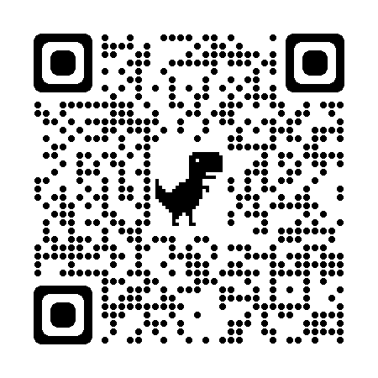
Tiered funding feedback
Notes:
$2000/sem up from $2000/year, essentially doubling the amount of funding you can apply for

Slide 40
tier system
The Tier system would allow SGA to give out more funding to clubs while still being assured that it will be put to good use
Tier 1 - $250 subsidy
Tier 2 - $2000 + $250 subsidy
Tier 3 - $3500 + $250 subsidy
Tier 4 - $5000 + $250 subsidy
Tier Request Forms must be completed every semester to receive funding the following semester!!
TRFs are due this semester on April 8th @11:55pm on EagleLife
NO LATE FORMS ARE ACCEPTED
For Information regarding the Tier Funding System requirements please go to
EagleLife > Org Resources > Financial Resources > SGA RSO Tier Requests and view all the documents

Slide 41
Tier appeals
Tier appeals will be conducted in April
Appeal paperwork is due on April 15th @ 11:55pm on EagleLife
Appeal presentations dates will be sent to you if we need you to present
Appeal decisions will be sent out the week of the presentations
Steps in the Tier Appeal Process:
Submit the Tier Appeal Form
Present your case to the Student Treasury Board
Presentations must be no longer than 3 minutes (no minimum time)
No dress code
Please include:
Your current tier
The tier you want to be in
The requirement(s) you are challenging
The evidence for your challenge

Slide 42
Tier appeals
Please note: the appeals process is not for RSOs to challenge the legitimacy of a requirement. The purpose of the appeals process is for RSOs who can give new information that was not submitted with their TRF or to clarify information that was submitted.

Slide 43
Sga Club Subsides

Slide 44
Overview
In addition to the SGA Grant, clubs are eligible for a $250 subsidy every semester
Same eligibility requirements as club grants, except brand new clubs are eligible for this as well
Can fund food for on campus events
Purchase Pepsi products if possible
No alcohol, cigarettes, or anything prohibited by university policy
List of members who eat the food is required when submitting
Funded on reimbursement basis. Must include the itemized original receipt when submitting for refund
First come, first serve
Visit EagleLife > Org Resources > Financial Resouces > SGA RSO Subsidies to find an information sheet, a template and the subsidy form!
DUE ON APRIL 12, 2024 @ 11:55pm on EagleLife

Slide 45
Sga sponsored Events

Slide 46
Overview
SGA can sponsor events that are ON CAMPUS and BENEFIT THE ENTIRE STUDENT BODY
There is no deadline for these types of things, it is based on when you need it!
You will make a presentation that outlines when, where and what the event is and include a detailed budget for the event.
This presentation will be presented at an SGA Closed and Open meeting where the student body will discuss it and SGA will vote to approve it or not.
It is advised that you run the event and presentation by me first so I can ensure that it follows the SGA Funding Guidelines
I am hoping to conduct a training on this to help you all use this funding option to the best of your ability
For more information, please visit EagleLife > Org Resources > Financial Resources > SGA Additional Funding Proposal Guidelines!
AS ALWAYS, REACH OUT WITH ANY QUESTIONS!

Slide 47
Any Questions?
Contact the SGA Treasurer with any questions:
Makayla Gill
Prsgatre@erau.edu

Slide 48
Questions?
Notes:
How presentation will benefit audience: Adult learners are more interested in a subject if they know how or why it is important to them.
Presenter’s level of expertise in the subject: Briefly state your credentials in this area, or explain why participants should listen to you.

Slide 49
Notes:
How presentation will benefit audience: Adult learners are more interested in a subject if they know how or why it is important to them.
Presenter’s level of expertise in the subject: Briefly state your credentials in this area, or explain why participants should listen to you.

Slide 50
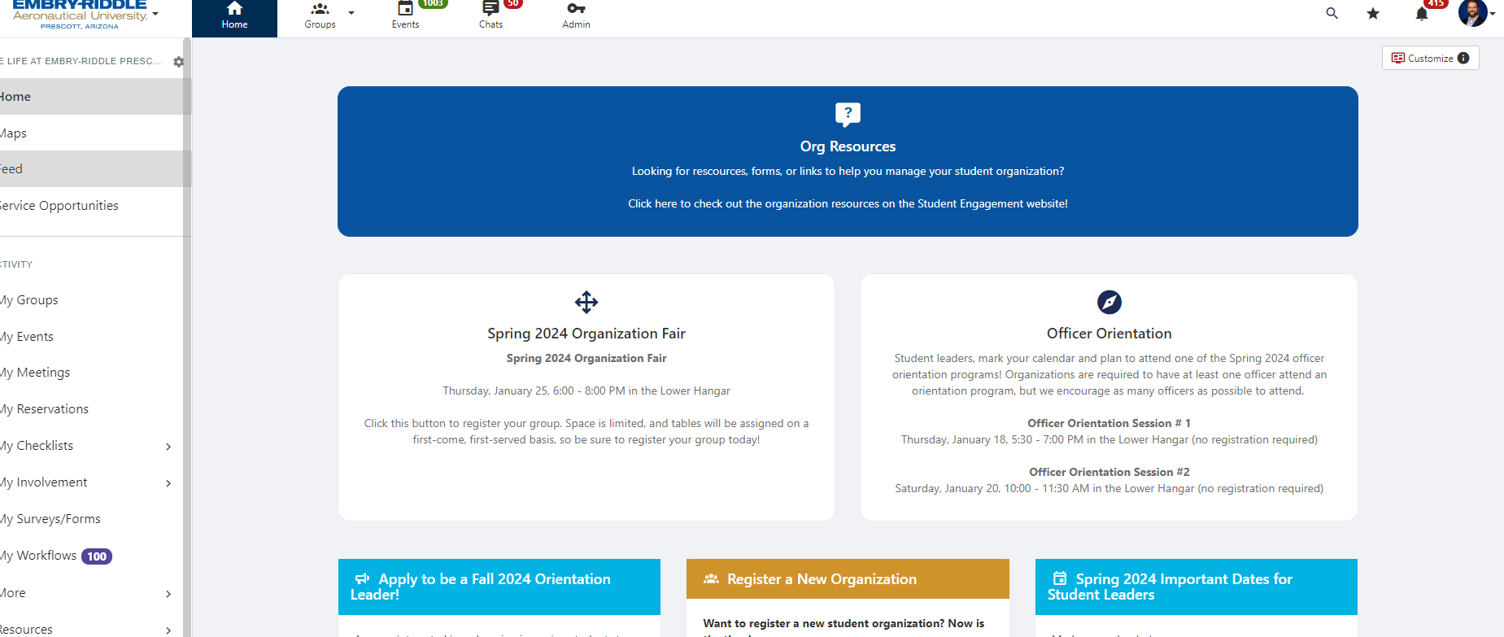

Slide 51
Eagle Life
Event registration
Virtual / On campus / off campus (same day and local) / off campus (travel)
Annual org re-registration
Maintain roster of organization members
Communicate with membership
Promote your org and events to the campus community
Create a public facing website
Safely store documents and records for easy officer turnover
Notes:
How presentation will benefit audience: Adult learners are more interested in a subject if they know how or why it is important to them.
Presenter’s level of expertise in the subject: Briefly state your credentials in this area, or explain why participants should listen to you.

