Slide 1

GSA General Body Meeting
September 13th, 2023

Slide 2
Agenda
Approval of Minutes
Overview of GSA & Officer Introductions
New Student Group Presentations and Vote
Budget Presentation & Vote
Officer Announcements
GSA/SOM Committee Announcements
Program Rep or Student Group Announcements
Misc. Announcements

Slide 3
Approval of the Minutes
Approving June 2023
Notes:
October and November

Slide 4
Introduction of Officers
President- Rodney Eric Williams
President Elect- Scarlett (Jiaxin) Ge
Director of Administration- Nirvani Jairam
Director of Finance- Estefan Santi
Director of Diversity, Inclusion, & Outreach- Ying Yu (Ashley) Chen
Director of Social & Community Affairs- Mark Allen Co Jacob
Director of Media & Public Relations- Juliane Liberto
Director of Student Involvement & Groups- Edna A. Ferreira
Director of Policy & Strategic Initiatives- Nick Zhu
Past-President- Taylor Evans
https://jhu.campusgroups.com/gsa/meet-the-executive-board/

Slide 5
Overview of the GSA
GSA represents and governs all ~1000 graduate students in the school of medicine
It serves as the primary advocacy group for all SOM grad students
Recognizes, Governs, and Funds grad student organizations in the SOM
The GSA Council is composed of 9 Executive Officers and Program Representatives & Student Group Representatives (Non-voting)
Hosts informational, social, and outreach based programming
Secures and distributes resources for students (Parking, Equipment, Facilities, laptop loaner program, etc…)
Works with administration across the university to secure a better grad student experience

Slide 6
General Body Meetings
GSA General Body Meetings occur once per month on the 2nd Wednesday of Each month
All Officers and Representatives are required to attend each meeting
Meetings will be a mix of in person, hybrid, and virtual through out the year
Various speakers will be invited from across the university (Provost’s Office, Graduate Biomedical Education, Student Health & Well Being, etc)
All in person meetings will have food!!

Slide 7
New Student Group Presentations
Theoretical and Computational Neuroscience Journal Club
JHGMSA – Johns Hopkins Graduate Muslin Student Association

Slide 8
New Student Group Presentations
Theoretical and Computational Neuroscience Journal Club

Slide 10
New Student Group Presentations
JHGMSA – Johns Hopkins Graduate Muslin Student Association

Slide 11

A student faith group created with the intention of fostering Muslim students’ connection with one another and within the wider Hopkins community
Notes:
Our purpose

Slide 12
The JHGMSA will bring the following:
Create a safe space for Muslim students to connect with other Muslim students within the School of Public Health, the School of Medicine, and several other schools
Provide an avenue for members of the wider Hopkins community to engage with the Muslim community for educational or experiential purposes
Foster a sense of inclusion and belonging for a traditionally misrepresented group, facilitating greater network expansion as well as career and personal support
Advocate for the needs of Muslim students as related to supporting their practice of faith (ex. Fasting, celebration of Eid, educational seminars)
Bridge cultural divides of Muslim students from different cultural backgrounds and encourage active integration within the Muslim community and wider Hopkins community
Integrate into a larger network of MSAs present in the DMV area, encouraging cross-institutional interactions and relationships

Slide 13


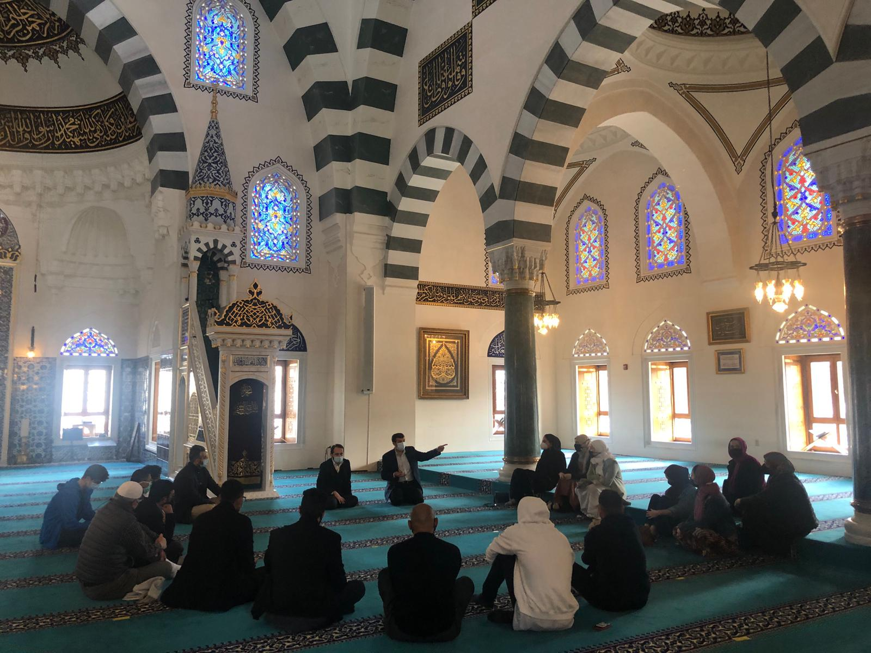
Previous Events within the Academic Year

Slide 14



Currently Happening
Halaqas are now on Wednesdays. We now offer a walking club.

Slide 15
Extra Slides
The following slides address:
Upcoming Events
Maintaining communications with Hopkins students
Executive Board Positions and voting

Slide 16


Ideas for Outreach and Events
Events:
Hikes,
BBQs,
Iftars
  Interfaith
Eid Celebrations
Notes:
Do you have a plan for maintaining active communication with SA? Asian Pacific Public Health Network, at the School of Public Health

Slide 17



Maintaining Regular Communication to Sustain Membership
Website in the making!

Slide 18
GSA Budget Approval
***Only Officers and Program Reps should be voting***
If there is more than one representative in your program all must come to a unanimous decision and cast only one vote.
FY2024 Budget Proposal.xlsx
Notes:
October and November

Slide 19
Officer Announcements
President (Rodney)
President Elect (Scarlett)
Director of Administration (Nirvani)
Director of Diversity, Inclusion, and Outreach (Ashley)
Director of Finance (Estefan)
Director of Social and Community Affairs (Mark)
Director of Media and Public Relations (Juliane)
Director of Student Involvement and Student Groups (Edna)
Director of Policy & Strategic Initiatives (Nick)

Slide 20
GSA Resources
GSA offers subsidized parking to SOM Grad Students
GSA/OGBE offers a laptop loaner program for SOM Grad Students
GSA has an event equipment loaner program
GSA offers a private reservable room for Telehealth and other personal meetings
GSA/OGBE has meeting/study available in the OGBE office (6th floor of 1830 Building)
GSA offer travels awards for travel to conferences
GSA offers funding to subsidiary student groups
https://jhu.campusgroups.com/gsa/home/

Slide 21
Campus Updates- Health & Well Being
Student Health & Well Being/OGBE partnering to offer monthly Mental Health Wellness Seminars
Johns Hopkins East Baltimore Behavioral Health Crisis Support Team https://wellbeing.jhu.edu/bhcst/
  Health Benefits (New Insurance) https://jhusom.mycare26.com/benefits
  Timely Care (Free Therapy/Counseling)
  https://wellbeing.jhu.edu/blog/2020/08/26/timelymd-access-info-and-faqs/
  https://app.timelycare.com/auth/login

Slide 22
Campus Updates- Other Resources
Update on Cooley Center Replacement
Transportation Updates
Free Food Alert App- https://freefoodalert.com/

Slide 23

Graduate Coating Ceremony

Slide 24
Officer Announcements
President (Rodney)
President Elect (Scarlett)
Director of Administration (Nirvani)
Director of Diversity, Inclusion, and Outreach (Ashley)
Director of Finance (Estefan)
Director of Social and Community Affairs (Mark)
Director of Media and Public Relations (Juliane)
Director of Student Involvement and Student Groups (Edna)
Director of Policy & Strategic Initiatives (Nick)

Slide 25
Officer Announcements
President (Rodney)
President Elect (Scarlett)
Director of Administration (Nirvani)
Director of Diversity, Inclusion, and Outreach (Ashley)
Director of Finance (Estefan)
Director of Social and Community Affairs (Mark)
Director of Media and Public Relations (Juliane)
Director of Student Involvement and Student Groups (Edna)
Director of Policy & Strategic Initiatives (Nick)

Slide 26

GSA Student Spotlight
Purpose: recognize outstanding graduate students for their academic and community-based achievements
Can nominate yourself, or a peer
Didn’t win? Renominate as many times as you would like
Winners will receive a $25 gift card
Info and links to enter can be found on:
Our website: https://jhu.campusgroups.com/gsa/home/
All-grad email notifications
GSA Newsletter
Our social media channels – follow us!

Slide 27



June 2023 GSA Student Spotlight Winners
Jackson Mace
Tie
Cellular and Molecular Medicine
???
VOTE
Jackson just received the 2023 Toffler Scholar grant for his research and received a highly fundable score for his F31 NIH predoctoral grant. Recently, Jackson presented his work at a National Keystone Summit in Canada, along with various other conferences such as the American Neurological Association in Philadelphia. In the last two months, Jackson was the co-first author of a review manuscript (describing multiple sclerosis model systems), a second author on a clinical research paper (neuronal death biomarker that correlates with progressive multiple sclerosis), and a co-author on a research manuscript (drug treatment to prevent demyelination in multiple sclerosis mouse models).

Slide 28
Vote for Second Student Spotlight Winner
Nominee was awarded a fellowship from the American Association of Immunologists, a conference abstract award, and they had a first author paper accepted!
Nominee just finished up an amazing year as chief grad of the pathobiology program and deserves to be recognized for all that they did to help their classmates have a wonderful year. They spent countless hours organizing journal clubs, helping students with a mock oral exam, and being a liaison between faculty and students. They care so much about their peers and is a great leader!
Notes:
Wesley Godfrey (Immunology)
Stephen Brown (Pathobiology)

Slide 29
Officer Announcements
President (Rodney)
President Elect (Scarlett)
Director of Administration (Nirvani)
Director of Diversity, Inclusion, and Outreach (Ashley)
Director of Finance (Estefan)
Director of Social and Community Affairs (Mark)
Director of Media and Public Relations (Juliane)
Director of Student Involvement and Student Groups (Edna)
Director of Policy & Strategic Initiatives (Nick)

Slide 30

Monthly Diversity Events
Movie events (every 2nd Thursday, except Dec)
- Sep: Hispanic Heritage Month
- Oct: National Disability Employment Awareness Month
- Nov: Native American/American Indian Heritage Month
- Jan: (1/27) Holocaust Memorial Day
- Feb: African American/Black History Month
- Mar: Women's history Month
- Apr: Sexual Assault Awareness Month
- May: Asian American and pacific islander Heritage Month
- June: LGBTQ+ Pride Month
Other diversity events
E.g. Collaborating with SDS for some talks/events in Oct

Slide 31

Health Insurance Overview
Speaker: Jamie Karl
(from the Student Benefit Office)
Information sessions
- Sep 19th (04:00 p.m.) at West Room, Turner
- Sep 20th (12:30 p.m.) at Mountcastle, PCTB
Hybrid and will record the 20th one
The presentation will take 40 minutes
followed by a 30-minute Q&A session
(Questions/cases that have been submitted
to the questionnaire will be addressed first)

Slide 32
Menstrual Products
Pilot for the East Baltimore Campus in several weeks
10-15 restrooms located in different badge access-required buildings (mostly on ground/1st floor)

Slide 33
Officer Announcements
President (Rodney)
President Elect (Scarlett)
Director of Administration (Nirvani)
Director of Diversity, Inclusion, and Outreach (Ashley)
Director of Finance (Estefan)
Director of Social and Community Affairs (Mark)
Director of Media and Public Relations (Juliane)
Director of Student Involvement and Student Groups (Edna)
Director of Policy & Strategic Initiatives (Nick)

Slide 34
A Few Finance Updates...
New GSA constitution is up and running, so here's a couple of things to keep in mind:
  Student group budgets have been traded for a Student Fund Pool.
  Purchase Requests must be a least 1 month in advance.
  All purchases are brought before the eboard, with purchases above $500 being brought before everyone here.
  I will provide basic budgetary metrics during these instances.
  Everything and more is in the GSA constitution on our Hopkins Groups Website, so check it out!

Slide 35
Example Slide: Finance Vote
This slide contains the information used for crafting a student group's high value request (>$500).
Included in each slide:
  Basic itemization/breakdown of the purchase
  Reasons for purchases
  Amount requested by student group
  Additional information about the org (if relevant to purchase)
Let me know if I am missing anything via email.

Slide 36

Travel Awards Are Back!
More instructions will be provided on the email, so keep an eye out!

Slide 37
Any Questions?

Slide 38
Officer Announcements
President (Rodney)
President Elect (Scarlett)
Director of Administration (Nirvani)
Director of Diversity, Inclusion, and Outreach (Ashley)
Director of Finance (Estefan)
Director of Social and Community Affairs (Mark)
Director of Media and Public Relations (Juliane)
Director of Student Involvement and Student Groups (Edna)
Director of Policy & Strategic Initiatives (Nick)

Slide 39

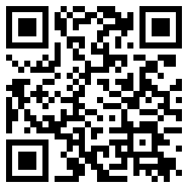
Interschool Happy Hour
SOM x SON x SOPH Collaboration Limited
Date: September 15th, 2023
Time: 4:00 PM to 7:00 PM
Location: PCTB Courtyard
Free food, drinks, and entertainment!
Meet new connections from all the schools!
Register through HopkinsGroups for access!

Slide 40
Officer Announcements
President (Rodney)
President Elect (Scarlett)
Director of Administration (Nirvani)
Director of Diversity, Inclusion, and Outreach (Ashley)
Director of Finance (Estefan)
Director of Social and Community Affairs (Mark)
Director of Media and Public Relations (Juliane)
Director of Student Involvement and Student Groups (Edna)
Director of Policy & Strategic Initiatives (Nick)

Slide 41
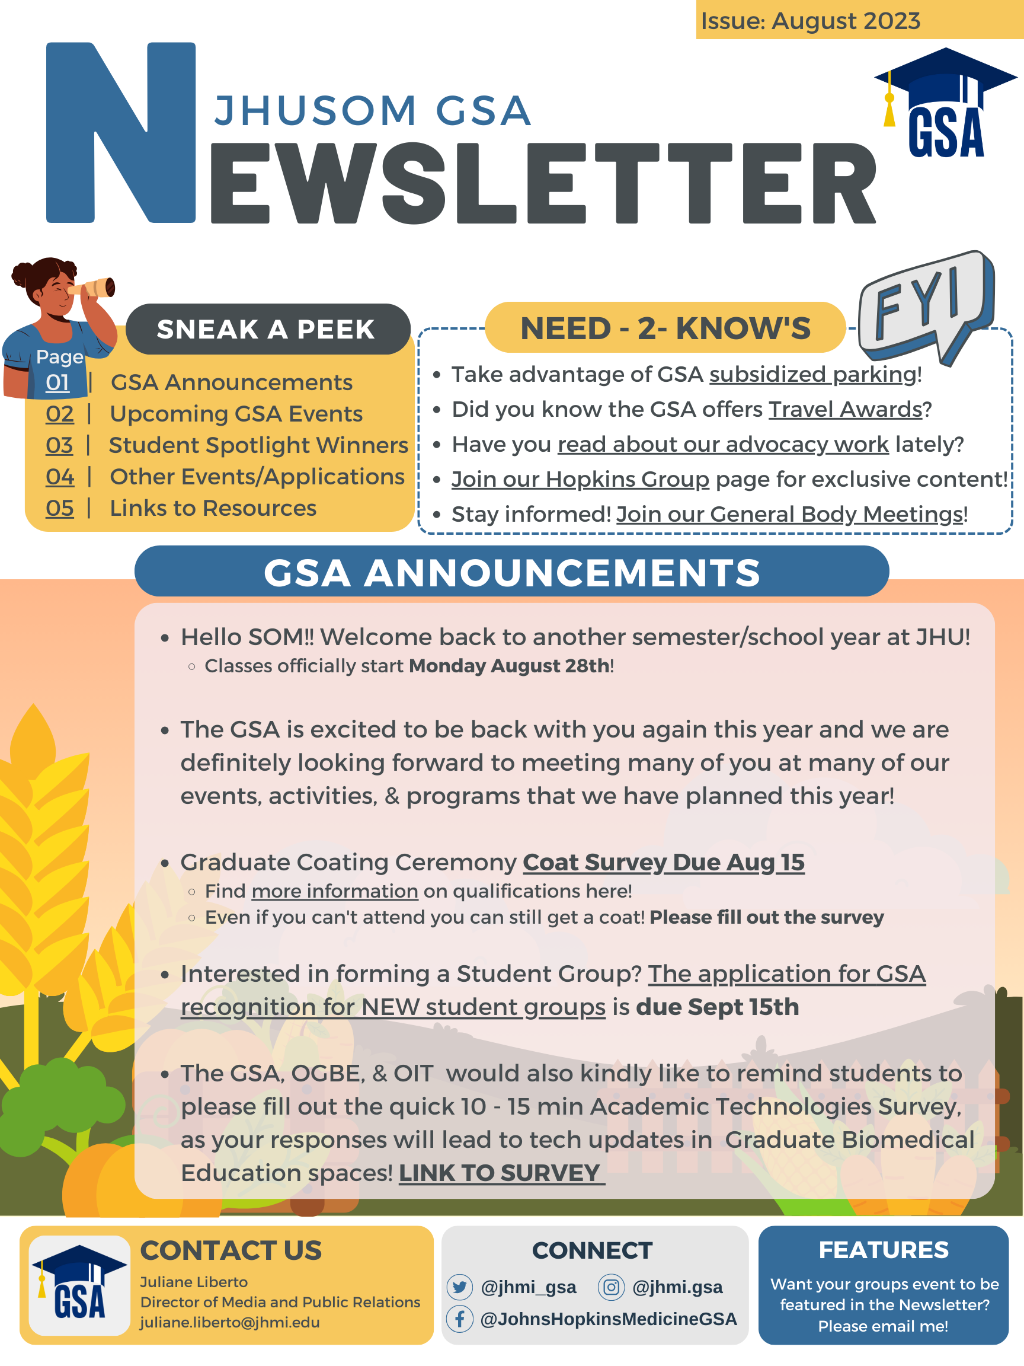

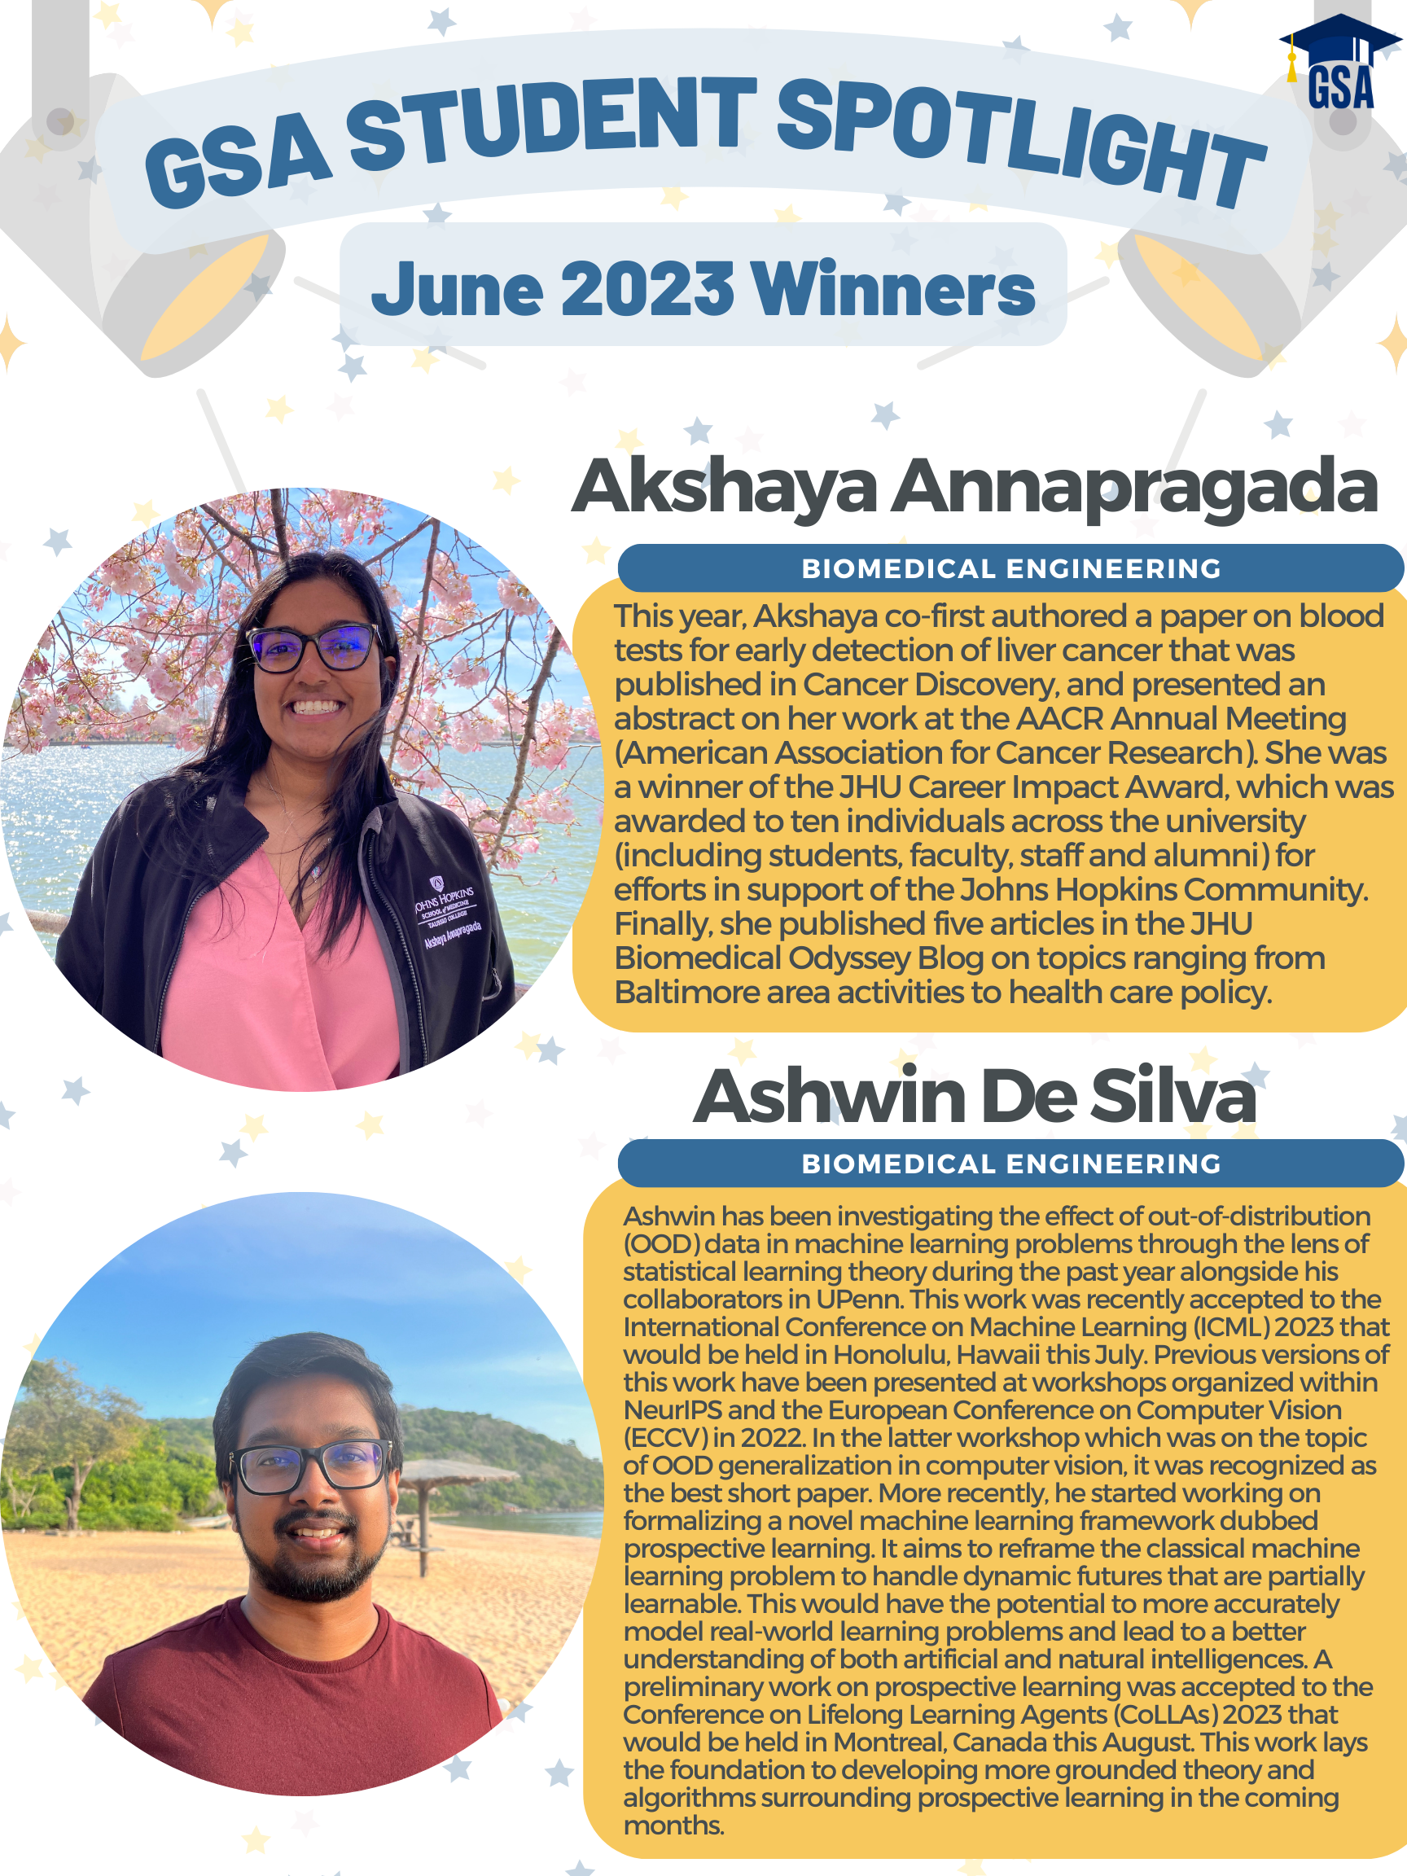
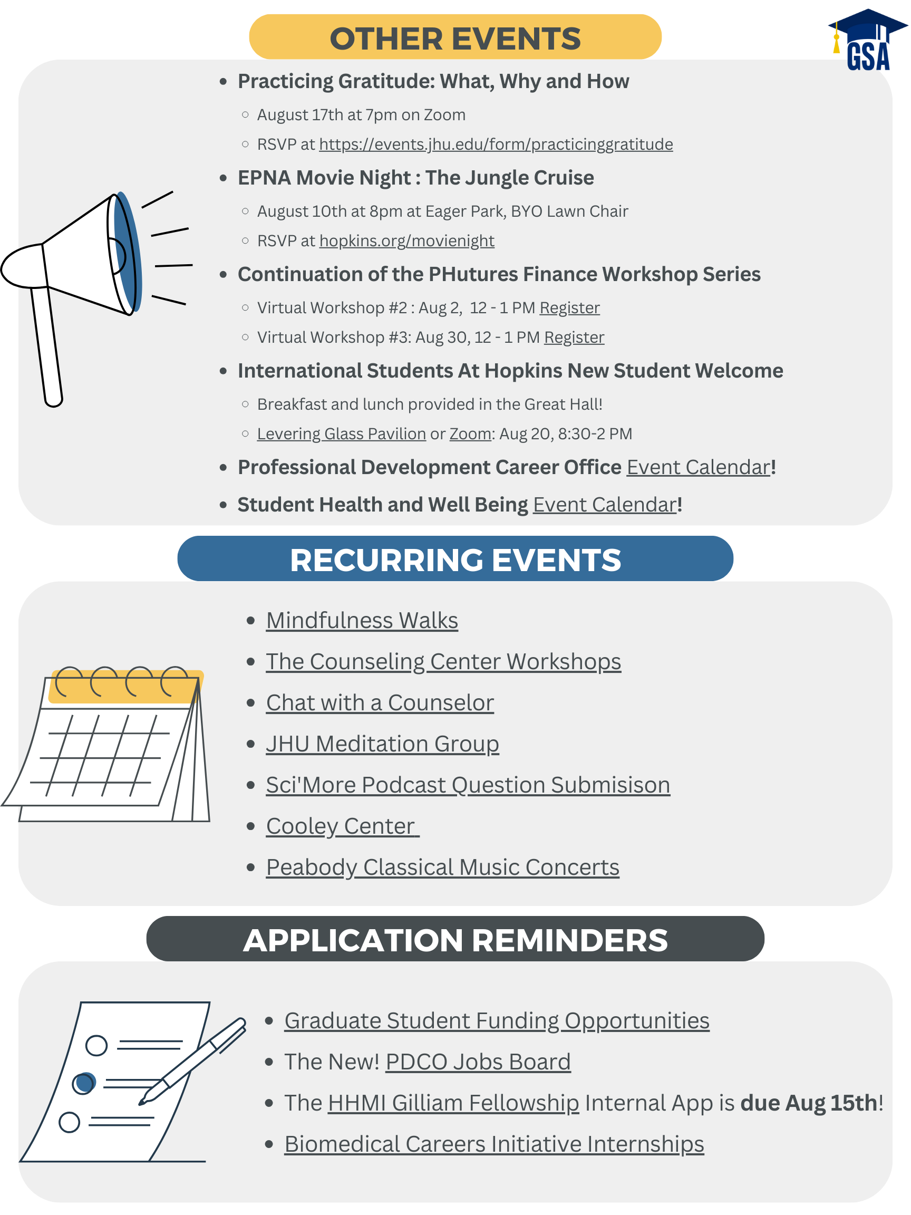

Updated Newsletter
Our Newsletter has a new look (again)!
Highlight of some updates
"Sneak a peek" section now has links to the pages
"Need-2-Know's" is a new section and links to important GSA resources
"Student Spotlight" will now include photos of winners
"Other Events" is now only half a page – if you want your event featured you need to email me all the details by the 20th of the month before.
Do you have ideas for improvements?
Let me know, I happily take feedback!

Slide 42

B'more Fall Photo Contest
New! Quarterly Photo Contest
Winner's photo submissions will be highlighted on our Socials, Website, & Newsletter!
To ensure only SOM Graduate students are participating, submissions will be submitted via GSA registered Hopkins Groups members.
TBD – would like to have a gallery platform for all photo submissions to be viewed (Website?)
Photos due Oct 20th!
Student body will be selecting winners through survey sent through Allgrad.
Submission Form OPEN today at 5pm: https://cglink.me/2dh/s82340
Rules/Guidelines
You must be a registered SOM graduate student within SOM
Photos must be taken within the city limits of Baltimore, MD
Photos should be submitted using JPEG format
One photo submission per student
Only recent Fall photos can be submitted (photo cannot be from last year)
Please do not plagiarize from professional/online photos
Have fun!

Slide 43
Allgrad Listserv
Want to send a message to all SOM graduate students?
allgrad@lists.jh.edu
Things to keep in mind when sending messages
Please make sure to write your message EXACTLY as you wish it to be seen
Size limit is 10MB – includes message size and attachment size
Attachments take a lot longer to send and deliver
If you make a typo (and you have not gotten an approval notice) email me (juliane.liberto@jhmi.edu) to let me know, I will deny your message and have you resend the corrected email.

Slide 44
Officer Announcements
President (Rodney)
President Elect (Scarlett)
Director of Administration (Nirvani)
Director of Diversity, Inclusion, and Outreach (Ashley)
Director of Finance (Estefan)
Director of Social and Community Affairs (Mark)
Director of Media and Public Relations (Juliane)
Director of Student Involvement and Student Groups (Edna)
Director of Policy & Strategic Initiatives (Nick)

Slide 45
Welcome Program and Student Group Representatives!
Please see GSA website for information
  Program rep names + contact information
  Student group descriptions
  Student group rep names + contact information
Relevant Items: The Constitution!!
  Attendance Policy
  Funding Requests
  Election Procedures (for ‘24-25)
  Student Group Renewal (for ‘24-25)
  Other exciting things!

Slide 46
GSA Committees/Subcommittees
President & President Elect Committee – Rodney & Scarlett
General Affairs Committee – Nirvani
Public Relations Committee – Juliane
Policy & Strategic Initiatives Committee – Nick
Finance Committee – Estefan
Diversity, Equity and Inclusion Committee – Ashley
  EASM – Equal Access in Science and Medicine
Events Committee – Mark
  The Peer Collective

Slide 47
Officer Announcements
President (Rodney)
President Elect (Scarlett)
Director of Administration (Nirvani)
Director of Diversity, Inclusion, and Outreach (Ashley)
Director of Finance (Estefan)
Director of Social and Community Affairs (Mark)
Director of Media and Public Relations (Juliane)
Director of Student Involvement and Student Groups (Edna)
Director of Policy & Strategic Initiatives (Nick)

Slide 48
Announcements
GSA Committees
TPC
EASM
SOM Committees
Program Reps/Student Groups
Misc.

Slide 49




THANK YOU!
@jhmi.gsa
Johns Hopkins Medicine GSA
@jhmi_gsa
jhu.campusgroups.com/gsa

