Slide 1
Instructions for Creating and Submitting a Purchase Request in Hopkins Groups

Slide 2
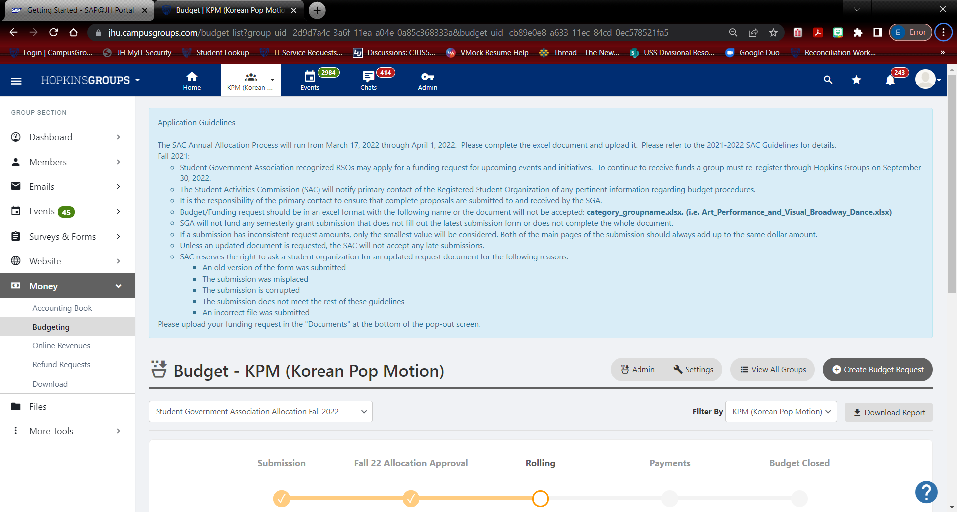
Start by navigating to the Budgeting page for your group.
Search for the name of your group in the search field at the top of the Hopkins Groups main page
Click Money on the left side of the screen
Click Budgeting

Slide 3
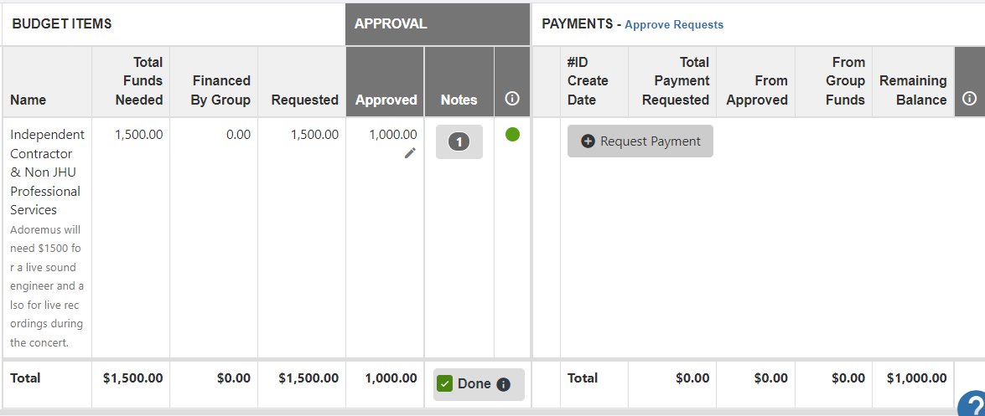
Scroll down to the appropriate budget
Find an item in the budget with a green dot. This will indicate that funding was approved for that item.
Click the Request payment button to begin.

Slide 4
Select the correct transaction type from the dropdown menu. Enter a description of the expense. Enter the amount of the expense. If the expense is to be deducted from Group Funds, enter the amount in the “From Group Funds” space rather than the “From Allocated” space.

Slide 5
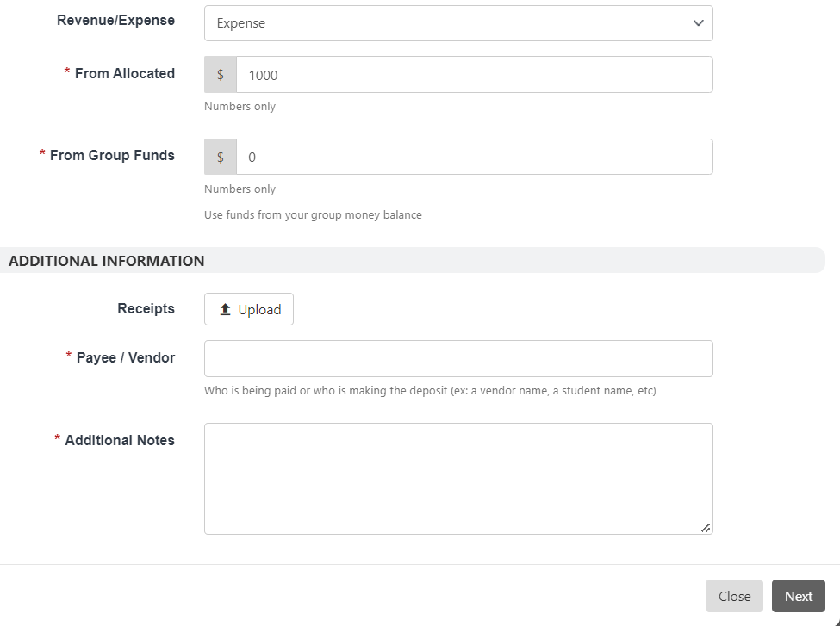
Receipts only need to be entered if the request is classified as a pre-approved reimbursement.
Payee/Vendor space – here, please ONLY enter the name of the vendor; for example, if this is an Amazon order, Amazon should be entered here. If this will be a catering order, Foodify should be entered here. Do not enter a name in this space unless there is a student being reimbursed. (Please note that reimbursements cannot be entered by the student receiving the reimbursement.)
The Additional notes section should include any important information the LEED office needs to make the purchase for your group. If there is nothing to add, enter “N/A.”

Slide 6
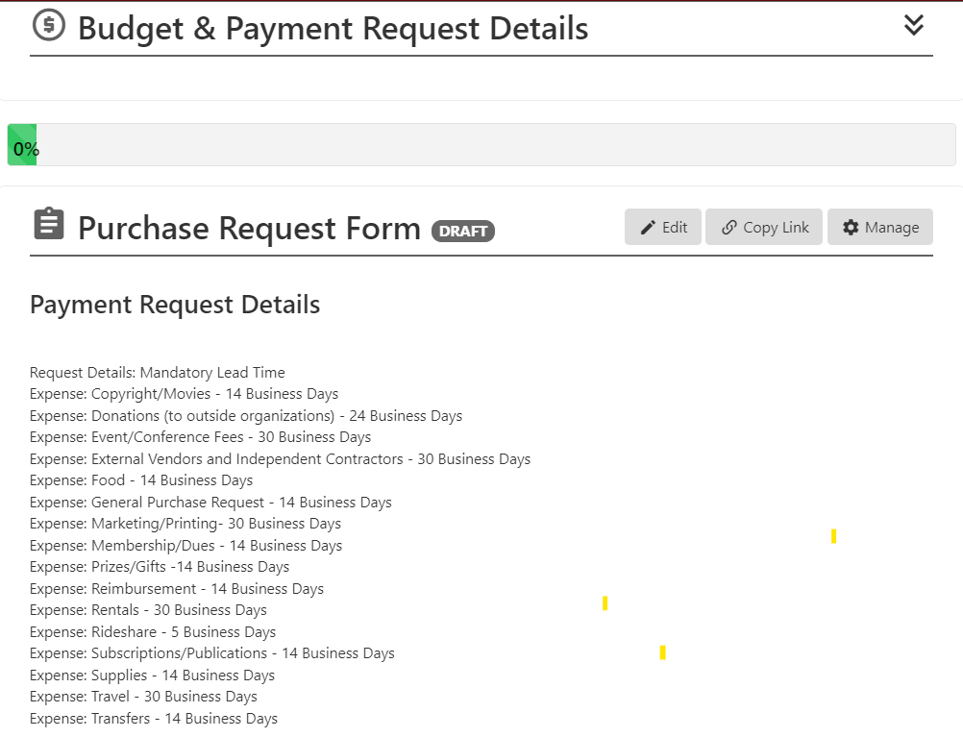
This is the second screen in the purchase request form.
Take note of the “Payment Request Details” as this is the minimum lead time needed by the LEED office to fulfill any requests.

Slide 7
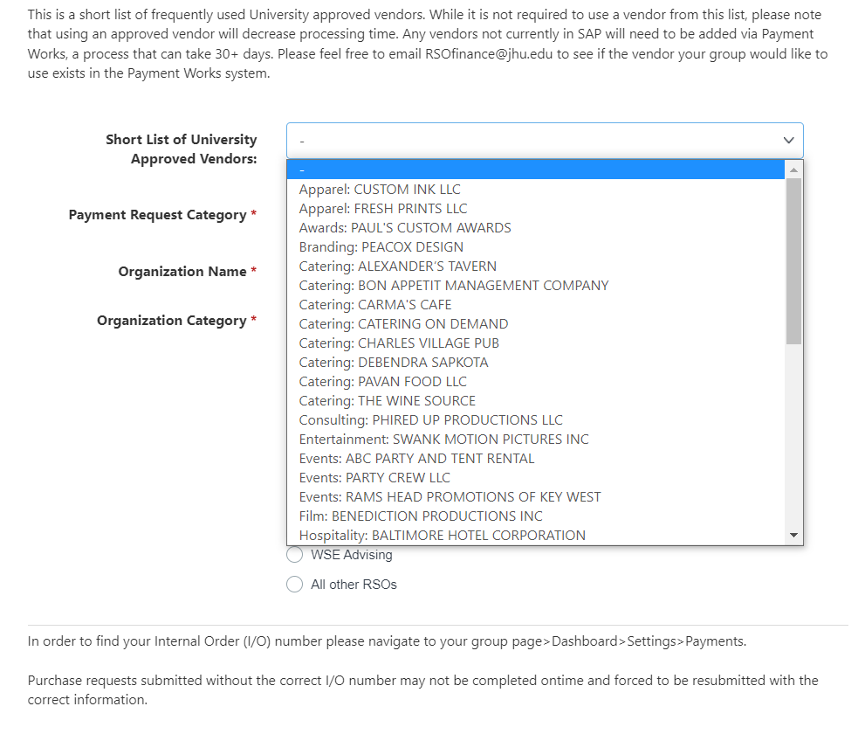
Short List of University Approved Vendors: it is not required that students use a vendor on this list. It will, however, speed up processing time significantly if students use a vendor that is already in our system rather than electing to use a brand new vendor that will need to register in the Payment Works system.

Slide 8
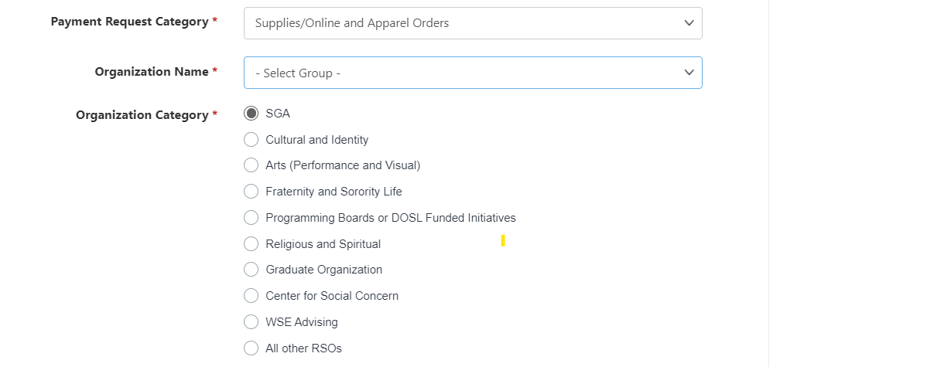
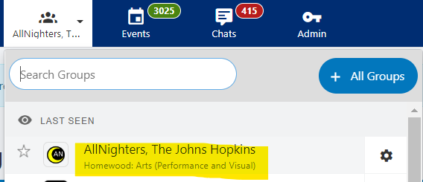
Select the name of your group from the dropdown menu.
The organization category is a required field and is essential for the approval and routing process. 90% of all groups will fall under SGA. The exceptions are The Hop, Hopthon, Class Councils, and a few others. These groups should select “Programming Boards.” To find your group’s classification, enter the name of your group in the search field and check the text underneath. In the example below, this group is classified as Homewood Arts.
*The All Other RSO’s button should not be selected.

Slide 9
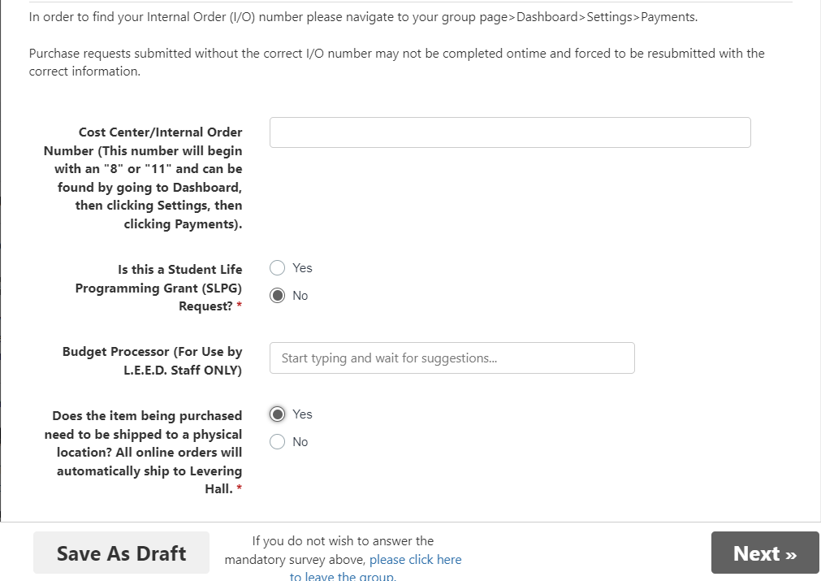
Enter your group’s budget number. The instructions to find that number are directly above that field.
Next, indicate if this request will utilize SLPG funds.
The Budget Processor field should not be altered.
If this is an online order, the “Yes” radio button should always be selected.
If you ever need to pause when submitting a purchase request, you can save it as a draft.

Slide 10
Enter a link to the event in Hopkins Groups if applicable.

Slide 11
Enter the details for online orders here. Any requests lacking direct links or other required items will be rejected. Please ensure that Amazon wish list links are public.

Slide 12
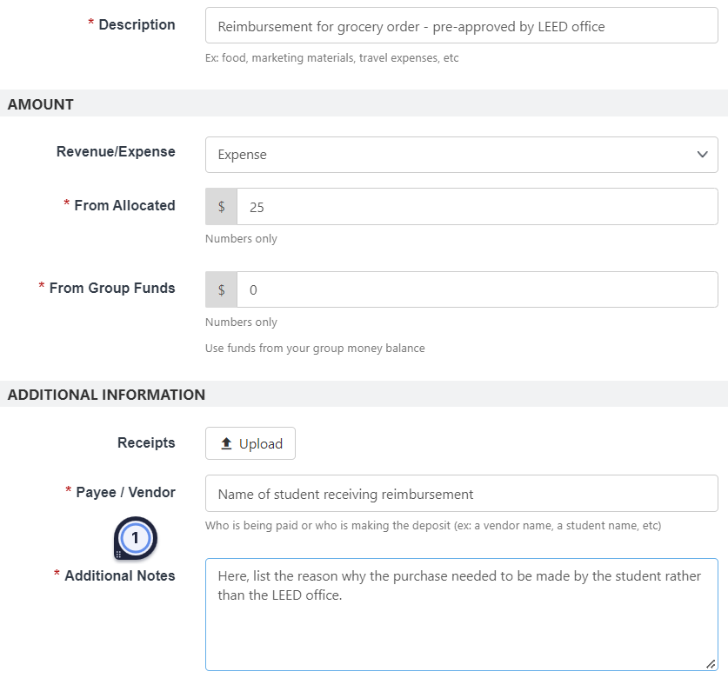
Reimbursement (after pre-approval):
1. Start by selecting Reimbursement from the initial drop-down menu.
2. Next, fill in the required fields with a variation of the details entered in the example here:

Slide 13
3. After once again selecting reimbursement from the dropdown menu, fill out the fields on this screen as indicated:

Slide 14
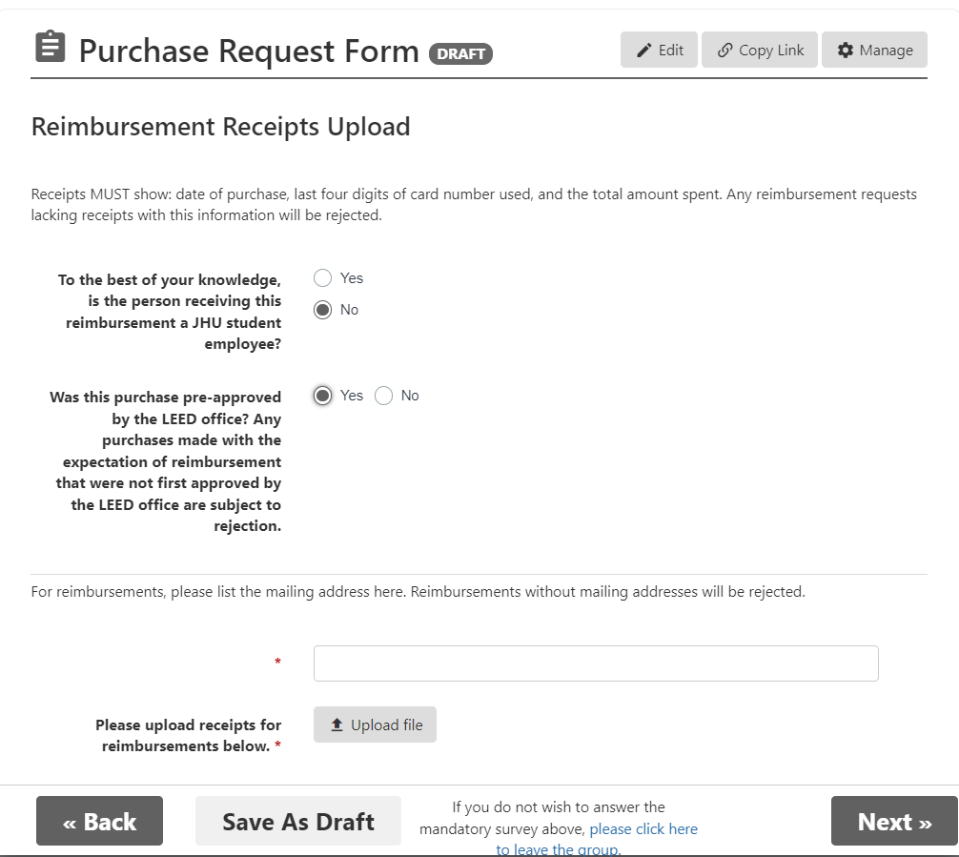
4. Enter the details of the event that required a reimbursement:
5. Complete the fields as shown here:
*Remember that receipts must show the date of purchase, the last four digits of the card used, the store or website where the purchase was made, and a listing of the items purchased.*

Slide 15
This is the final step of any request submitted in Hopkins Groups. If you do not reach this screen, your request will be saved as a Draft. Drafts cannot be seen by the LEED office and will not be processed.

Slide 16
To delete a purchase request, click the hyperlinked number next to the request to be deleted. Then click the red delete button at the bottom of the screen.

Slide 17
Questions?
Contact the LEED office at RSOFinance@jhu.edu for questions with this process.

