Slide 1
GSA General Body Meeting
October 11th, 2023

Slide 2
Agenda
Approval of Minutes
Office of Graduate Biomedical Education
Student Group Finance Requests Presentation and Vote
Officer Announcements
GSA/SOM Committee Announcements
Program Rep or Student Group Announcements
Misc. Announcements

Slide 3
Approval of the Minutes
Approving September 2023
Notes:
October and November

Slide 4
Join us in Welcoming
The Office of Graduate Biomedical Education
Email: ogbe@jhmi.edu
Phone: 410-614-3385
Office Location: 1830 E. Monument Street, Suite 620
Notes:
October and November

Slide 5
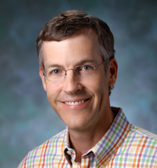
Dr. Peter Espenshade (He/Him/His)
Associate Dean for Graduate Biomedical Education
Email: peter.espenshade@jhmi.edu
Notes:
October and November

Slide 6
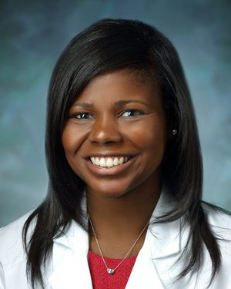
Dr. Andrea Young (She/Her/Hers)
Assistant Dean for Graduate Biomedical Education & Graduate Student Diversity
Email: ayoung90@jhmi.edu
Notes:
October and November

Slide 7
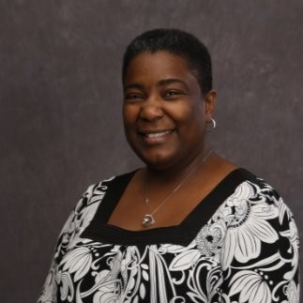
Kristina Nance, MS (She/Her/Hers)
Assistant Director for Graduate Student Experience & Diversity
Email: knance2@jh.edu
Notes:
October and November

Slide 8
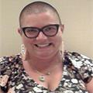
Dr. Katie Labor (she/her/hers)
Graduate Student Experience Coordinator
Email: jlabor1@jhmi.edu
Notes:
October and November

Slide 9
FUNDING REQUEST
Project Bridge
Baltimore Brainfest
“Baltimore Brainfest is a science outreach event to help introduce the Greater Baltimore Community to neuroscience through engaging demonstrations designed to be accessible to children of all ages. Last year we brought Brainfest back from its pandemic hiatus for a successful event involving over 40 graduate students and postdoctoral volunteers running over 30 different fun and educational activities such as Build-a-neuron or learning about habituation through smell. We engaged over 70 different community members at the event, many of whom reported not having access to science outreach organizations outside of Brainfest that year. One of our goals for this year is to bring back more aspects of previous Baltimore Brainfests such as our “Escape the Brain” escape room. We would also like to bring back community partner involvement with other organizations like Thread or with local businesses. To increase community attendance and grow the event, we collected data on the efficacy of our various advertising methods and can now optimize our advertising. Overall, GSA funding would go a long way to expand the outreach and quality of this event.”

Slide 10
Project Bridge Baltimore Brainfest Event Date: 03/16/24 Submitted: 08/30/23
Requested $1000 from GSA
- Shirts/uniform for volunteers $500 (50 shirts)
- Food for volunteers $400
- Event Insurance $100
GSA E-Board has voted on approving $650 for the event
Additional pending funding: JHAA grant (1350) + Neuroscience Dept Funding (750)
- Requires a vote by the E-board and GSA council members
- Any questions for Project Bridge Reps?

Slide 11
Officer Announcements
President (Rodney)
President Elect (Scarlett)
Director of Administration (Nirvani)
Director of Diversity, Inclusion, and Outreach (Ashley)
Director of Finance (Estefan)
Director of Social and Community Affairs (Mark)
Director of Media and Public Relations (Juliane)
Director of Student Involvement and Student Groups (Edna)
Director of Policy & Strategic Initiatives (Nick)

Slide 12
Cooley Center Updates
Cooley Center has approximately 3800 members (900 faculty staff & 2900 trainees)
BSPH Annex will remain open and shift its hours & offerings
Examining spaces on East Baltimore campus
Looking at spaces in nearby community (Marriot/Atwaters Space)
O'Connor center likely to be included in any solution
Working with fitness management company to evaluate third party options
On campus facility will likely not have courts/pools

Slide 13
Coating Ceremony
Coating Ceremony is November 1, 2023 at 5:00pm in Turner Auditorium
Participants must upload their personalized slides by October 15, 2023
Guest numbers will be based on original RSVPs
Dr. Jelani Zarif will be the keynote speaker
Coating ceremony will have an accompanying live stream
Biggest coating ceremony to date for School of Medicine

Slide 14
JHPD Updates
https://publicsafety.jhu.edu/community-safety/jhpd/jhpd-draft-policies/list-of-draft-policies/
DUE BY NOV 20

Slide 15
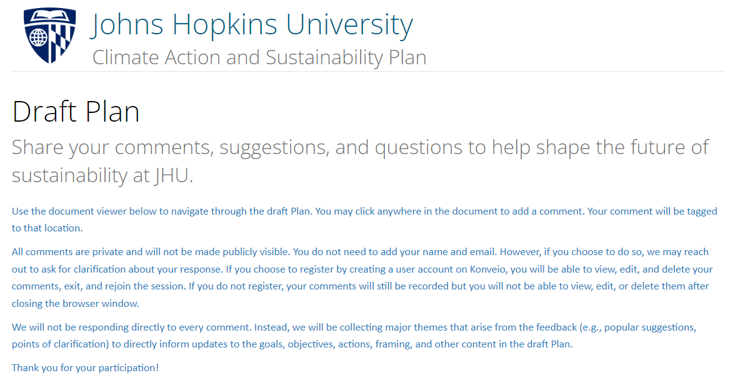
JH Sustainability
https://jhusustainability.konveio.com/draft-plan

Slide 16
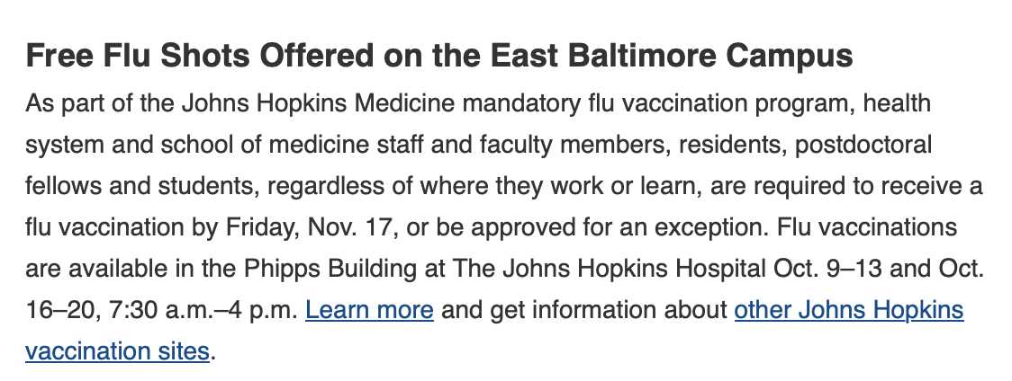
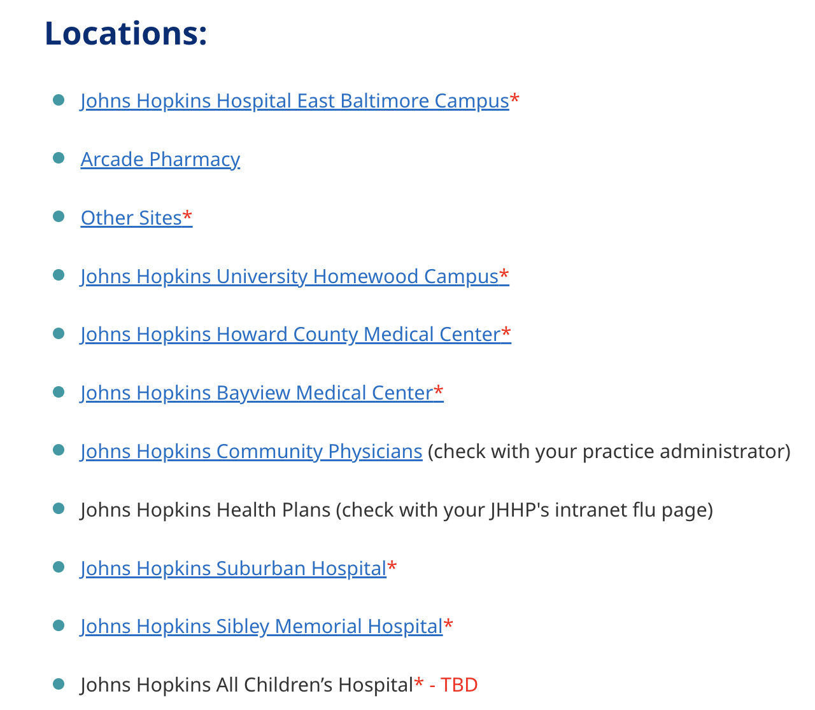
Flu Shot
https://www.hopkinsmedicine.org/hse/offices-programs/occupational-health/jh-affiliate-locations

Slide 17
Other updates
OGBE will be changing the process to book the conference room 2-303 and the classroom 2-108. The calendars will now be managed through outlook and one can place their own meetings on the calendar and cancel meetings
We are so excited to begin planning our next Convocation ceremony, which will take place in May of 2024. To ensure that we have an inspiring and engaging speaker to celebrate the students graduating in 2024, please vote on 2024 SOM Convocation Speaker!!
https://jhmi.co1.qualtrics.com/jfe/form/SV_ehz46JVsCy4nW2G
The deadline to submit your preferences is Wednesday, November 1st , at 11:59 pm.

Slide 18
Officer Announcements
President (Rodney)
President Elect (Scarlett)
Director of Administration (Nirvani) - Ashley Presenting
Director of Diversity, Inclusion, and Outreach (Ashley)
Director of Finance (Estefan)
Director of Social and Community Affairs (Mark)
Director of Media and Public Relations (Juliane)
Director of Student Involvement and Student Groups (Edna)
Director of Policy & Strategic Initiatives (Nick)

Slide 19
GSA Student Spotlight
Purpose: recognize outstanding graduate students for their academic and community-based achievements
Can nominate yourself, or a peer
Didn’t win? Renominate as many times as you would like
Winners will receive a $25 gift card
Info and links to enter can be found on:
Our website: https://jhu.campusgroups.com/gsa/home/
All-grad email notifications
GSA Newsletter
Our social media channels – follow us!

Slide 20
Oct 2023 GSA Student Spotlight Winners
Nicole Pannullo
Eleana Parajón
Cellular and Molecular Medicine
Cellular and Molecular Medicine
Eleana is the epitome of a model scientist. She recently became an HHMI Gilliam Fellow, championing not only equity and inclusion in science, but also outstanding scientific prowess and work ethic. The HHMI Gilliam Fellowship is an extremely competitive program with only 50 fellows being named across the US. In lab, her drive and scrupulous personality is infectious, inspiring everyone in lab to better themselves. Outside of the lab, she is an incredibly kind person who will ask about your day and be invested. I am grateful to have met her and she is more than deserving of student of the month.
Nicole received an NIH F31 grant for her thesis work involving retinal regeneration!

Slide 21
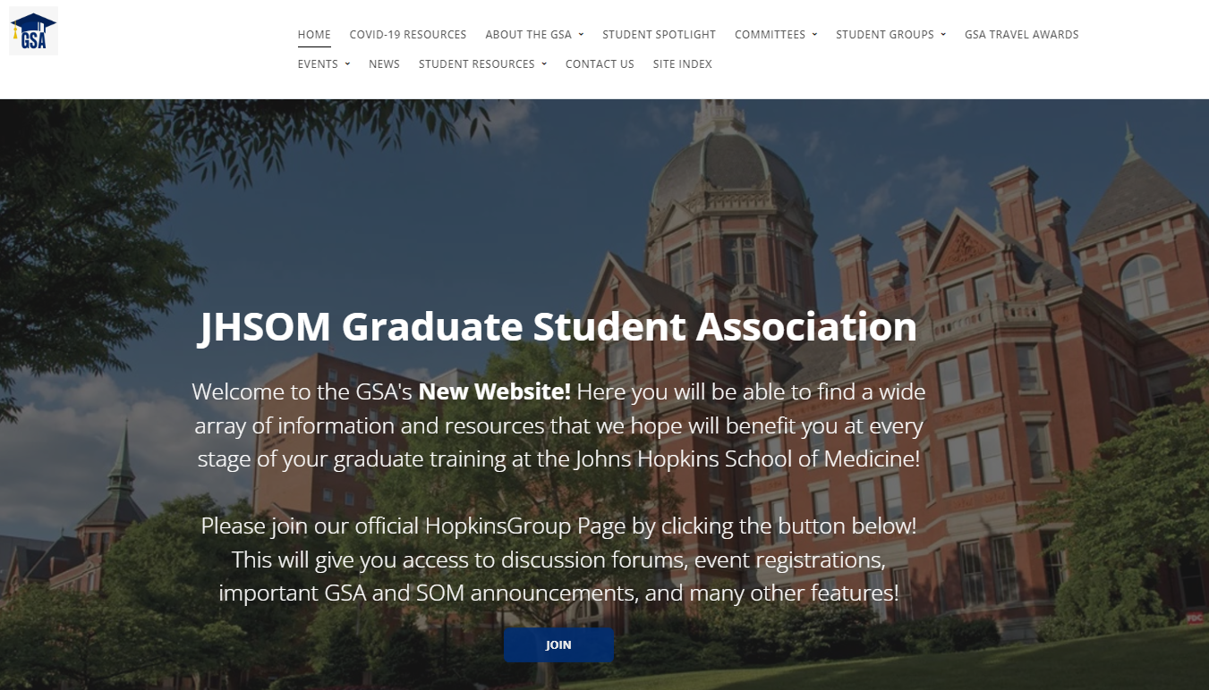
The GSA Website 101
jhu.campusgroups.com/gsa
I would like to highlight pages that might be relevant to you as Program Reps, and Student Group Reps.

Slide 22
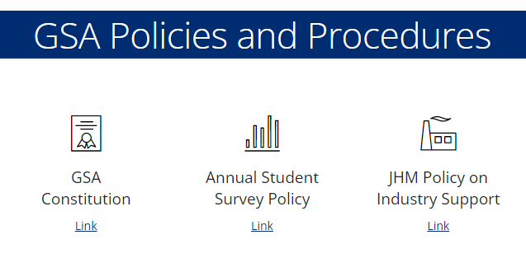
Our Constitution

Slide 23
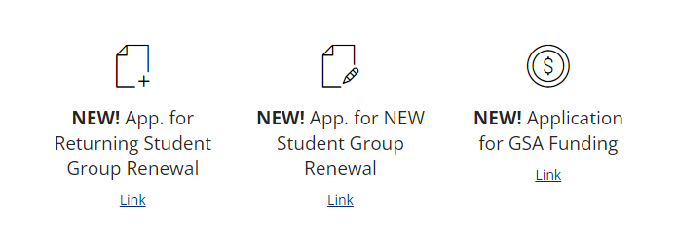
Student Group Applications

Slide 24
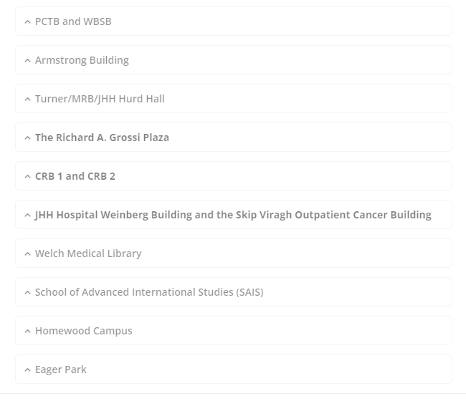
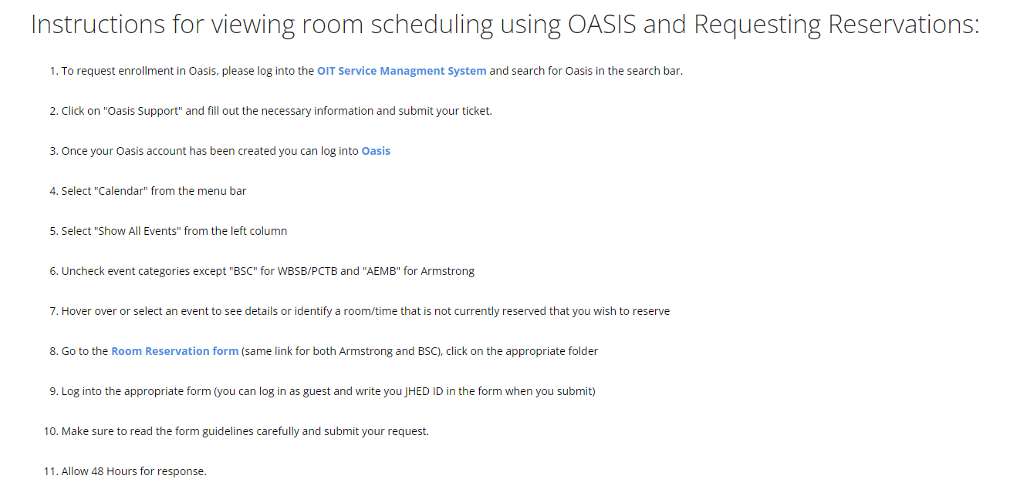
If you want to host an event

Slide 25
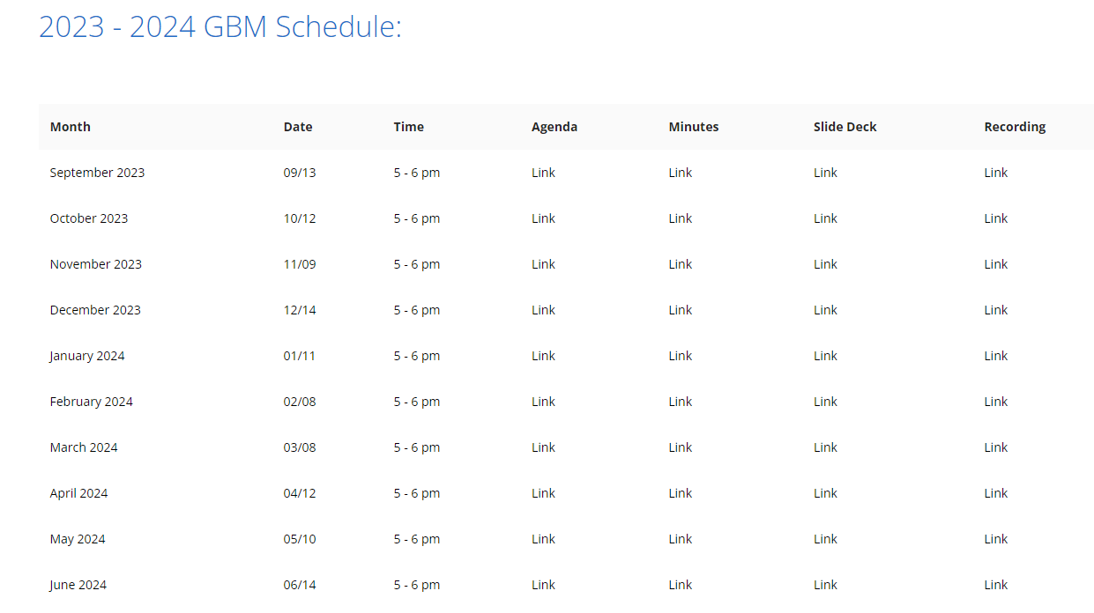
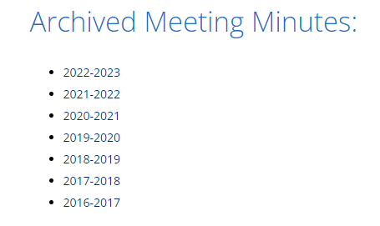
IMPORTANT! Where you can find ALL GBM related information!

Slide 26
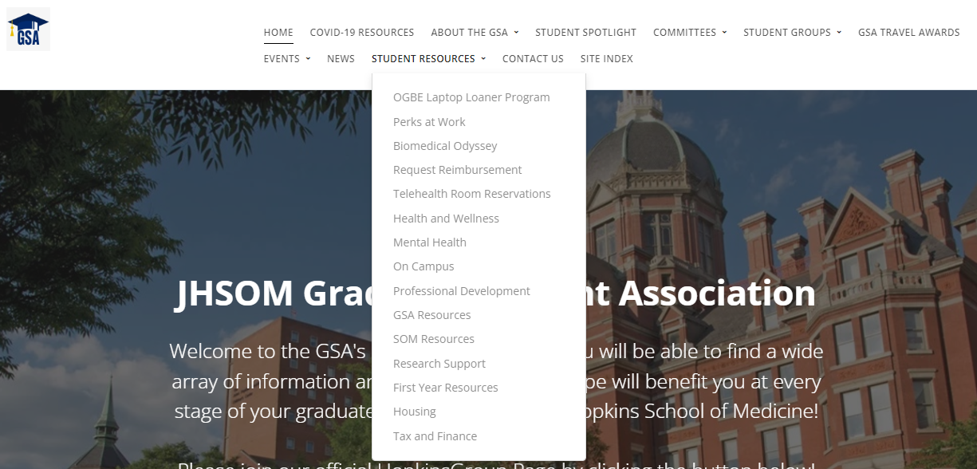
Resources for students!
Link to apply for laptop loan from OGBE

Slide 27
Resources for students!
Link to apply for reimbursement from GSA

Slide 28
Resources for students!
Link to private space in MRB

Slide 29
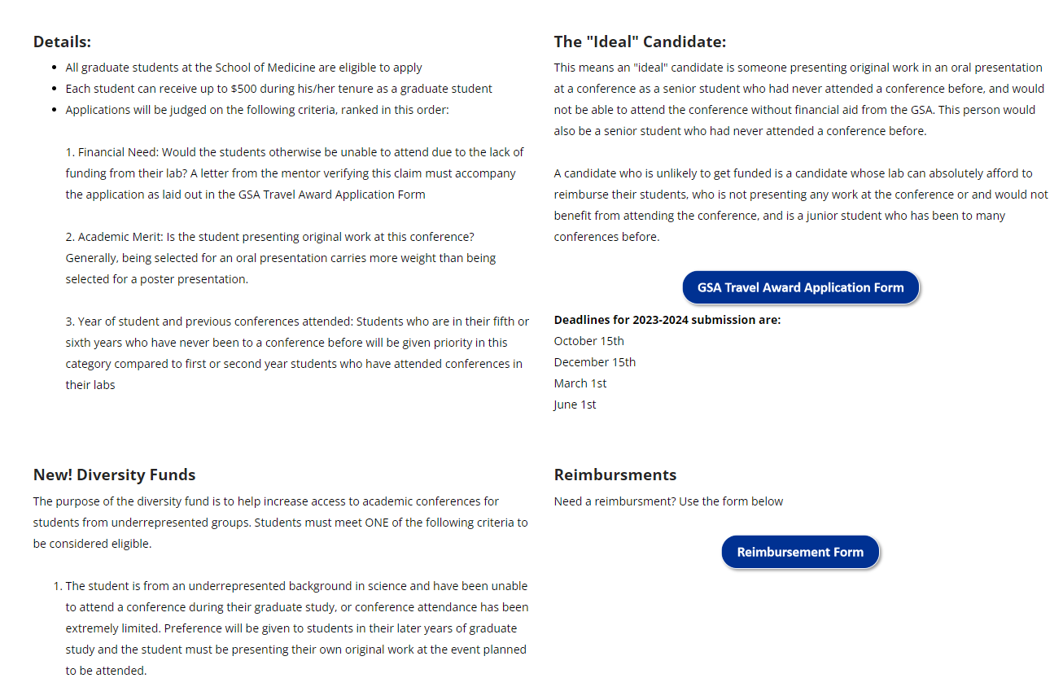
Resources for students!

Slide 30
Officer Announcements
President (Rodney)
President Elect (Scarlett)
Director of Administration (Nirvani)
Director of Diversity, Inclusion, and Outreach (Ashley)
Director of Finance (Estefan)
Director of Social and Community Affairs (Mark)
Director of Media and Public Relations (Juliane)
Director of Student Involvement and Student Groups (Edna)
Director of Policy & Strategic Initiatives (Nick)

Slide 31
National Disability Employment Awareness Month
Student Disability Services (SDS)
(Senior director: Joanne Benica;
Event Coordinator: Courtney Harris)
Interschool events
Last week of October
Finalizing the space and various options for activities

Slide 32
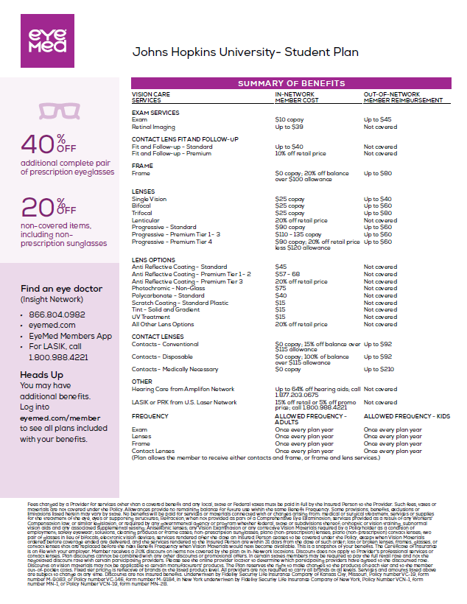
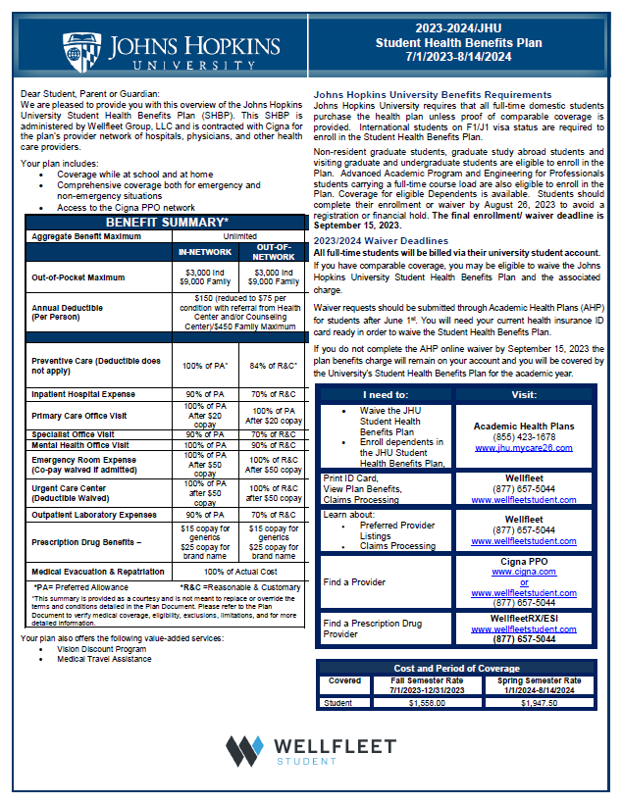
Information Sessions (Past)
Update information on the GSA website
- Recording video of the session (already shared with email)
- Summary of Q & A
- Flyers with detailed insurance plan

Slide 33
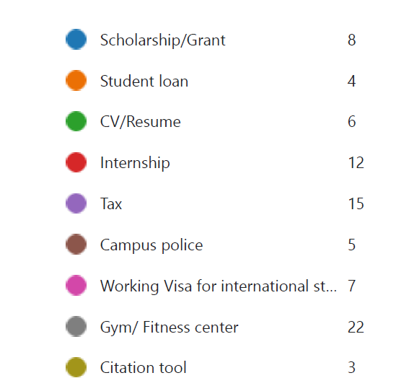
Information Session (Future)
30 responses
Top 3 topic: Gym/Fitness Center, Tax (Feb/Mar), Internship

Slide 34
Menstrual Product
Feminine hygiene products are now available in the following restrooms on the East Baltimore Campus:
CRB I- (North and South restroom on 1st floor)
CRB II- (North and South restroom on 1st floor)
AMEB- All restrooms
Turner (Concourse level)
MRB- 3rd floor restroom
PCTB- (1st floor and 3rd floor)
WBSB- (3rd floor restroom)
Ross- ( 3rd floor restroom)
Welch- (1st floor restroom)
Rangos - (4th floor restroom)
2024- ( 1st floor restroom)
2041- (Ground floor locker room)
Will send out the information to the group on Thursday

Slide 35
Officer Announcements
President (Rodney)
President Elect (Scarlett)
Director of Administration (Nirvani)
Director of Diversity, Inclusion, and Outreach (Ashley)
Director of Finance (Estefan)
Director of Social and Community Affairs (Mark)
Director of Media and Public Relations (Juliane)
Director of Student Involvement and Student Groups (Edna)
Director of Policy & Strategic Initiatives (Nick)

Slide 36
Travel Awards Are Due Soon!
Detailed instructions are provided on the email!

Slide 37
Officer Announcements
President (Rodney)
President Elect (Scarlett)
Director of Administration (Nirvani)
Director of Diversity, Inclusion, and Outreach (Ashley)
Director of Finance (Estefan)
Director of Social and Community Affairs (Mark)
Director of Media and Public Relations (Juliane)
Director of Student Involvement and Student Groups (Edna)
Director of Policy & Strategic Initiatives (Nick)

Slide 38
Interschool Boo Bash
Join GSA for a frightfully fun night!
October 27th
Grossi Plaza
5:00- 8:00 pm
Food, Drinks, and Costume Contest
Registration Link:
https://cglink.me/2dh/r1943206
SOM x SON x SOPH x Homewood

Slide 39
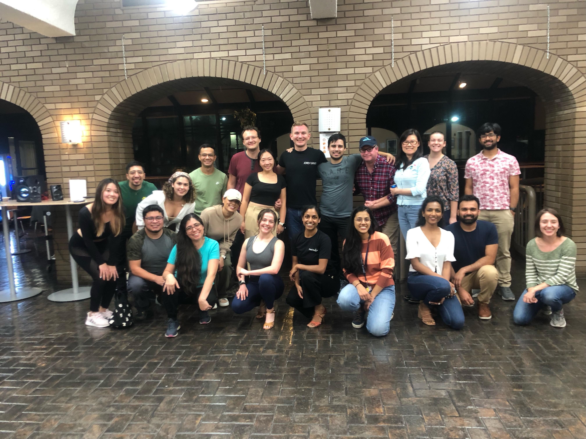
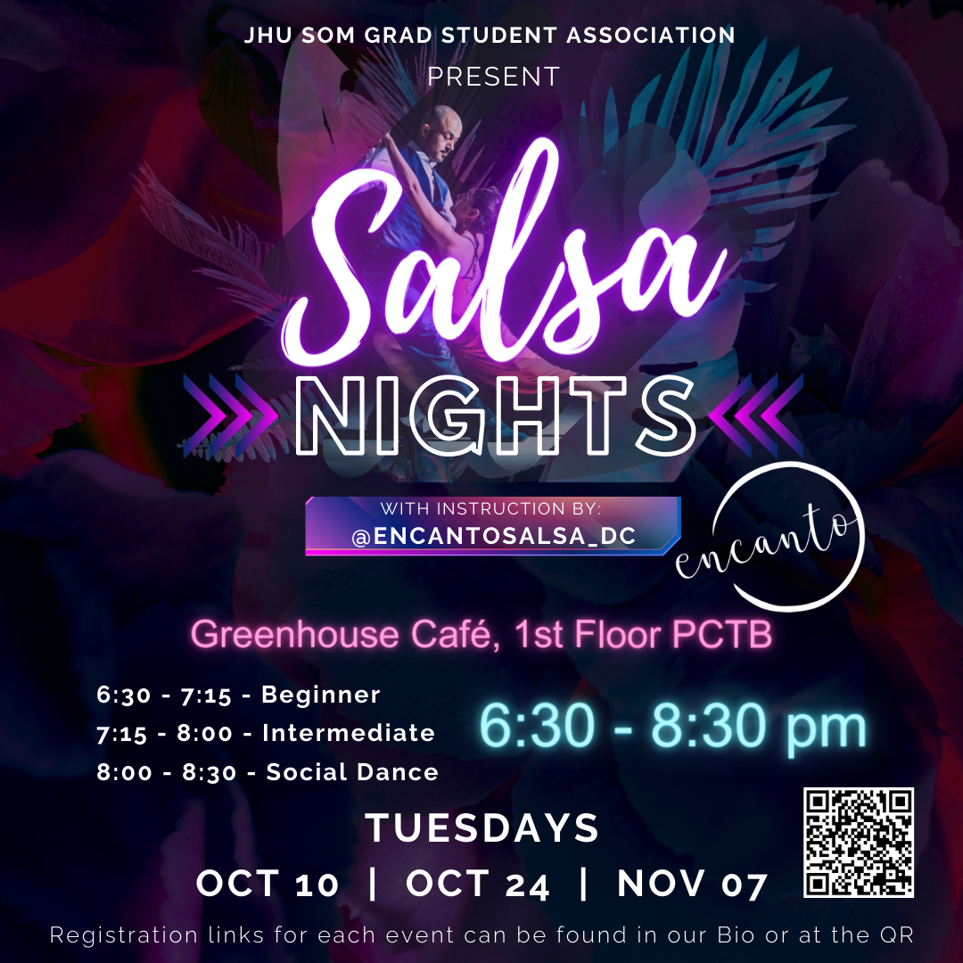
Salsa Nights
Join GSA for Salsa Dancing Lessons!
October 10th, 24th, & Nov 7th
Greenhouse Café PCTB 1st Floor!
6:30 - 8:30 PM
Light Refreshments will be provided!
Registration Link:
https://cglink.me/2dh/r1937704

Slide 40
Young Frankenstein!
Join GSA for Halloween Movie Night!
October 31st
GSA Lounge WBSB G-03
4:45 – 7pm!
FREE Popcorn 🍿 and Halloween Candy 🍬
Registration Link:
https://cglink.me/2dh/r1942379

Slide 41
Officer Announcements
President (Rodney)
President Elect (Scarlett)
Director of Administration (Nirvani)
Director of Diversity, Inclusion, and Outreach (Ashley)
Director of Finance (Estefan)
Director of Social and Community Affairs (Mark)
Director of Media and Public Relations (Juliane)
Director of Student Involvement and Student Groups (Edna)
Director of Policy & Strategic Initiatives (Nick)

Slide 42
B'more Fall Photo Contest
Closes this month! Photos due Oct 20th!
Winner's photo submissions will be highlighted on our Socials, Website, & Newsletter!
To ensure only SOM Graduate students are participating, submissions will be submitted via GSA registered Hopkins Groups members.
TBD – would like to have a gallery platform for all photo submissions to be viewed (Website?)
Student body will be selecting winners through survey sent through Allgrad.
Submission Form OPEN: https://cglink.me/2dh/s82340
Rules/Guidelines
You must be a registered SOM graduate student
Photos must be taken within the city limits of Baltimore, MD
Photos should be submitted using JPEG format
One photo submission per student
Only recent Fall photos can be submitted (photo cannot be from last year)
Please do not plagiarize from professional/online photos
Have fun!

Slide 43
Allgrad Listserv/Hopkins Groups
I am manually adding 1st years
Program Reps, please send Edna your email lists ASAP!
I need individual emails, NO listservs!
Please check all spelling and formatting, emails should be:
JHEDID@jhmi.edu OR JHEDID@jh.edu OR JHEDID@jhu.edu
No special characters such as < , - ; ) " } etc.
* Full (1st years & beyond) lists are appreciated so I can make sure all SOM are added to the listserv and have access to Hopkins Groups! Thanks!

Slide 44
Use of the Allgrad Listserv
The GSA would kindly like to ask that you all please limit the number of times that you send the same event/email to the listserv.
Allgrad is the primary means of communication for student groups and JHU offices and in many instances the number of emails sent though this resource can be overwhelming to students.

Slide 45
Officer Announcements
President (Rodney)
President Elect (Scarlett)
Director of Administration (Nirvani)
Director of Diversity, Inclusion, and Outreach (Ashley)
Director of Finance (Estefan)
Director of Social and Community Affairs (Mark)
Director of Media and Public Relations (Juliane)
Director of Student Involvement and Student Groups (Edna)
Director of Policy & Strategic Initiatives (Nick)

Slide 46
Officer Announcements
President (Rodney)
President Elect (Scarlett)
Director of Administration (Nirvani)
Director of Diversity, Inclusion, and Outreach (Ashley)
Director of Finance (Estefan)
Director of Social and Community Affairs (Mark)
Director of Media and Public Relations (Juliane)
Director of Student Involvement and Student Groups (Edna)
Director of Policy & Strategic Initiatives (Nick)

Slide 47
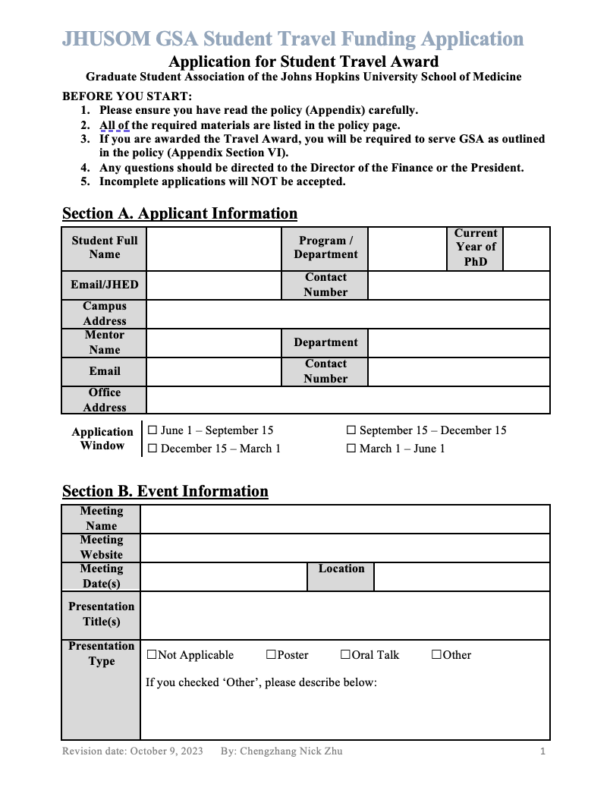
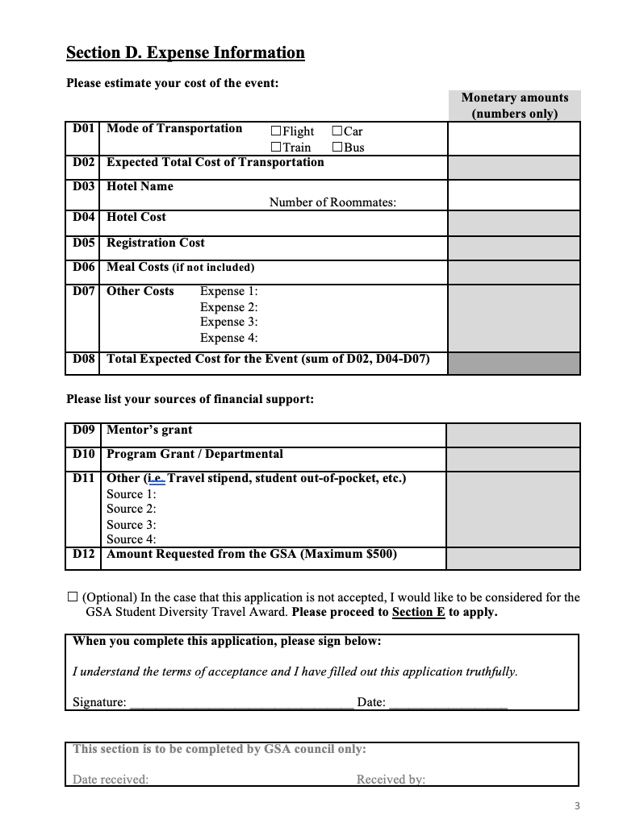
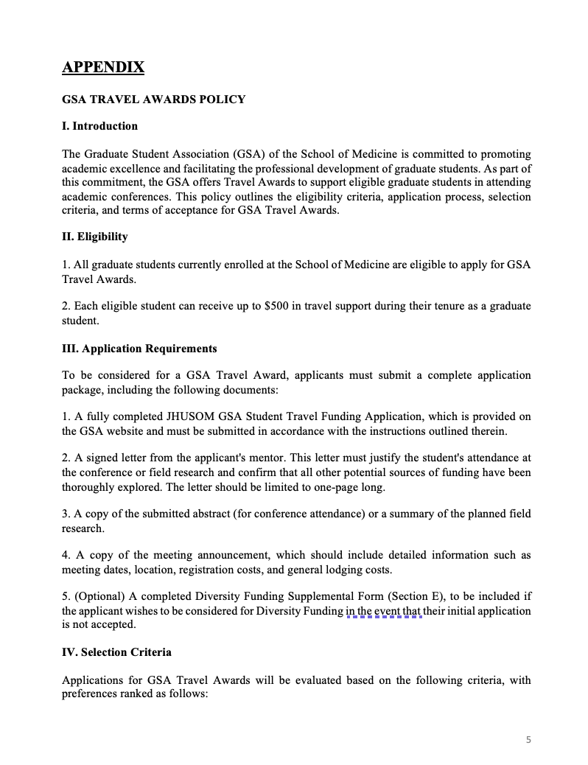
Updated Travel Award Application Form and New Policy Document

Slide 48
Announcements
SOM Committees
WLAC by Estefan
Program Reps/Student Groups
Misc.

Slide 49
Updates from the WLAC
I had recently been appointed as student advisor in the Welch Library Advisory Committee and had my meeting recently.
A survey was conducted to better represent the wishes of the Ph.D. SOM student body.
I have all questions and answers prepared onto a FAQ document that I plan to send to the student body once all details are completed and made to fully represent the thoughts of WLAC.
I will also work with WLAC to disseminate information, so future surveys as well as information about the WL will be made available soon.

Slide 50
THANK YOU!
@jhmi.gsa
Johns Hopkins Medicine GSA
@jhmi_gsa
jhu.campusgroups.com/gsa

