Slide 1
Creating a fundraiser In Hopkins groups

Slide 2
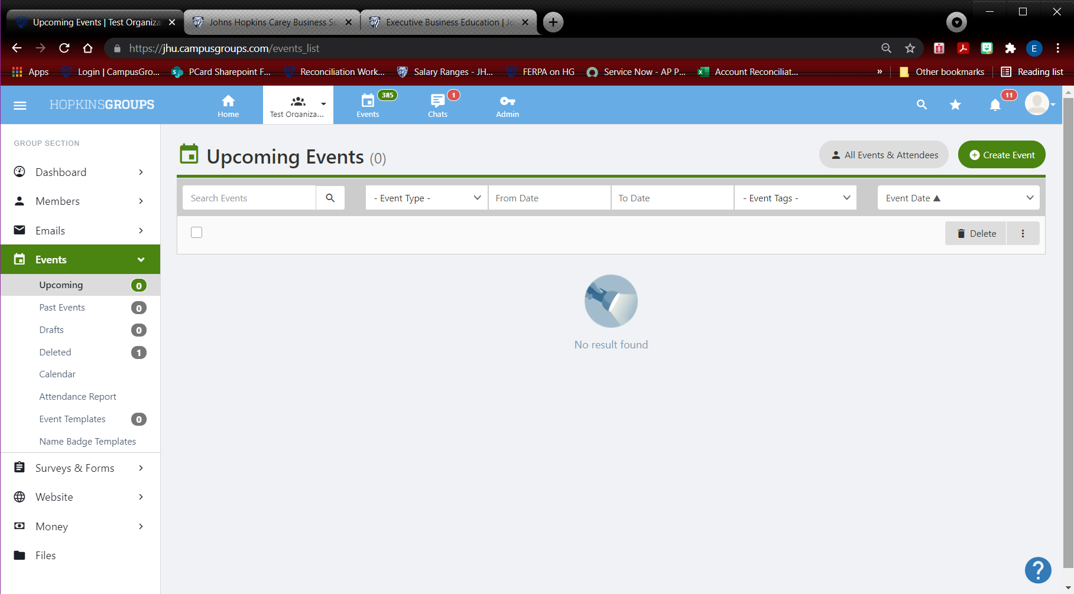
1. Go to your group’s event page

Slide 3
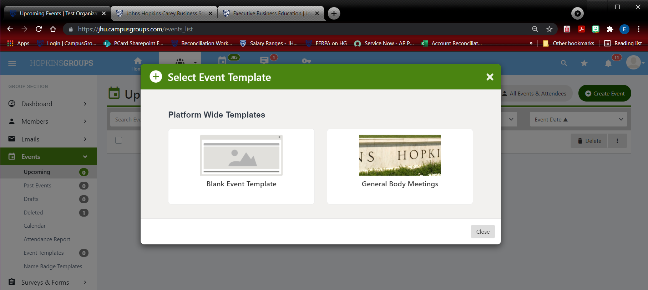
2. Click create event 3. Select the Blank Template option

Slide 4
4. Enter the details for the event in box #1

Slide 5
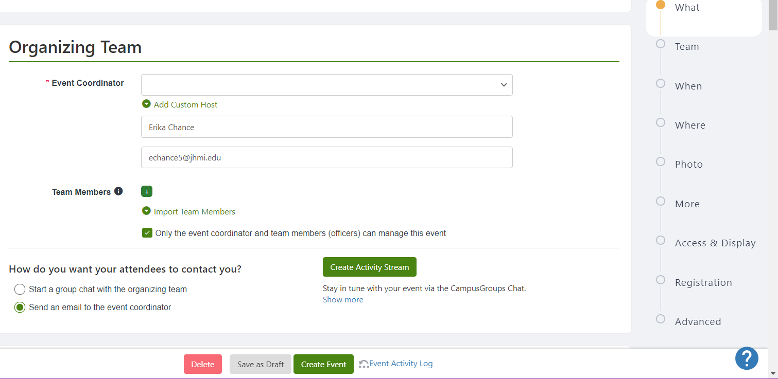
5. Next, enter the organizer’s details. Select the correct radio button to determine communication between your group and attendees.

Slide 6
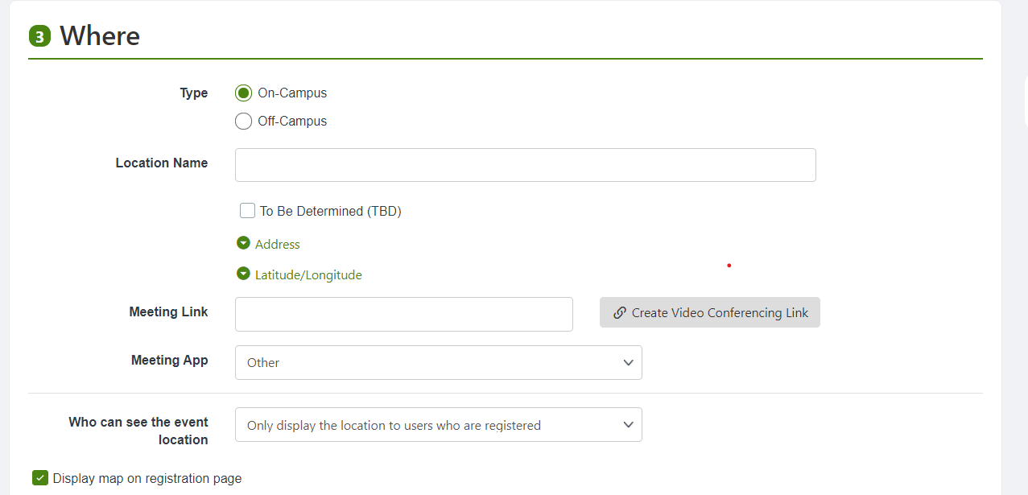
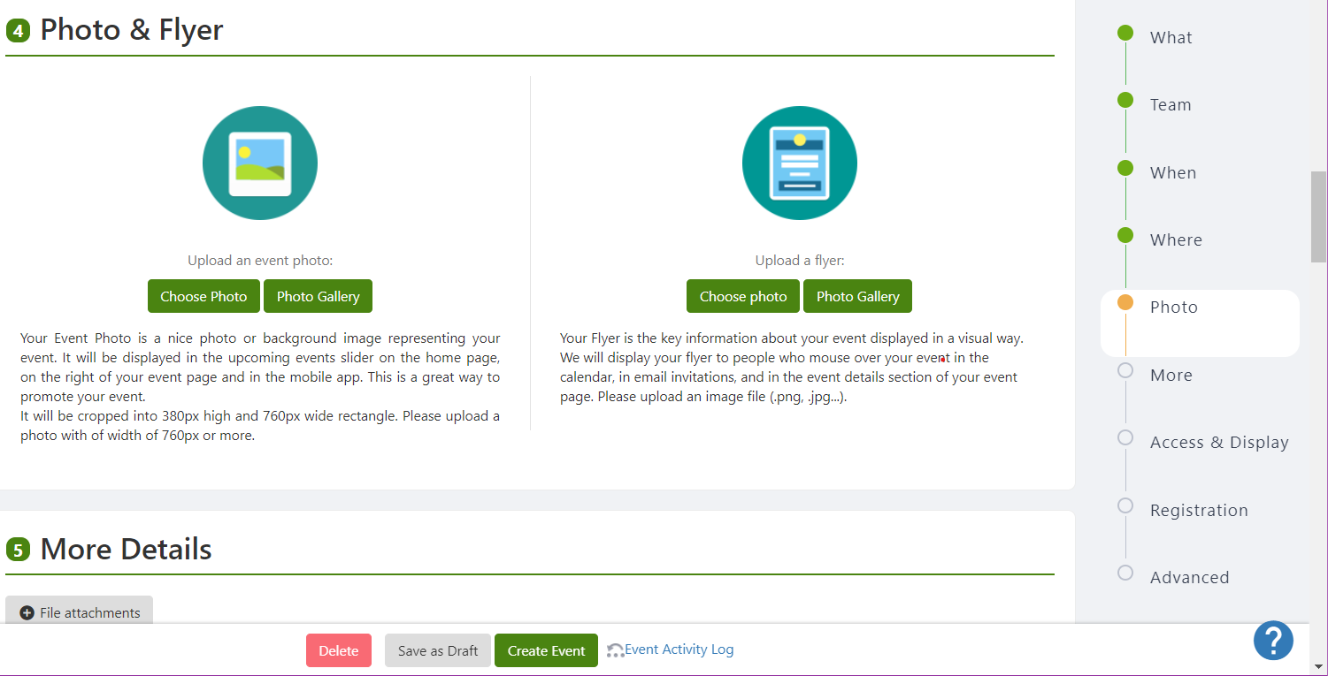
6. Complete sections 2 – 4 by entering specific details regarding your event.

Slide 7
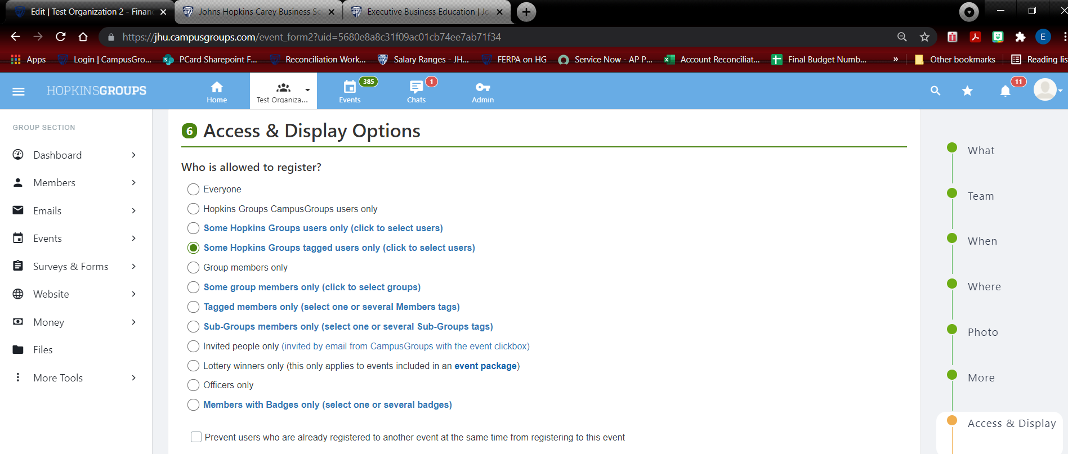
7a. For portion 6, this is where you may indicate who can participate. If this is event is open to the public, please select the “Everyone” radio button.

Slide 8
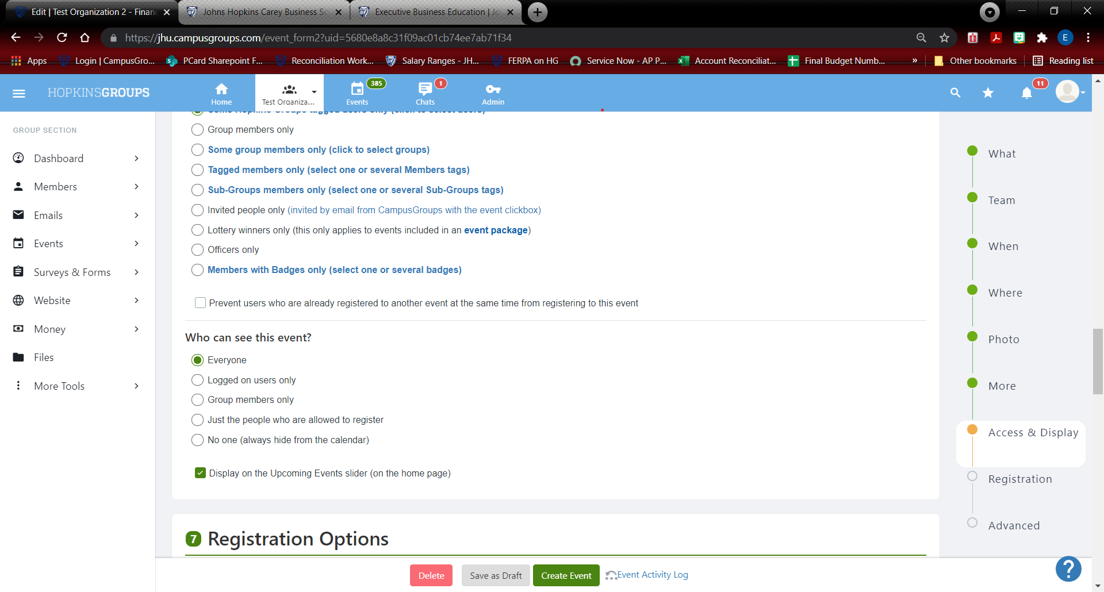
7b. Select who can see the event. Be sure to check the box for the option to display on the home page.

Slide 9
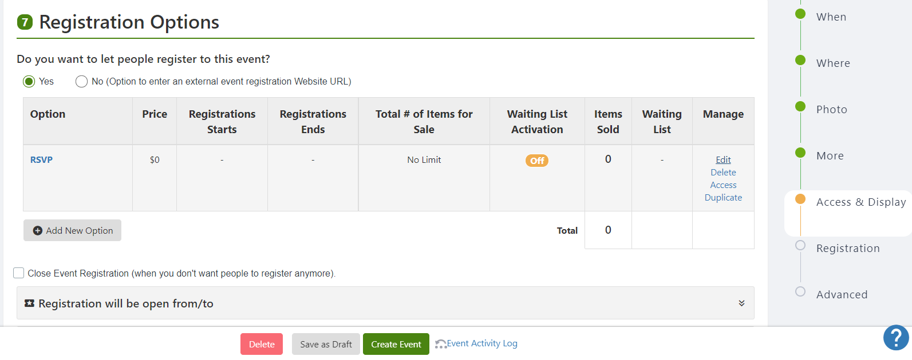
8. Next is portion #7 Registration Options. This is where you will indicate that this event is a fundraiser. If registration is required, please select the “yes” radio button under that question. Next, under Manage, click Edit to change the RSVP option.

Slide 10
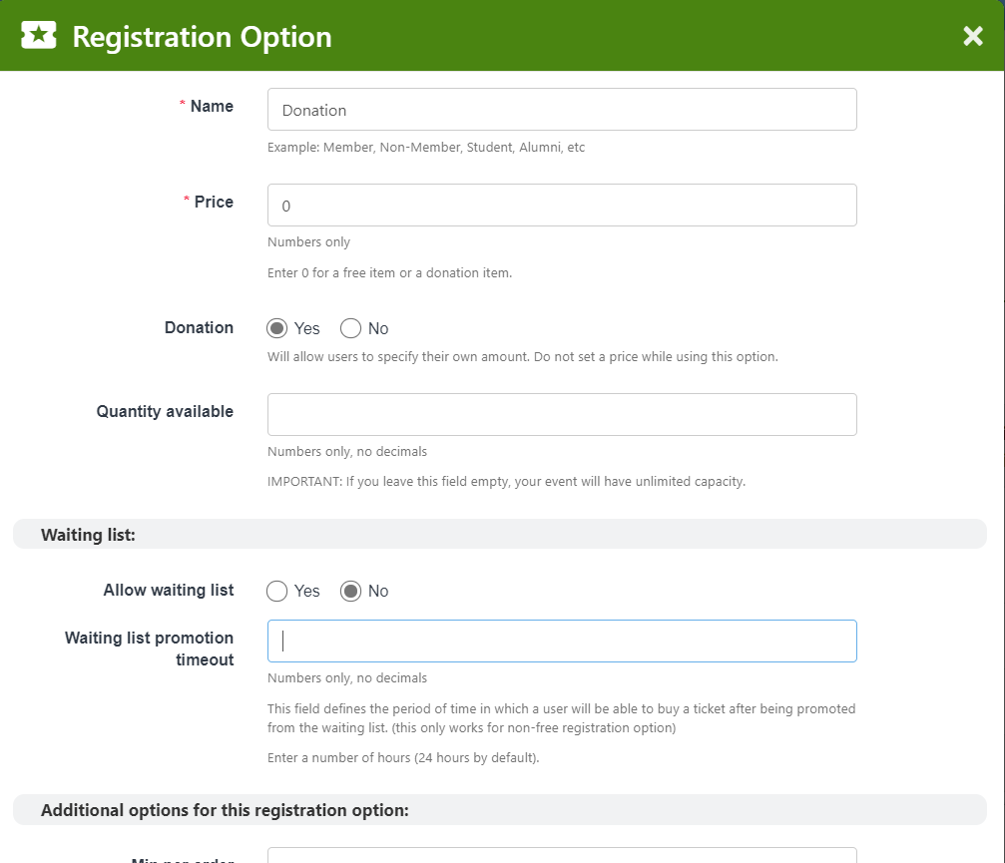
9. For the Name, enter Donation. For Price, leave at 0 unless there is minimum donation requested. Next, click the Yes radio button next to Donation. For quantity available, leave blank. The rest of the options on this form are non-essential to this process. Be sure to click Save at the bottom to continue.

Slide 11
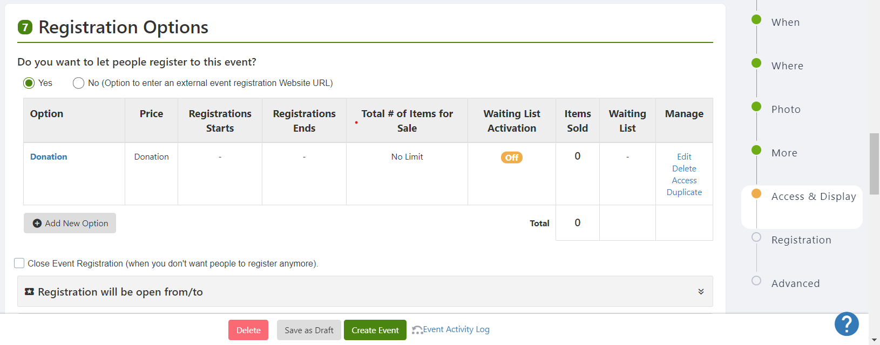
10. Once the save button is clicked, the Registration Option box will disappear and the options selected will populate as shown above:

Slide 12
11. The remainder of the Registration Options in Box #7 are nonessential and are not required to create a donation page. The Advanced Options section is also nonessential for this process but can be completed if desired. Finally, click the Create Event button at the bottom of the page.

Slide 13
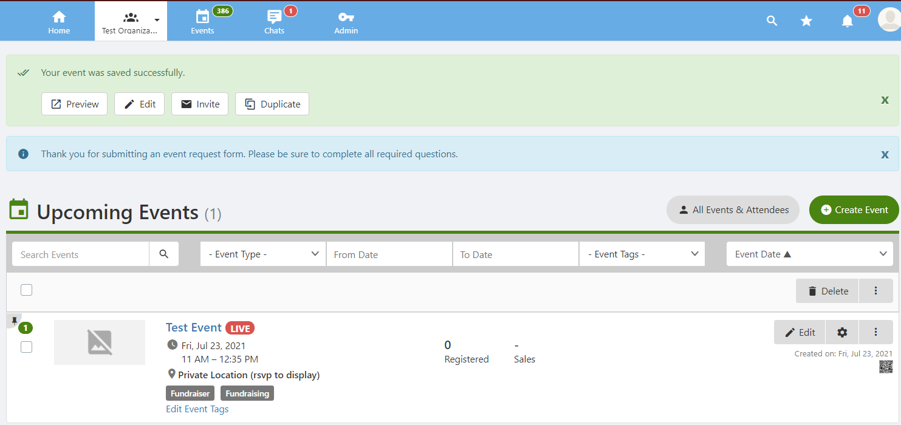
12. If Created Successfully, the event should appear like in the screen shot below:

Slide 14
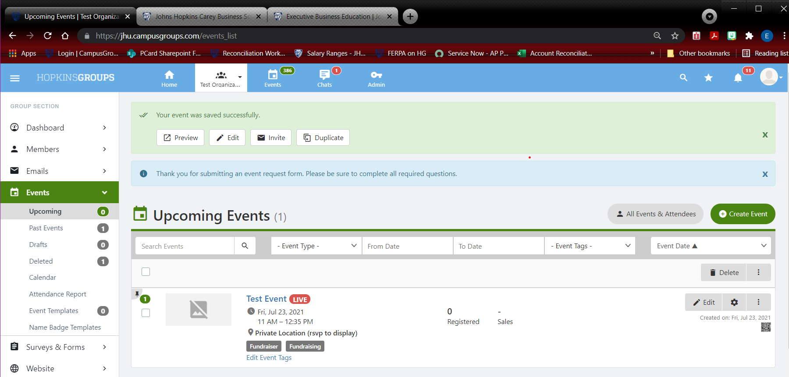
13. If anything is incorrect, the event can be edited or deleted altogether via the Edit and Delete buttons on the right side of the screen. To view how others will see the event, click the Preview button at the top.

Slide 15
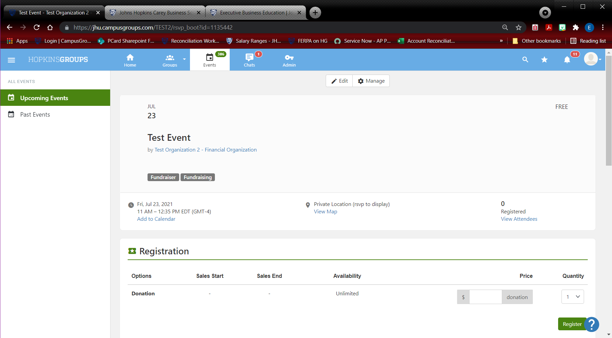
14. The event may also be managed and edited on this screen.

Slide 16
IF EVERYTHING LOOKS GOOD, YOU’RE ALL SET!!

