Slide 1
GSA General Body Meeting
November 8th, 2023

Slide 2
Agenda
Approval of Minutes
Speakers from the Provost's Office
Student Group Finance Requests Presentation and Vote
Officer Announcements
GSA/SOM Committee Announcements
Program Rep or Student Group Announcements
Misc. Announcements

Slide 3
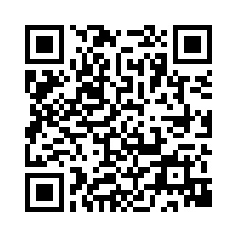
GBM Attendance Survey

Slide 4
Approval of the Minutes
Approving October 2023
Notes:
October and November

Slide 5
Join us in Welcoming
JHU Office of the Provost
Website: https://provost.jhu.edu/
Phone: (410) 516-8070
Office Location: 265 Garland Hall, 3400 N Charles St.
Notes:
October and November

Slide 6
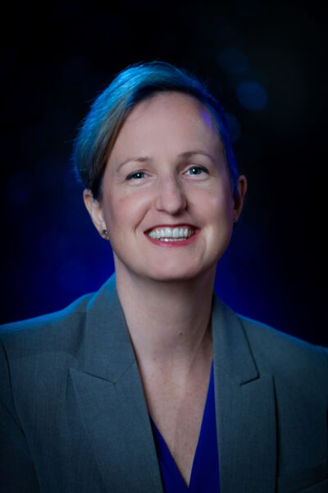
Dr. Sabine Stanley (She/They)
Vice Provost for Graduate & Professional Education
Email: sabine@jhu.edu
Notes:
October and November

Slide 7
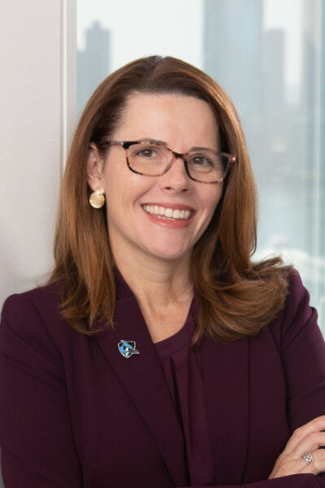
Rachelle Hernandez, M.Ed (She/Her)
Vice Provost for Student Affairs
Email: rachellehernandez@jhu.edu
Phone: (410) 516-0602
Notes:
October and November

Slide 8
Officer Announcements
President (Rodney)
President Elect (Scarlett)
Director of Administration (Nirvani)
Director of Diversity, Inclusion, and Outreach (Ashley)
Director of Finance (Estefan)
Director of Social and Community Affairs (Mark)
Director of Media and Public Relations (Juliane)
Director of Student Involvement and Student Groups (Edna)
Director of Policy & Strategic Initiatives (Nick)

Slide 9
Cooley Center Updates
Cooley Center has approximately 3800 members (900 faculty staff & 2900 trainees)
BSPH Annex will remain open and shift its hours & offerings
Cooley will be temporarily replaced by 4 smaller locations on JHMI Campus. (BSPH Annex, Two locations on Ashland, One TBA)
O'Connor center likely to be included in any solution
On campus facility will not have courts/pools
In conversations with Merrit Health Clubs about access to Courts/Pools

Slide 10
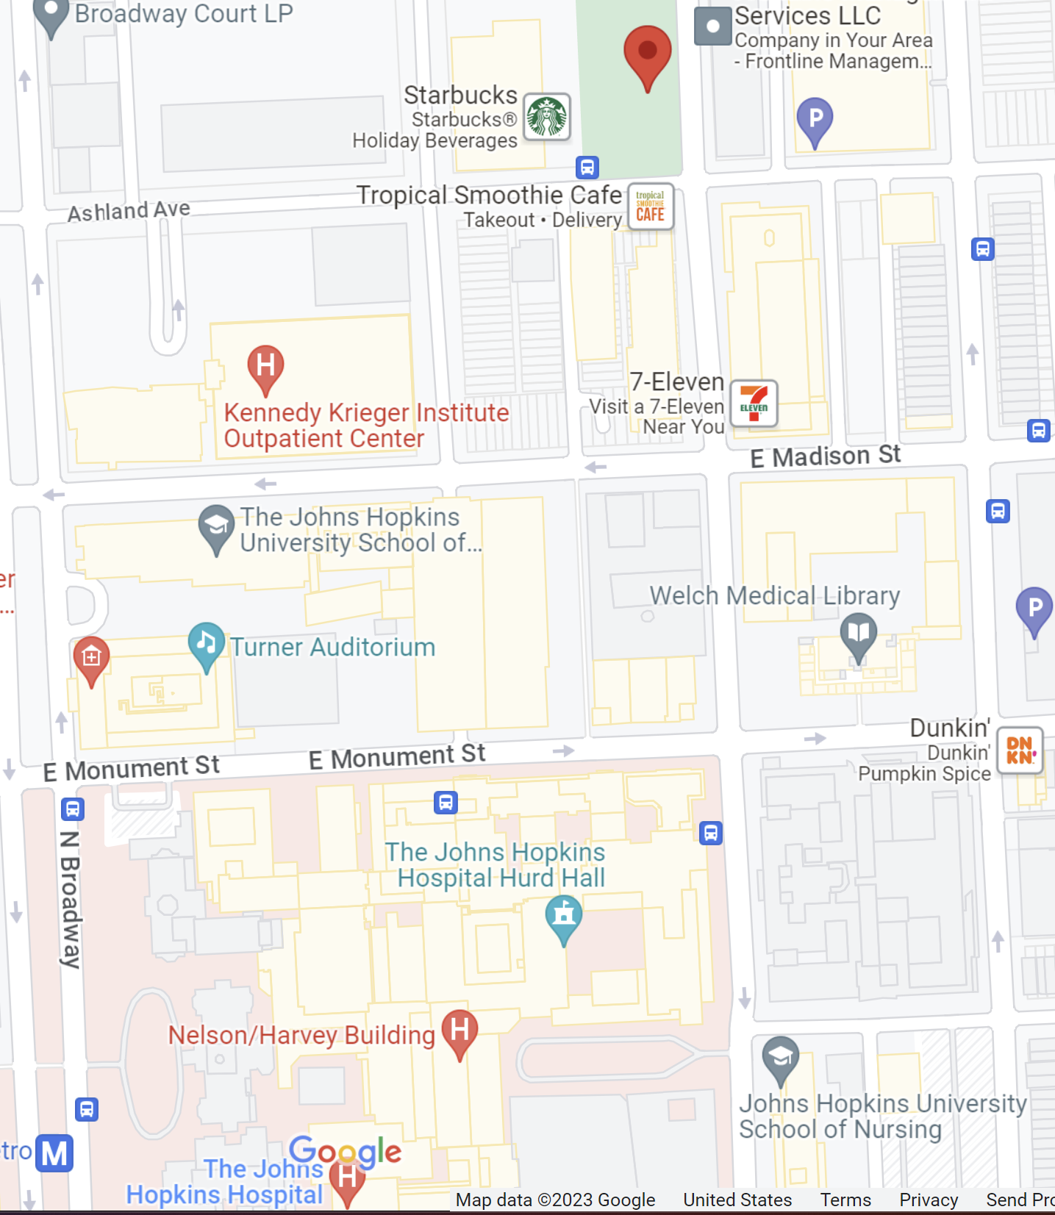
Confirmed fitness facility locations to replace Cooley Center

Slide 11
JHPD Updates
https://publicsafety.jhu.edu/community-safety/jhpd/jhpd-draft-policies/list-of-draft-policies/
DUE BY NOV 20

Slide 12
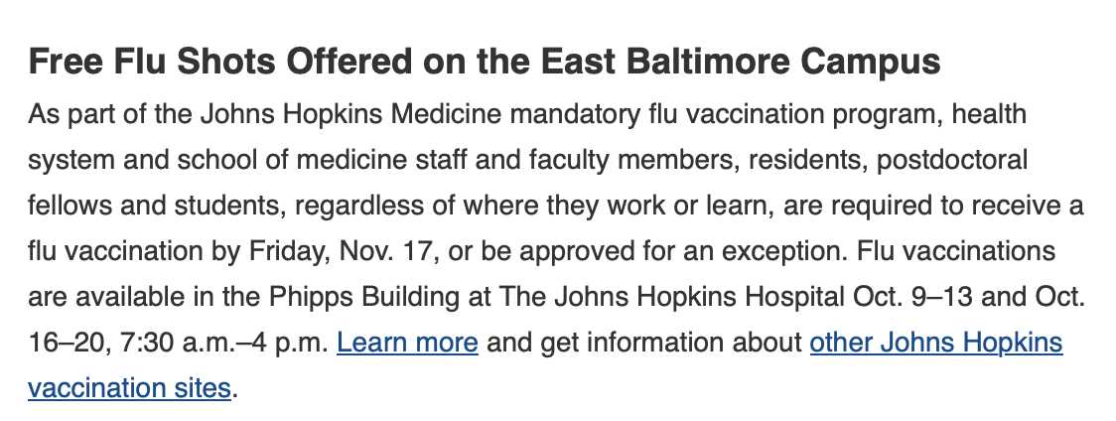
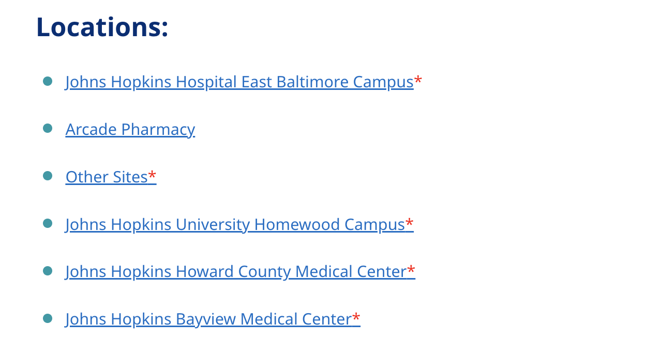
Flu Shot
https://www.hopkinsmedicine.org/hse/offices-programs/occupational-health/jh-affiliate-locations
Nov. 13–15, 11 a.m.- 7 p.m.
Nov. 6–10 and Nov. 13–17, 8 a.m. - 8 p.m.
Nov. 14, 9am-5pm Shriver Hall

Slide 13
Officer Announcements
President (Rodney)
President Elect (Scarlett)
Director of Administration (Nirvani)
Director of Diversity, Inclusion, and Outreach (Ashley)
Director of Finance (Estefan)
Director of Social and Community Affairs (Mark)
Director of Media and Public Relations (Juliane)
Director of Student Involvement and Student Groups (Edna)
Director of Policy & Strategic Initiatives (Nick)

Slide 14
GSA Student Spotlight
Purpose: recognize outstanding graduate students for their academic and community-based achievements
Can nominate yourself, or a peer
Didn’t win? Renominate as many times as you would like
Winners will receive a $25 gift card
Info and links to enter can be found on:
Our website: https://jhu.campusgroups.com/gsa/home/
All-grad email notifications
GSA Newsletter
Our social media channels – follow us!

Slide 15
June 2023 GSA Student Spotlight Winners
Kexin Wang
Tie
Biomedical Engineering
???
Kexin Wang is driven by an unwavering passion for magnetic resonance imaging (MRI) research. In October, she achieved the remarkable feat of publishing a first-authored paper and co-authoring another in the esteemed journal of Magnetic Resonance in Medicine. Her work involved the extraction and validation of creatine in mouse brain at 3T MRI, marking a pioneering milestone in this field. Kexin aspires to extend her findings to human applications, with the potential to illuminate the metabolic processes underlying various diseases. Additionally, she is actively contributing as the Director of Membership for the Association of Women in Science (AWIS).
VOTE

Slide 16
Vote for Second Student Spotlight Winner
Their first first-author paper was just accepted and published in Philosophical Transactions of the Royal Society B. They are also a photographer - their photo of monocytes stained for immunofluorescence was selected as the cover photo of this issue of the journal!
Besides being an excellent TA for the cell biology course for the past 3 years, setting aside hours of extra time. The nominee also has dedicated at least 1 day a week this month, tutoring students to help them with their qualifying exam. Finally, they are the coach of a JHU softball team, where we just finished our season in 1st place undefeated.
Notes:
Mekha Thomas (Immunology)
Brady Goulden (BCMB )

Slide 17
Officer Announcements
President (Rodney)
President Elect (Scarlett)
Director of Administration (Nirvani)
Director of Diversity, Inclusion, and Outreach (Ashley)
Director of Finance (Estefan)
Director of Social and Community Affairs (Mark)
Director of Media and Public Relations (Juliane)
Director of Student Involvement and Student Groups (Edna)
Director of Policy & Strategic Initiatives (Nick)

Slide 18
Thanksgiving Messages
Messages will be sent out on Nov 20th individually

Slide 19
Turkey Program (JHU) & Project Feast (UMB)

Slide 20
Interschool
Diwali Event
Location
- TBD
(Turner concourse/
Green Café + Room 115)
Time
- 11/17 evening
Food (Mainly vegetarian)
Dance (Indian classicals)
Candles making

Slide 21
Officer Announcements
President (Rodney)
President Elect (Scarlett)
Director of Administration (Nirvani)
Director of Diversity, Inclusion, and Outreach (Ashley)
Director of Finance (Estefan)
Director of Social and Community Affairs (Mark)
Director of Media and Public Relations (Juliane)
Director of Student Involvement and Student Groups (Edna)
Director of Policy & Strategic Initiatives (Nick)

Slide 22
Officer Announcements
President (Rodney)
President Elect (Scarlett)
Director of Administration (Nirvani)
Director of Diversity, Inclusion, and Outreach (Ashley)
Director of Finance (Estefan)
Director of Social and Community Affairs (Mark)
Director of Media and Public Relations (Juliane)
Director of Student Involvement and Student Groups (Edna)
Director of Policy & Strategic Initiatives (Nick)

Slide 23
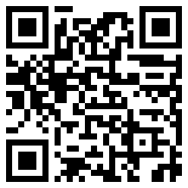
Power Plant Live Bar Crawl!
SOM x SON x SON x Homewood
Date: November 11th, 2023
Time: 10:00 PM to 2:00 AM
Limited RSVPs on HopkinsGroup
Two (2) free drink tickets with RSVP
Discounted drinks exclusively for Hopkins Graduate Students throughout the night
Must bring a physical government-issued ID!
Enjoy the company of graduate students from all walks of Hopkins!

Slide 24
Officer Announcements
President (Rodney)
President Elect (Scarlett)
Director of Administration (Nirvani)
Director of Diversity, Inclusion, and Outreach (Ashley)
Director of Finance (Estefan)
Director of Social and Community Affairs (Mark)
Director of Media and Public Relations (Juliane)
Director of Student Involvement and Student Groups (Edna)
Director of Policy & Strategic Initiatives (Nick)

Slide 25
B'more Fall Photo Contest
Closes this FRIDAY! Photos due NOV 10th!
Winner's photo submissions will be highlighted on our Socials, Website, & Newsletter!
To ensure only SOM Graduate students are participating, submissions will be submitted via GSA registered Hopkins Groups members.
Submission Form OPEN: https://cglink.me/2dh/s82340
Rules/Guidelines
You must be a registered SOM graduate student
Photos must be taken within the city limits of Baltimore, MD
Photos should be submitted using JPEG format
One photo submission per student
Only recent Fall photos can be submitted (photo cannot be from last year)
Please do not plagiarize from professional/online photos
Have fun!

Slide 26
Officer Announcements
President (Rodney)
President Elect (Scarlett)
Director of Administration (Nirvani)
Director of Diversity, Inclusion, and Outreach (Ashley)
Director of Finance (Estefan)
Director of Social and Community Affairs (Mark)
Director of Media and Public Relations (Juliane)
Director of Student Involvement and Student Groups (Edna)
Director of Policy & Strategic Initiatives (Nick)

Slide 27
Officer Announcements
President (Rodney)
President Elect (Scarlett)
Director of Administration (Nirvani)
Director of Diversity, Inclusion, and Outreach (Ashley)
Director of Finance (Estefan)
Director of Social and Community Affairs (Mark)
Director of Media and Public Relations (Juliane)
Director of Student Involvement and Student Groups (Edna)
Director of Policy & Strategic Initiatives (Nick)

Slide 28
Announcements
SOM Committees
EBHPWBC – Scarlett, Juls, Mark
Program Reps/Student Groups
Misc.

Slide 29
Updates from the EBHPWBC
1st Meeting held: 10/25/23
Committee Purpose: The purpose of the East Baltimore Health Promotion & Well-being Committee (EB HP&WB Comm) is to allow for multi-directional open communication regarding all things Student/Trainee Well-Being.
Representatives from: SON, BSPH, SOM – Med & Grads, Post Docs
Members surveyed about student/learner needs:
In regards specifically to SOM, we discussed the results of the recent GSA DEI survey sent to all grad, where Cooley center shut down, new insurance plan concerns, and tax literacy were brought up as current issues students are facing
Cooley Center – discussed about the current working group which Rodney covered earlier
Insurance – GSA hosted Jamie Karl from SBO, but she did not cover how mental health coverage is affected by new plans – possible to host another info session regarding this topic
Tax Literacy – Possible connections with OIS and Carey to host a tax session with students, event WIP
We also brought up that in SOM class syllabi don’t list HP/WB or SHWB info on them, only JHSAP which is no longer a direct contact as all mental health processes should now go through Student Mental Health Services 410-955-1892 – are there plans to update this information on class syllabi?

Slide 30
THANK YOU!
@jhmi.gsa
Johns Hopkins Medicine GSA
@jhmi_gsa
jhu.campusgroups.com/gsa

