Slide 1
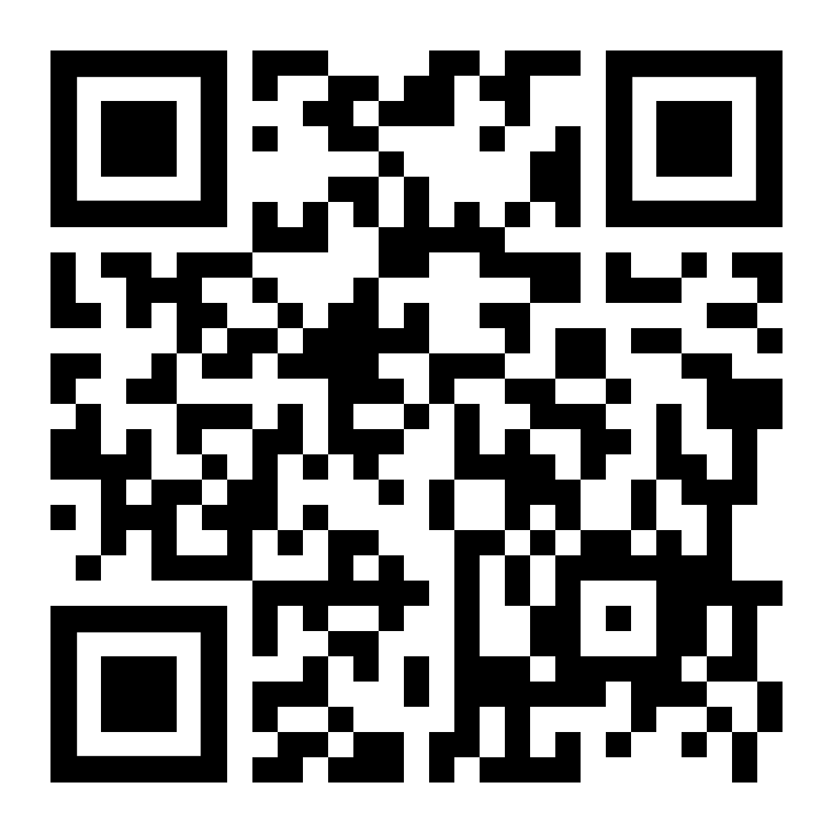
GSA General Body Meeting
Sign In!
December 13th, 2023

Slide 2
Agenda
Approval of Minutes
Officer Announcements
GSA/SOM Committee Announcements
Misc. Announcements

Slide 3
GBM Attendance Survey

Slide 4
Approval of the Minutes
Approving November 2023
Notes:
October and November

Slide 5
Officer Announcements
President (Rodney)
President Elect (Scarlett)
Director of Administration (Nirvani)
Director of Diversity, Inclusion, and Outreach (Ashley)
Director of Finance (Estefan)
Director of Social and Community Affairs (Mark)
Director of Media and Public Relations (Juliane)
Director of Student Involvement and Student Groups (Edna)
Director of Policy & Strategic Initiatives (Nick)

Slide 6
Cooley Center Updates
Cooley Center will be open until the new locations open in February
BSPH Annex will remain open and shift its hours & offerings
Cooley will be temporarily replaced by 4 smaller locations on JHMI Campus. (BSPH Annex, Three locations on Ashland near Rangos/929)
On campus facility will not have courts/pools
There were conversations with Merrit Health Clubs about access to Courts/Pools

Slide 7
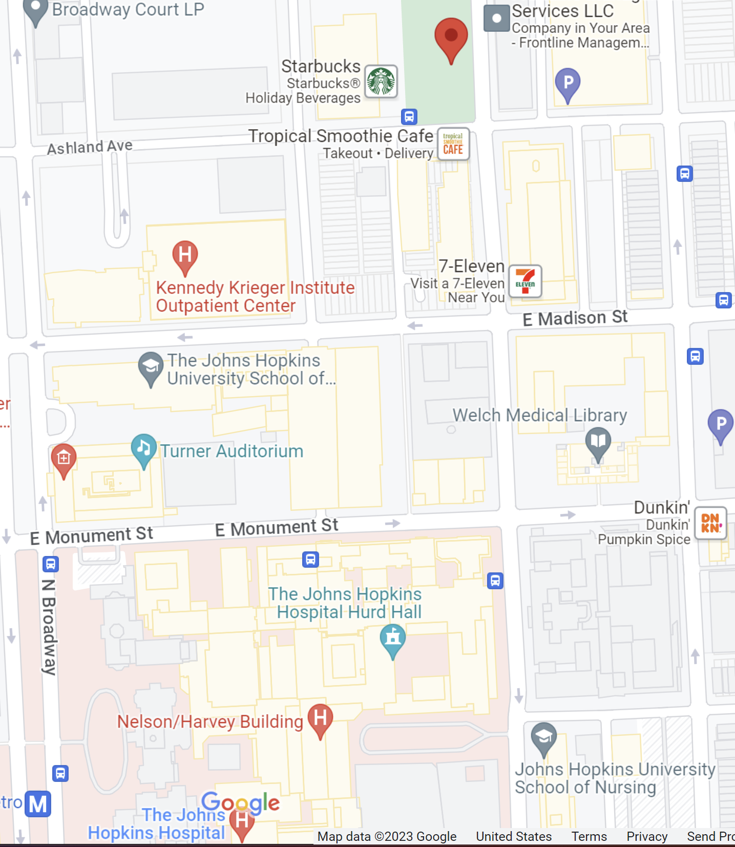
Confirmed fitness facility locations to replace Cooley Center

Slide 8
Student Health & Well-Being Announcements
Progress:
Expanded BHCST to East Baltimore - August 2023
Rebrand Mental Health Services
Mental Health Services – East Baltimore (UHS)
Services in Development
Single Session Interventions (fall 2024)
Online Scheduling capabilities (fall 2024)
ADHD medication protocol and support (spring 2024)
Access to MHS-East Baltimore:
• Same-day and next-day appointments increase access to services when
students need them (20-25 min via Zoom)
• Goal-oriented therapy
• Online drop-in groups and workshops
• Therapy Groups – coming fall 2024
• Psychiatric evaluation and medication management
• Chat with a Counselor

Slide 9
Primary Care and Student Disability Services Updates
Primary care provides high quality, confidential health care to students.
Mandatory flu vaccine deadline was 11/17/23 - we still have vaccine available in our clinics if you need it
General services include:
In-person & telemedicine visits
Immunizations
Labs
Sexual & reproductive health care including IUDs/Nexplanon
Gender affirming care
Acute care for illness & injury
Specialist referrals
After hours nurse triage
• The SDS Third Party Review and Response (2023) are now posted on the new SDS website.
• Effective July 1, 2023, all professional staff within Student Disability Services (SDS) now report centrally to SDS in full-time roles.
• On August 14, 2023, SDS launched the new university-wide website, sds.jhu.edu.
• On April 14, 2023, Hopkins launched the university-wide Disability Inclusion Advisory Committee (DIAC), reporting to the Provost and chaired by a faculty member.
• SDS introduced a Newsletter, "Breaking Down Barriers" (BDB) in May 2023.
• There is a new MyLearning program available to faculty and staff on Disability Inclusion at JHU.
• SDS appointments can now be scheduled through Microsoft Bookings.

Slide 10
Officer Announcements
President (Rodney)
President Elect (Scarlett)
Director of Administration (Nirvani)
Director of Diversity, Inclusion, and Outreach (Ashley)
Director of Finance (Estefan)
Director of Social and Community Affairs (Mark)
Director of Media and Public Relations (Juliane)
Director of Student Involvement and Student Groups (Edna)
Director of Policy & Strategic Initiatives (Nick)

Slide 11
GSA Student Spotlight
Purpose: recognize outstanding graduate students for their academic and community-based achievements
Can nominate yourself, or a peer
Didn’t win? Renominate as many times as you would like
Winners will receive a $25 gift card
Info and links to enter can be found on:
Our website: https://jhu.campusgroups.com/gsa/home/
All-grad email notifications
GSA Newsletter
Our social media channels – follow us!

Slide 12
December 2023 GSA Student Spotlight Winners
Alejandra Montano Romero
Kin Israel Notarte
BCMB
Pathobiology
Alejandra has been amazing this past fall. Not only has she had a baby and grown her family, but she has also managed to submit two manuscripts as a 4th year graduate student. She works extremely hard and is also vocal about the struggles of being a new mom while doing a PhD. She is an inspiration and a true depiction of perseverance and passion. On top of all of this, she is a kind and compassionate person!
This summer, I had the honor of being selected as a Bayer Fellow, representing Johns Hopkins, after successfully navigating a rigorous global selection process. This opportunity allowed me to participate in the 72nd Lindau Nobel Laureate Meetings in Medicine/Physiology held in Germany. Additionally, my review paper on adeno-associated virus gene therapy infusion reactions, where I served as first author, was recently accepted for publication in the Journal of Medical Virology (IF: 12.7). Simultaneously, I’ve co-authored three papers published in reputable journals. Notably, my H-index has now reached 16, underscoring the impact and visibility of my scholarly work.

Slide 13
Officer Announcements
President (Rodney)
President Elect (Scarlett)
Director of Administration (Nirvani)
Director of Diversity, Inclusion, and Outreach (Ashley)
Director of Finance (Estefan)
Director of Social and Community Affairs (Mark)
Director of Media and Public Relations (Juliane)
Director of Student Involvement and Student Groups (Edna)
Director of Policy & Strategic Initiatives (Nick)

Slide 14
Officer Announcements
President (Rodney)
President Elect (Scarlett)
Director of Administration (Nirvani)
Director of Diversity, Inclusion, and Outreach (Ashley)
Director of Finance (Estefan)
Director of Social and Community Affairs (Mark)
Director of Media and Public Relations (Juliane)
Director of Student Involvement and Student Groups (Edna)
Director of Policy & Strategic Initiatives (Nick)

Slide 15
Travel Awards are only a month away (plus change)
The next period of travel award application dues takes place on January 15th, 2024.
This period covers between January 15th to March 31st
Link to website is here
Questions?

Slide 16
Officer Announcements
President (Rodney)
President Elect (Scarlett)
Director of Administration (Nirvani)
Director of Diversity, Inclusion, and Outreach (Ashley)
Director of Finance (Estefan)
Director of Social and Community Affairs (Mark)
Director of Media and Public Relations (Juliane)
Director of Student Involvement and Student Groups (Edna)
Director of Policy & Strategic Initiatives (Nick)

Slide 17
Officer Announcements
President (Rodney)
President Elect (Scarlett)
Director of Administration (Nirvani)
Director of Diversity, Inclusion, and Outreach (Ashley)
Director of Finance (Estefan)
Director of Social and Community Affairs (Mark)
Director of Media and Public Relations (Juliane)
Director of Student Involvement and Student Groups (Edna)
Director of Policy & Strategic Initiatives (Nick)

Slide 18
Officer Announcements
President (Rodney)
President Elect (Scarlett)
Director of Administration (Nirvani)
Director of Diversity, Inclusion, and Outreach (Ashley)
Director of Finance (Estefan)
Director of Social and Community Affairs (Mark)
Director of Media and Public Relations (Juliane)
Director of Student Involvement and Student Groups (Edna)
Director of Policy & Strategic Initiatives (Nick)

Slide 19
Officer Announcements
President (Rodney)
President Elect (Scarlett)
Director of Administration (Nirvani)
Director of Diversity, Inclusion, and Outreach (Ashley)
Director of Finance (Estefan)
Director of Social and Community Affairs (Mark)
Director of Media and Public Relations (Juliane)
Director of Student Involvement and Student Groups (Edna)
Director of Policy & Strategic Initiatives (Nick)

Slide 20
Announcements
SOM Committees
EBHPWBC – Scarlett, Juls, Mark
Program Reps/Student Groups
Misc.

Slide 21
THANK YOU!
@jhmi.gsa
Johns Hopkins Medicine GSA
@jhmi_gsa
jhu.campusgroups.com/gsa

