Slide 1
University Health Services

Slide 2
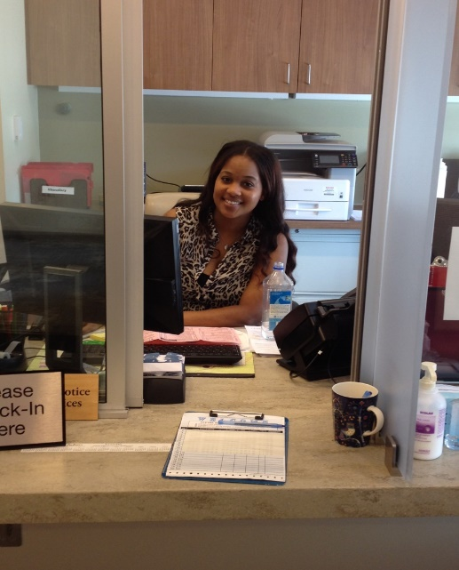
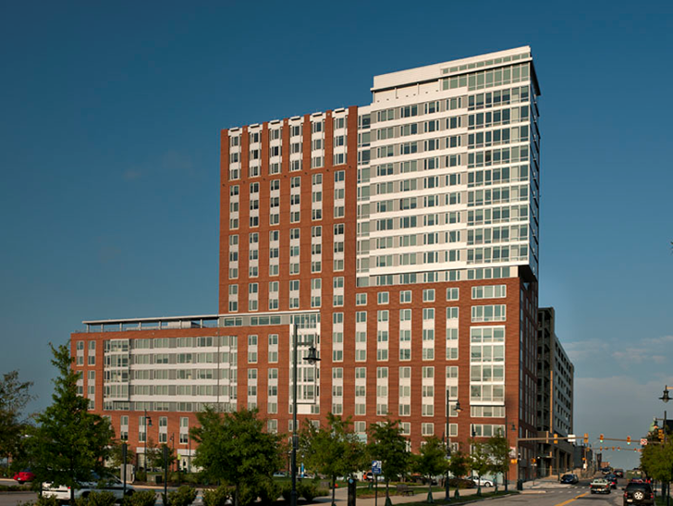
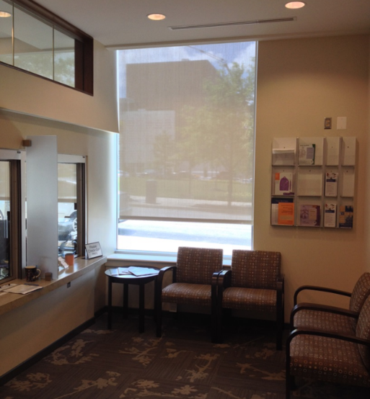
University Health Services
UHS Clinic: 933 N. Wolfe St
Clinical Services
Primary Care
Mental Health
Benefits Office
Health Insurance Plan (EHP/Student Health Program)
Wellness and Health Promotion
https://www.hopkinsmedicine.org/uhs/

Slide 3
UHS Primary Care
Hours
Mon -Fri: 8AM – 5PM
Appt. Line: (410) 955-3250
After Hours Urgent Issues – Call the Johns Hopkins Hospital page operator at 410-955-4331 and ask for the on-call UHS primary care provider.

Slide 4
UHS Primary Care
Acute problems
Routine health maintenance
Basic women’s health (Pap smears, etc.)
Check-ups
Immunizations, except for travel (travel clinic)
Chronic health problems
Limited diagnostic testing: rapid strep test, urine dipstick, urinalysis, glucose
Notes:
Add something about confidentiality

Slide 5
UHS Primary Care
Same/next-day appointments available
Not a walk-in clinic so please call for appointment before visiting
Call early in the morning
Will do our best to get you seen as soon as possible
We may assign a primary care provider for continuity of care

Slide 6
Will I be charged for my visit to UHS?
There is no charge for physician visits
Your insurance will be billed and you may have to pay a copay for:
lab specimens we collect in clinic
prescriptions (at the pharmacy)
You may have to pay for certain vaccines if not covered by your insurance (we will let you know at the time of your visit)

Slide 7
UHS Benefits Office
Benefits/billing manager: Olha Gudesblat, 410-955-3872
Assistance with issues re: billing/insurance payments
Payment for approved travel vaccines for medical school electives
Payment for annual preventive eye exam at Wilmer Eye Institute

Slide 8
Orientation week activities
Health Screening
Review immunity status to measles, mumps, rubella, hepatitis B
May draw titers to verify immunity
Immunize you as needed
Screen for tuberculosis
Must complete requirements prior to contact with patients

Slide 9
University Health Services- Mental Health
Elizabeth Kastelic, MD
Director, UHS Mental Health

Slide 10
University Health Services- Mental Health
Clinic
Clinical Mission
Confidential
Scope of Practice
Notes:
UHS-MH provides confidential outpatient mental health services including psychiatric assessment, medication evaluation and management, and individual goal oriented short term therapy (long term therapy is available if medically indicated). The program provides care and treatment to students with a wide range of mental health concerns including management of chronic and complex psychiatric conditions.
Not in your academic record.
Separate EMR.

Slide 11
Mental Health Services
We Evaluate and Treat:
Anxiety disorders
Mood disorders
Attention Deficit Hyperactivity Disorder (ADHD)
Adjustment disorders
We Do Not Treat:
Active eating disorders
Substance abuse and/or dependence
Situations in which the severity of the condition cannot be appropriately treated in our office setting
Conditions requiring long term therapy unless medically necessary

Slide 12
Mental Health Services Provided
Psychiatric evaluation
Assessment and treatment
Medication management
Individual therapy
Long-term therapy if medically necessary/prescribed by a psychiatrist

Slide 13
How to make an appointment and what to expect?
Call: UHS-Mental Health (410) 955-1892
You will be scheduled for a same day phone triage appointment with a licensed clinician who will conduct a preliminary assessment of your needs.
Following triage, students are scheduled for an in person intake appointment with a psychiatrist, psychotherapist or both as necessary.
Appointments typically within 2 weeks.
Sooner if urgent
Notes:
Transition…..Just as a reminder these services, will not cost you

Slide 14
Will I be charged for my visit to UHS-MH?
Evaluation and therapy on-site covered by the health fee for students and trainees.
Does not cover medications or lab tests.

Slide 15
UHS- MH Hours
Hours
Monday - Friday: 8AM – 5PM
Appt. Line: (410) 955-1892
On-call coverage after hours and on weekend
Please call 410-955-1892, at the end of the message, please press 0, and you will be connected to the Johns Hopkins Paging Operator. Please request the UHS Mental Health on-call psychiatrist to be paged.
Notes:
Phone call and how to get there….

Slide 16
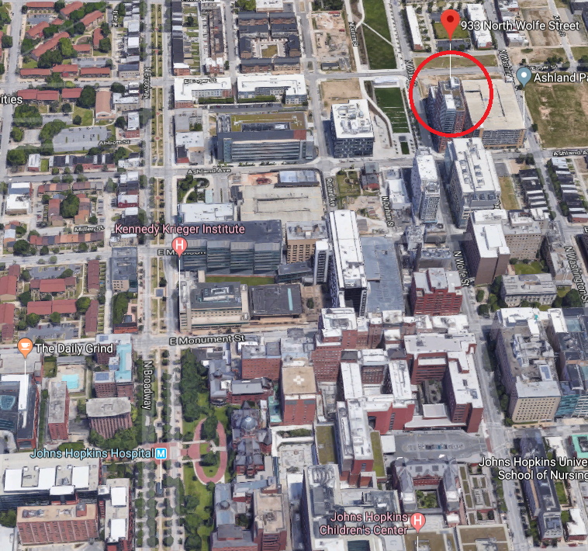
UHS-MH Location
933 N. Wolfe Street (adjacent to the 929 Apartments)
Co-located with Primary Care (UHS-PC)

Slide 17
Contact University Health Services-Mental Health:
410-955-1892
Notes:
Take a picture

