Slide 1
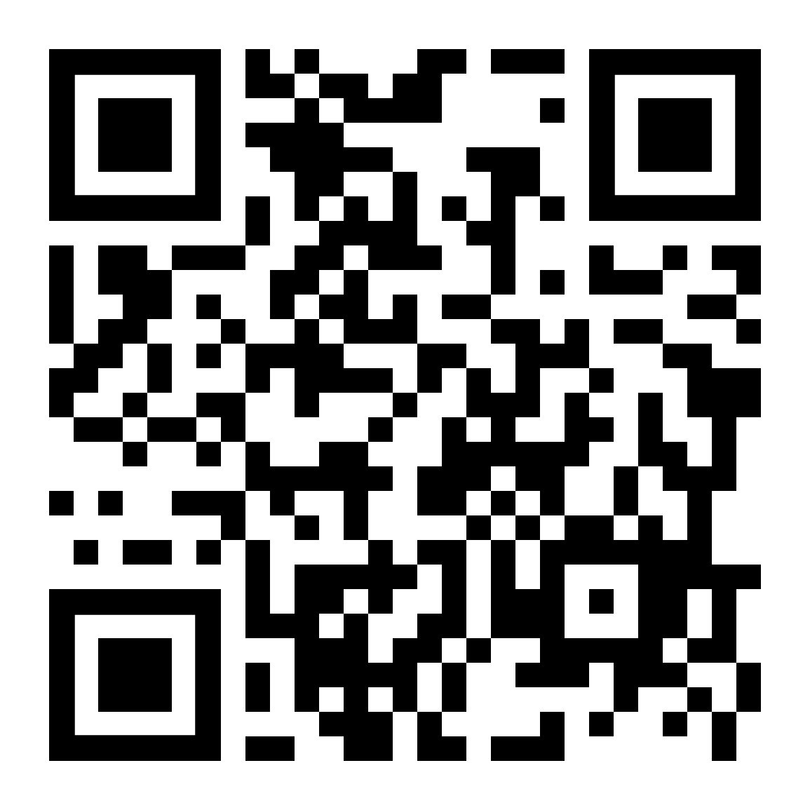
GSA General Body Meeting
Sign In!
March 13th, 2024

Slide 2
Agenda
Approval of Minutes
Presentation by Student Health & Well Being
Funding Request Vote
Officer Announcements
GSA/SOM Committee Announcements
Misc. Announcements

Slide 3
GBM Attendance Survey

Slide 4
Approval of the Minutes
Approving February 2024
Notes:
October and November

Slide 5
Student Health & Well-Being
wellbeing.jhu.edu (410) 516-8000
Notes:
October and November

Slide 6
Funding Request Women of Whiting Women in STEM Symposium 04/20/24
Submission: February 16th for $1000
Purpose: transportation fee/honorarium for the guest speakers and invited keynote speaker
if funds remain, they will go toward poster printing for students attending the symposium
The Women in STEM Symposium is an event highlighting female and minority students, alumni, and leaders in STEM fields, as well as providing an opportunity for students on campus to present their research. This is a valuable academic, professional development, networking, and community-building event for Hopkins students across various schools and divisions, with company representatives and invited speakers and panelists from the broader JHU community and other leaders in STEM. This year, the symposium will be a full-day event with the theme “Empowerment for Career Success.” We will begin with a speaker talking on the building a presence in the workspace. Two 30-minute workshop sessions, and an interactive panel will cover topics helpful in empowerment including negotiation, resilience building, confident speaking, etc. We will wrap up the main sessions with a keynote speaker and conclude with a networking and poster session.

Slide 7
Officer Announcements
President (Rodney)
President Elect (Scarlett)
Director of Administration (Nirvani)
Director of Diversity, Inclusion, and Outreach (Ashley)
Director of Finance (Estefan)
Director of Social and Community Affairs (Mark)
Director of Media and Public Relations (Juliane)
Director of Student Involvement and Student Groups (Edna)
Director of Policy & Strategic Initiatives (Nick)

Slide 8
The Moonflower Gala
Exclusive to GSA-affiliated students!
April 26th, 2024
7:00 PM to 11:00 PM
Dress code: Formal
Venue: The Assembly Room
LIMITED | Nearly sold out
$35 / ticket / Limit: 2 Tickets / person
Allowed to bring (1) additional guest (can be non-affiliated)

Slide 9
Cooley Center Update
Cooley Center replacement space will not be completed until August.
the Cooley Center will remain open until the end of July or early August.
There will be some brief period during which the Cooley Center will be closed, and the new spaces will not yet be open, in order to move equipment out of the Cooley Center and into the new spaces. We anticipate that the closure will be brief.

Slide 10
Graduate Student Teaching Award Finalists
Dr. Harold Lehmann- Biomedical Informatics
Dr. Jennifer Pluznick- CMP & BCMB
Dr. Ashani Weeraratna- CMM
Dr. Amy Bastian- Neuroscience & BME

Slide 11
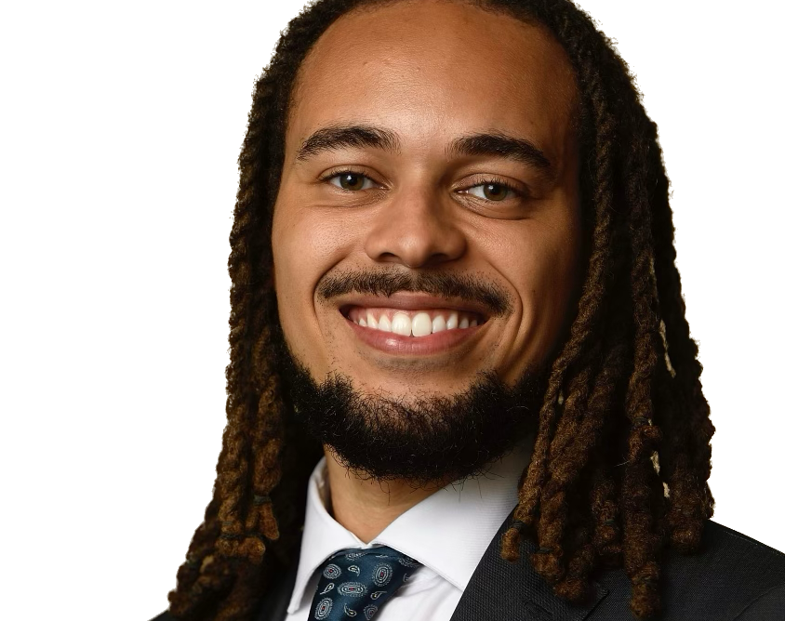
2024 Graduate Student Convocation Speaker
Michael Hopkins
Graduating PhD Candidate
Biochemistry, Cellular & Molecular Biology
Lab of Seth Margolis, PhD

Slide 12
Mentoring Survey
Sent out by Office of Assessment and Evaluation
Each Student Receives an individual link
Takes approximately 10 minutes to complete
Completely anonymous
All students required to completer survey
Deadline to respond is March 15

Slide 13
Officer Announcements
President (Rodney)
President Elect (Scarlett)
Director of Administration (Nirvani)
Director of Diversity, Inclusion, and Outreach (Ashley)
Director of Finance (Estefan)
Director of Social and Community Affairs (Mark)
Director of Media and Public Relations (Juliane)
Director of Student Involvement and Student Groups (Edna)
Director of Policy & Strategic Initiatives (Nick)

Slide 14
GSA Student Spotlight
Purpose: recognize outstanding graduate students for their academic and community-based achievements
Can nominate yourself, or a peer
Didn’t win? Renominate as many times as you would like
Winners will receive a $25 gift card
Info and links to enter can be found on:
Our website: https://jhu.campusgroups.com/gsa/home/
All-grad email notifications
GSA Newsletter
Our social media channels – follow us!

Slide 15
March 2024 GSA Student Spotlight Winners
Irika Sinha
Rodnie Colon-Ortiz
Neuroscience
Neuroscience
Irika is an exceptional advocate for her fellow students. She currently serves as a member of the TRU-UE bargaining committee and has been working to improve the working conditions for all PhD students across the university by donating countless hours of her time to this cause. Furthermore, she has been successful in her career development. She completed an industry internship at Arcus Biosciences to start the year where she brought publicly available genomic perturbation datasets in-house and mined genomic perturbation datasets for relevant cancer target interactions and new target validation.
During this current school year Rodnie has seen exceptional success in scientific endeavors. He has presented his research at multiple conferences. He also recently had some of his PhD work published in his first 1st author publication. "Cocaine regulates antiretroviral therapy CNS access through pregnane-x receptor-mediated drug transporter and metabolizing enzyme modulation at the blood brain barrier" in the Springer Nature Journal, "Fluids and Barriers of the CNS"

Slide 16
Officer Announcements
President (Rodney)
President Elect (Scarlett)
Director of Administration (Nirvani)
Director of Diversity, Inclusion, and Outreach (Ashley)
Director of Finance (Estefan)
Director of Social and Community Affairs (Mark)
Director of Media and Public Relations (Juliane)
Director of Student Involvement and Student Groups (Edna)
Director of Policy & Strategic Initiatives (Nick)

Slide 17
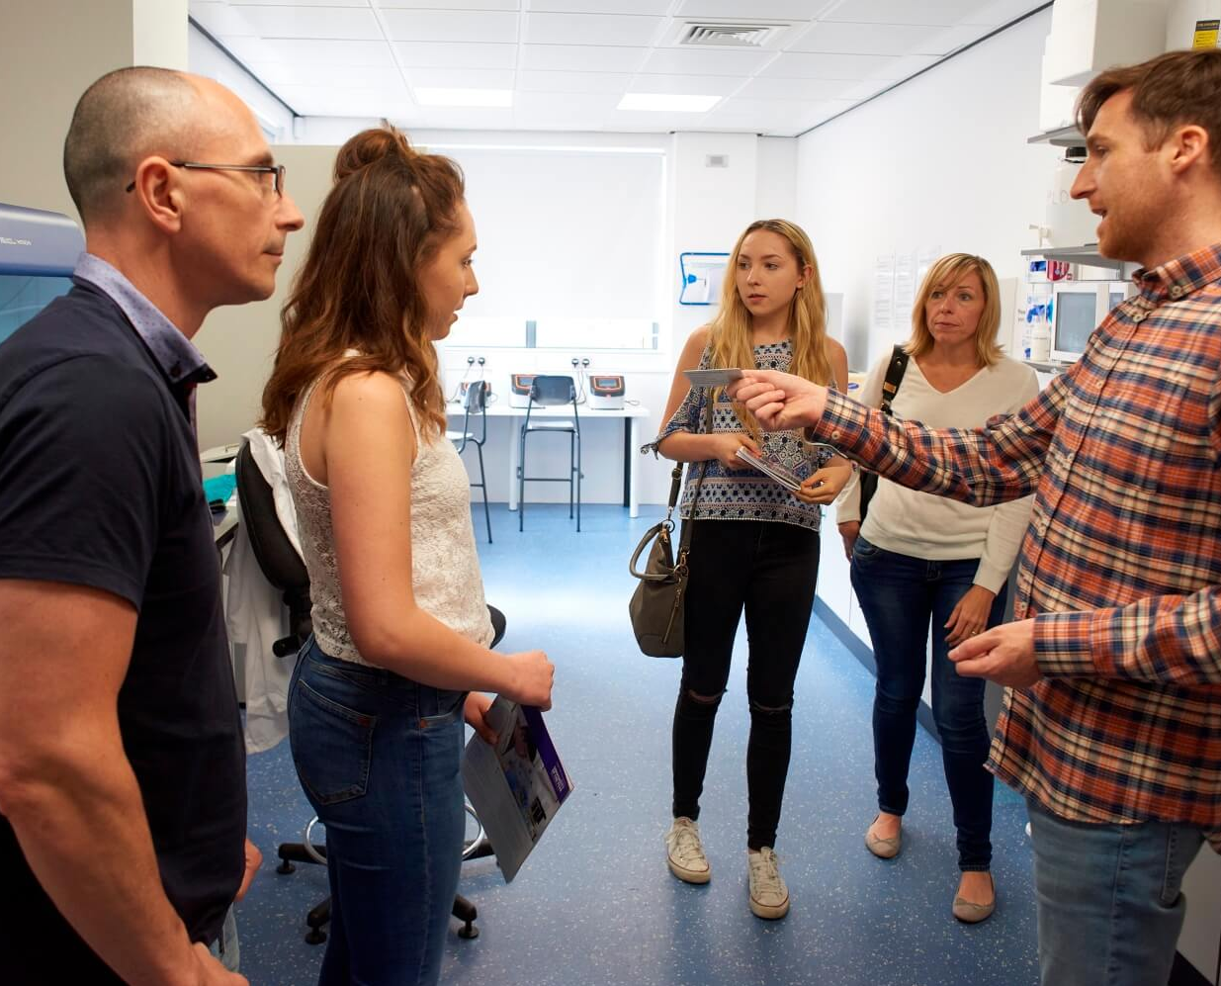
Second Look/
Accepted Applicants' Visit
Thursday, March 26th (virtually)
The invitation has been sent out
A Slack channel was created for current and prospective students: https://join.slack.com/t/jhu-ef88409/shared_invite/zt-2dpjghb0n-4wJohIYs9dl4fawDqHiZUQ

Slide 18
Update from CSAC
OneHop
Cross campus cooperation
Stellic

Slide 19
What is OneHop? and Why?
A platform for current students to connect with alumni mentors
Networking
Better response rate than others
(OneHop: 65%; LinkedIn: at most 25%)
Only students can reach out
Can set the preference on different aspects
Better quality of mentorship

Slide 20
Go to onehop.jhu.edu on your phone
Click “SIGN IN”
Login with your JHED ID

Slide 21
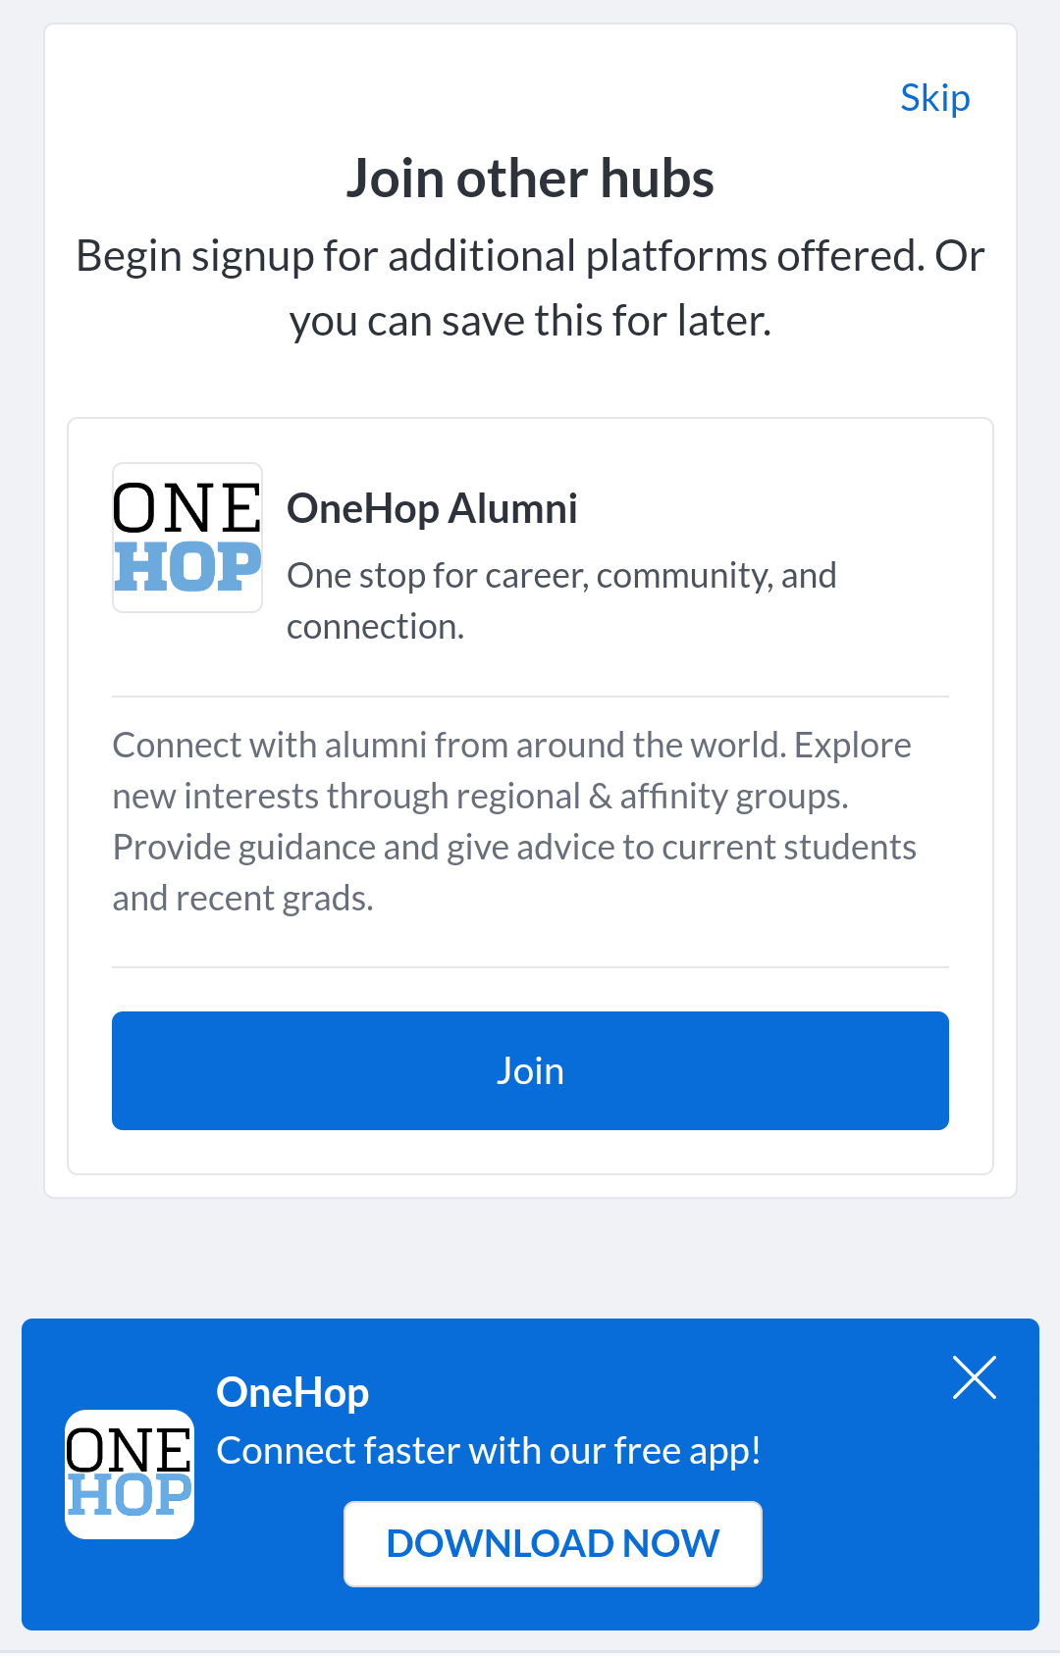
There will be a pop-up message suggesting you download the app
Click “DOWNLOAD NOW”
(The link will sense your device and download either ios or android app on your phone)

Slide 22
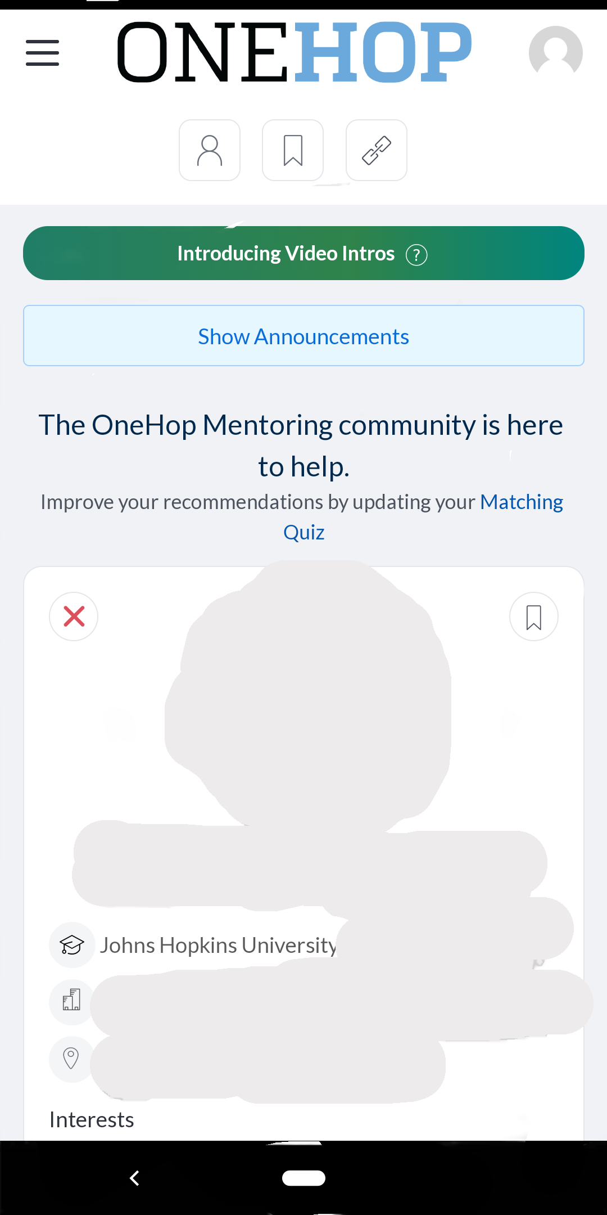
The suggested alumni profiles will be on the home page
Can contact them immediately or bookmarked them and do it later

Slide 23
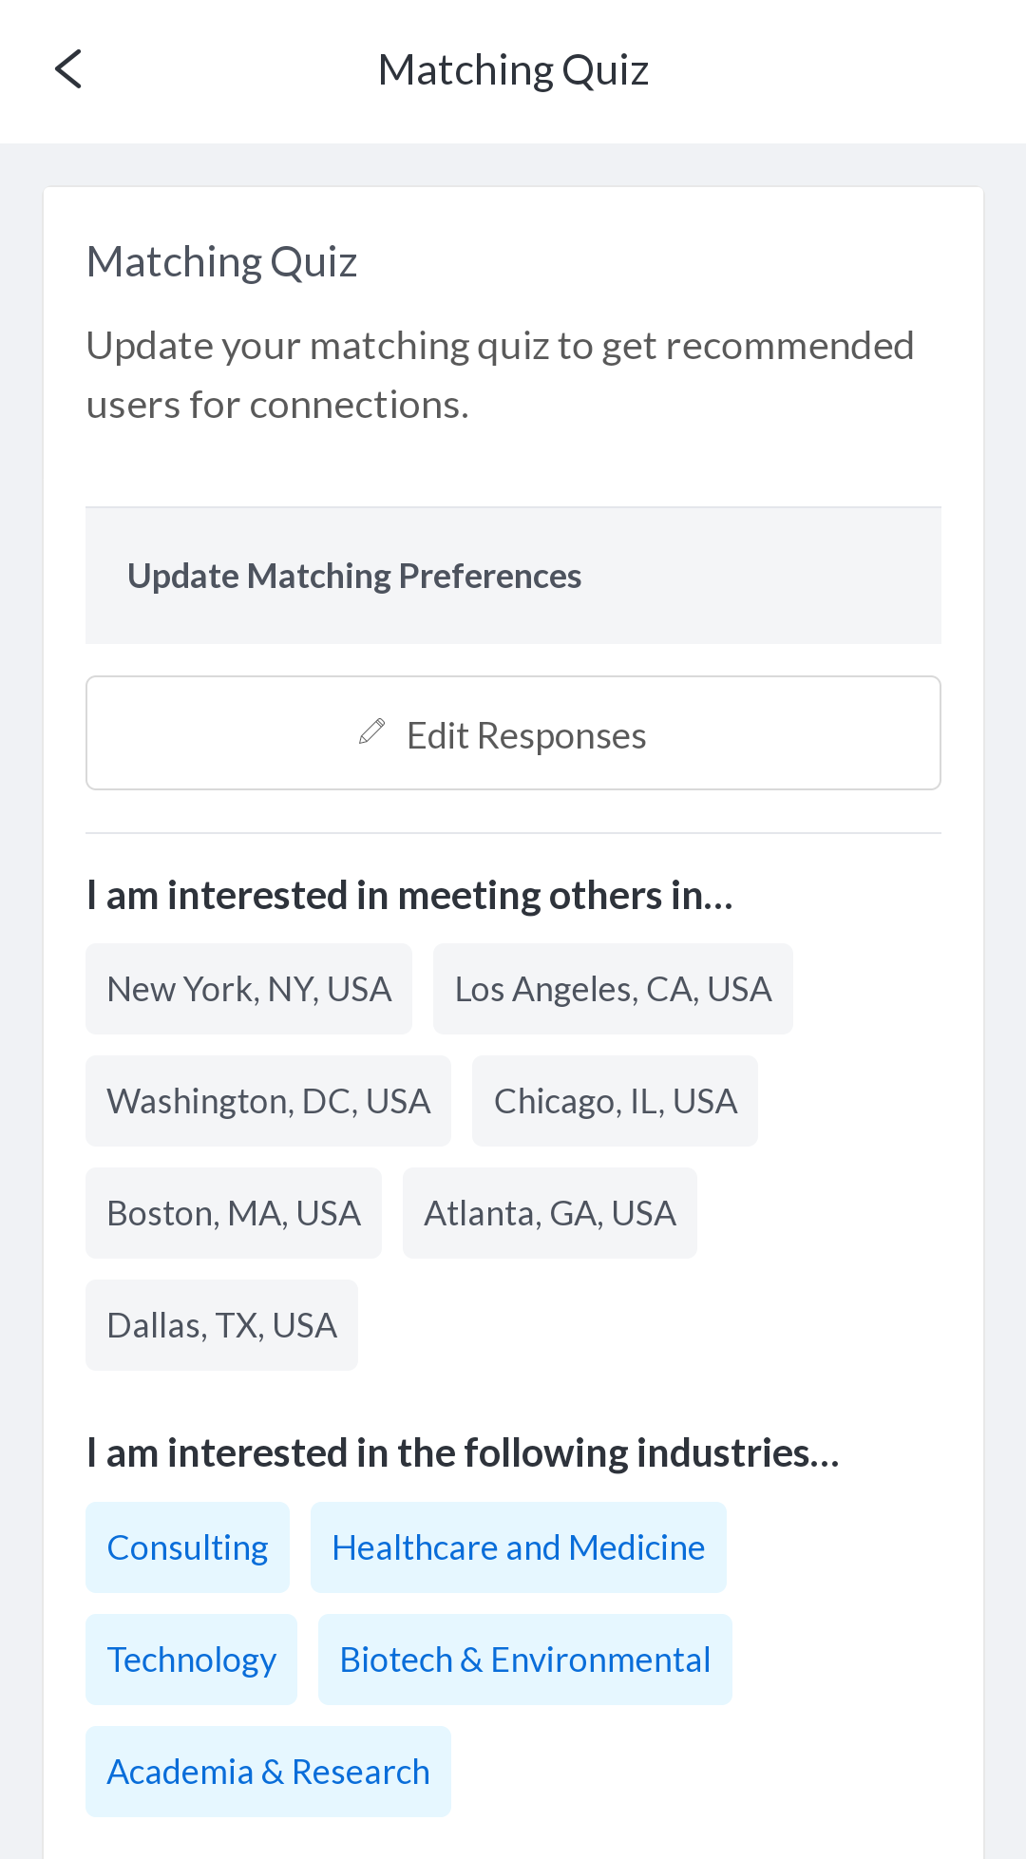
You can set the preference on the location, industries and topics of the jobs for the alumni recommendations

Slide 24
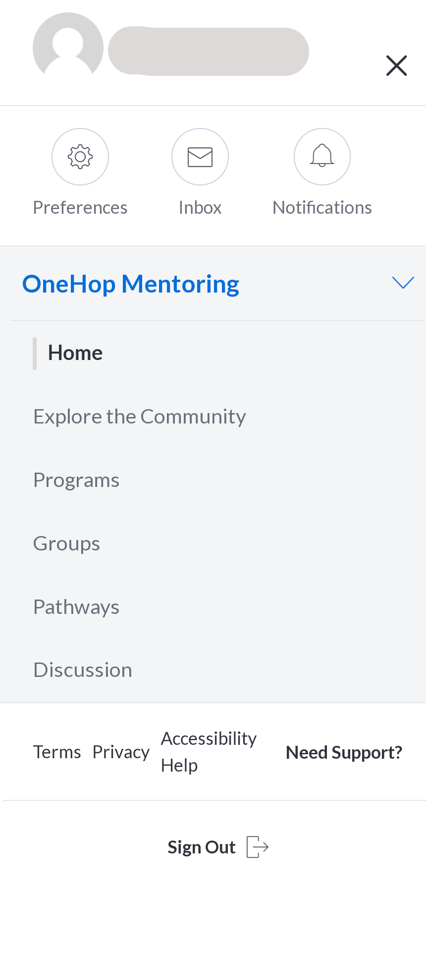
Click here
Swipe up

Slide 25
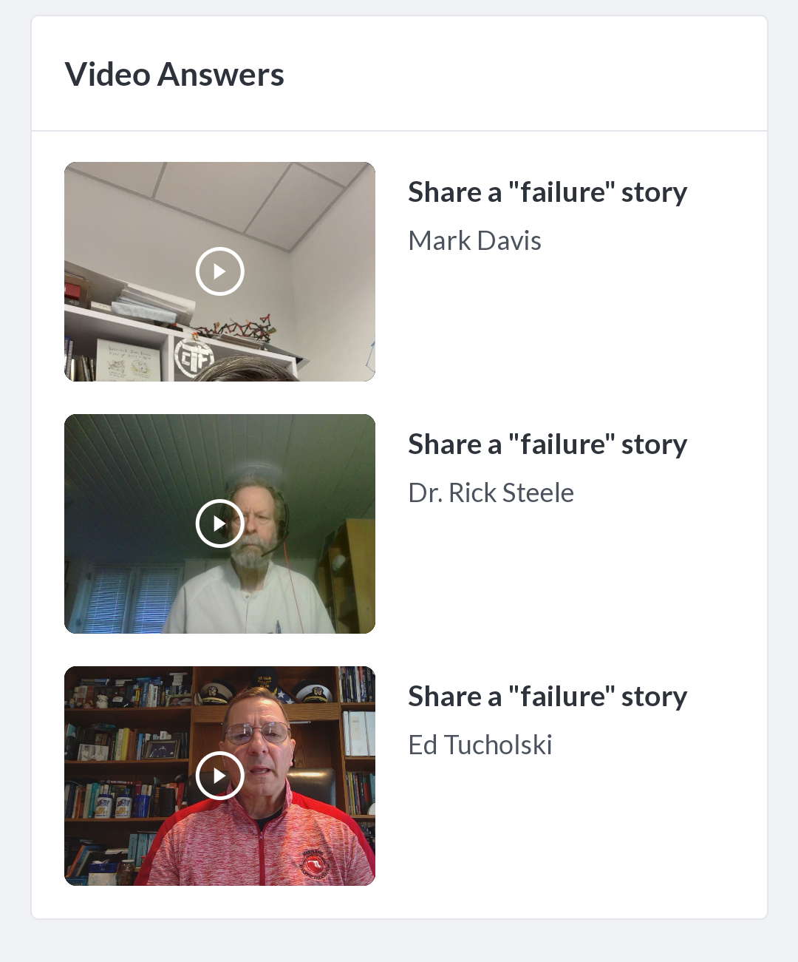
There
Some of common questions have been addressed and recorded
Some failure stories are shared so you can learn from others’ experience

Slide 26
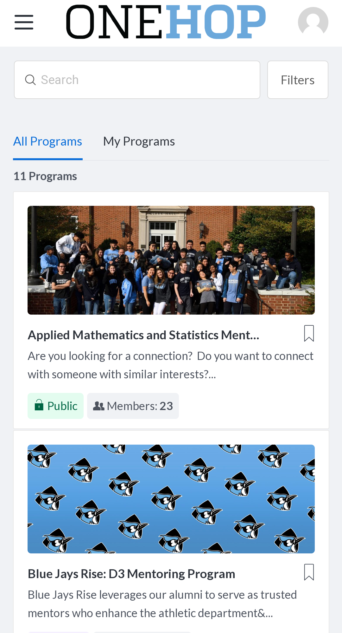
Usually organized by schools
Less formal
Make more connections at once
Can learn from others who is in the same stage

Slide 27
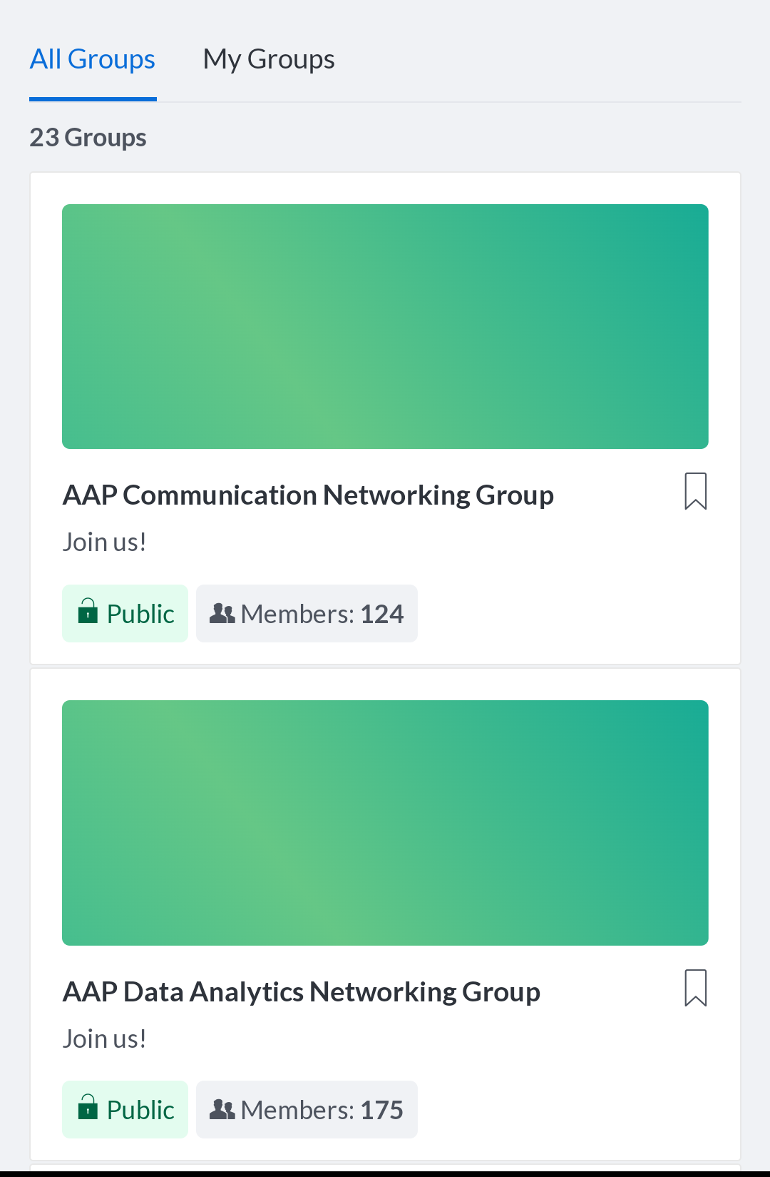
Could be organized by anyone
Networking

Slide 28
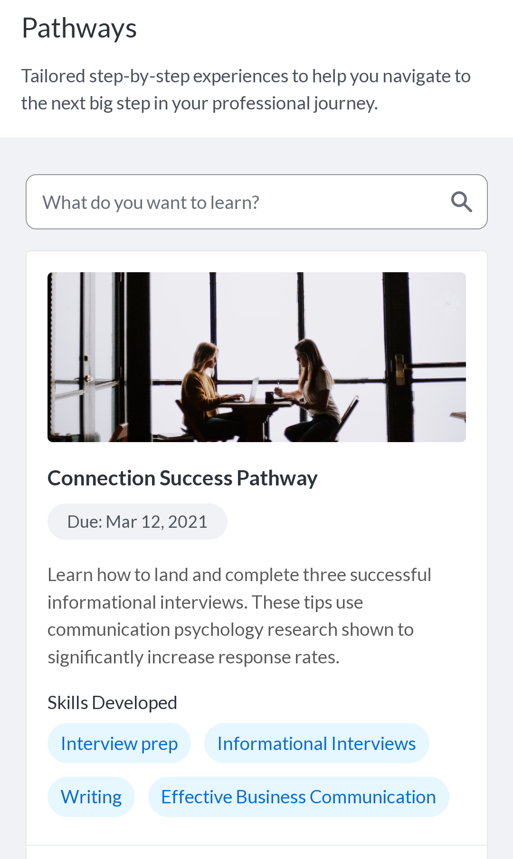
Suggested learning process
How to write a resume
How to prepare for an interview
... ,etc.

Slide 29
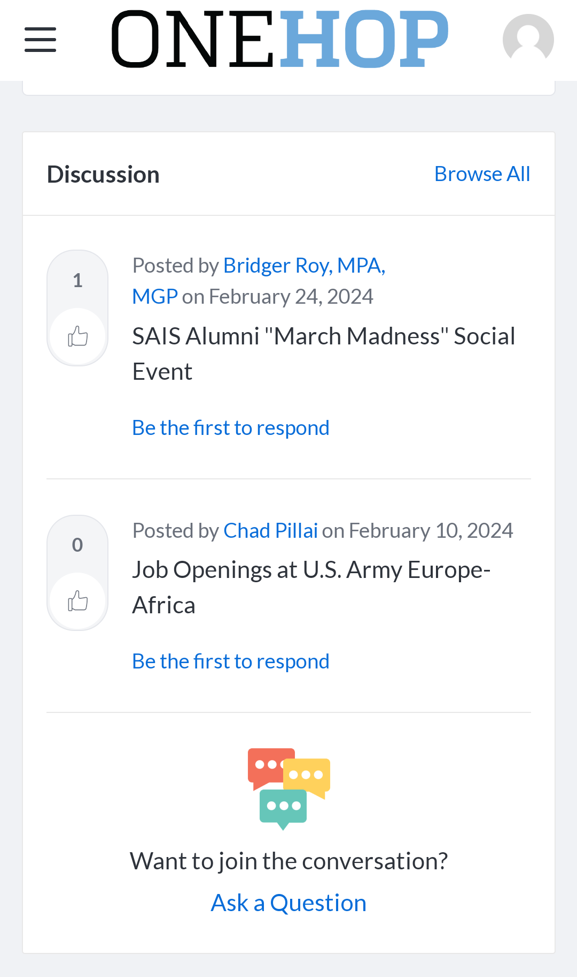
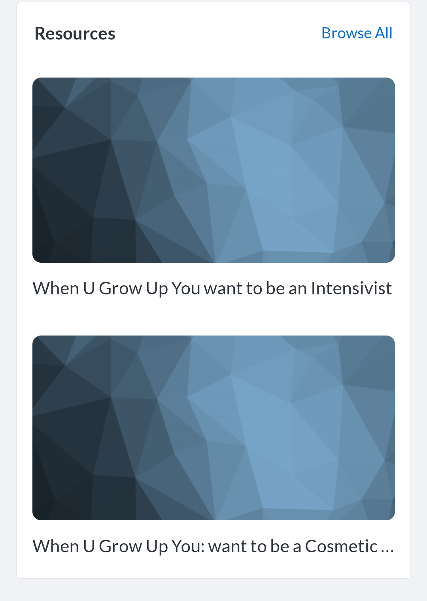
Posts, Podcasts, etc.

Slide 30
Cross-campus cooperation
Financial supports for the social events across campus
Transparency of active student groups from all campuses
Mentoring program
(Undergrads : Grad students = 2:1)

Slide 31
Stellic
Help students plan and track their path to completion
(Degree audit, course evaluation, available class from other campuses, etc.)
Shifting to the new platform since last July

Slide 32
Cross-Institutional Student Advisory Committee (CSAC)
A university-wide advisory body for undergraduate and graduate students
To discuss academic and co-curricular matters of broad interest to the university community
Next meeting date: 3/27
- Please send your suggestions/advice/questions to ychen401@jhmi.edu by 3/22 (Fri)

Slide 33
Officer Announcements
President (Rodney)
President Elect (Scarlett)
Director of Administration (Nirvani)
Director of Diversity, Inclusion, and Outreach (Ashley)
Director of Finance (Estefan)
Director of Social and Community Affairs (Mark)
Director of Media and Public Relations (Juliane)
Director of Student Involvement and Student Groups (Edna)
Director of Policy & Strategic Initiatives (Nick)

Slide 34
Travel Awards
Final Travel Awards of this fiscal year.
Same rules as last time, with due date being April 1st
Must report receipts before June 30th [end of fiscal year]
Please also consider applying for diversity award

Slide 35
Reminder: We have online resources!
Thanks to the e-boards efforts, we have a webpage dedicated towards Tax and Finance!
Includes:
FAQ Stream with an established accountant
Internal and external resources to help with managing finances and saving a few bucks
Information sessions and webinars
More
Link to location provided here

Slide 36
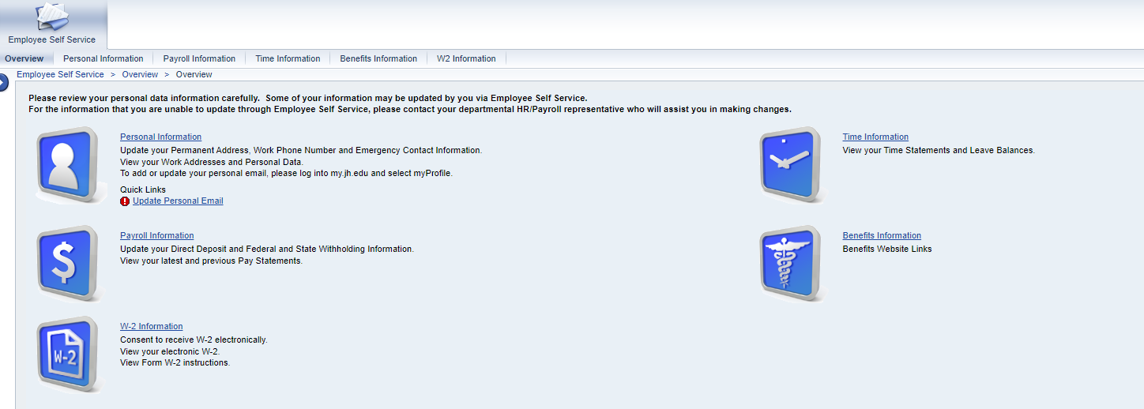
2023 W2 Tax Forms now available
Now available on ESS

Slide 37
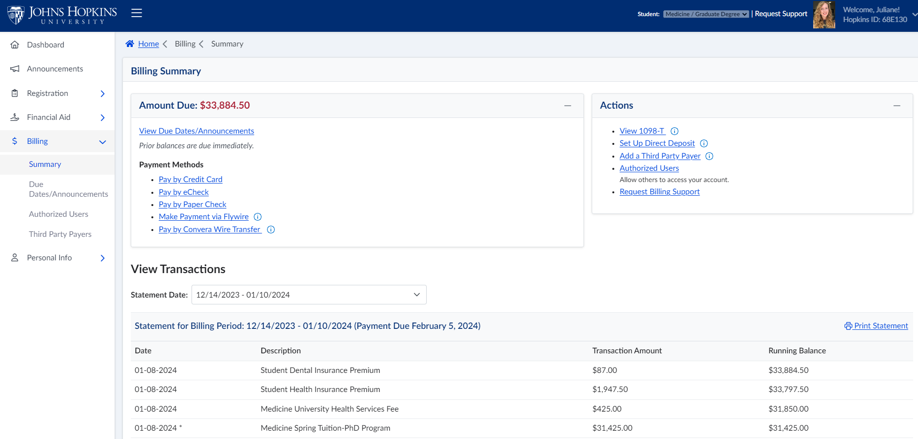
2023 1098T Tax Forms
Now available on SIS

Slide 38
Officer Announcements
President (Rodney)
President Elect (Scarlett)
Director of Administration (Nirvani)
Director of Diversity, Inclusion, and Outreach (Ashley)
Director of Finance (Estefan)
Director of Social and Community Affairs (Mark)
Director of Media and Public Relations (Juliane)
Director of Student Involvement and Student Groups (Edna)
Director of Policy & Strategic Initiatives (Nick)

Slide 39
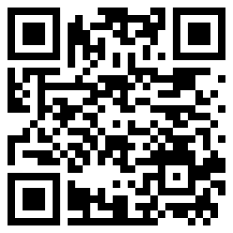
JHU at the DC Blossoms
SOM x SON x SOPH x Homewood
March 30th, 2024
9:30 AM to 4:00 PM
50 MARC train tickets available for School of Medicine
Baltimore's Penn Station to DC's Union Station
RSVP on HopkinsGroups for a ticket!
More information on the HopkinsGroup page!

Slide 40
Officer Announcements
President (Rodney)
President Elect (Scarlett)
Director of Administration (Nirvani)
Director of Diversity, Inclusion, and Outreach (Ashley)
Director of Finance (Estefan)
Director of Social and Community Affairs (Mark)
Director of Media and Public Relations (Juliane)
Director of Student Involvement and Student Groups (Edna)
Director of Policy & Strategic Initiatives (Nick)

Slide 41
Officer Announcements
President (Rodney)
President Elect (Scarlett)
Director of Administration (Nirvani)
Director of Diversity, Inclusion, and Outreach (Ashley)
Director of Finance (Estefan)
Director of Social and Community Affairs (Mark)
Director of Media and Public Relations (Juliane)
Director of Student Involvement and Student Groups (Edna)
Director of Policy & Strategic Initiatives (Nick)

Slide 42
Officer Announcements
President (Rodney)
President Elect (Scarlett)
Director of Administration (Nirvani)
Director of Diversity, Inclusion, and Outreach (Ashley)
Director of Finance (Estefan)
Director of Social and Community Affairs (Mark)
Director of Media and Public Relations (Juliane)
Director of Student Involvement and Student Groups (Edna)
Director of Policy & Strategic Initiatives (Nick)

Slide 43
Announcements
SOM Committees
Program Reps/Student Groups
Misc.

Slide 44
THANK YOU!
@jhmi.gsa
Johns Hopkins Medicine GSA
@jhmi_gsa
jhu.campusgroups.com/gsa

