Slide 1
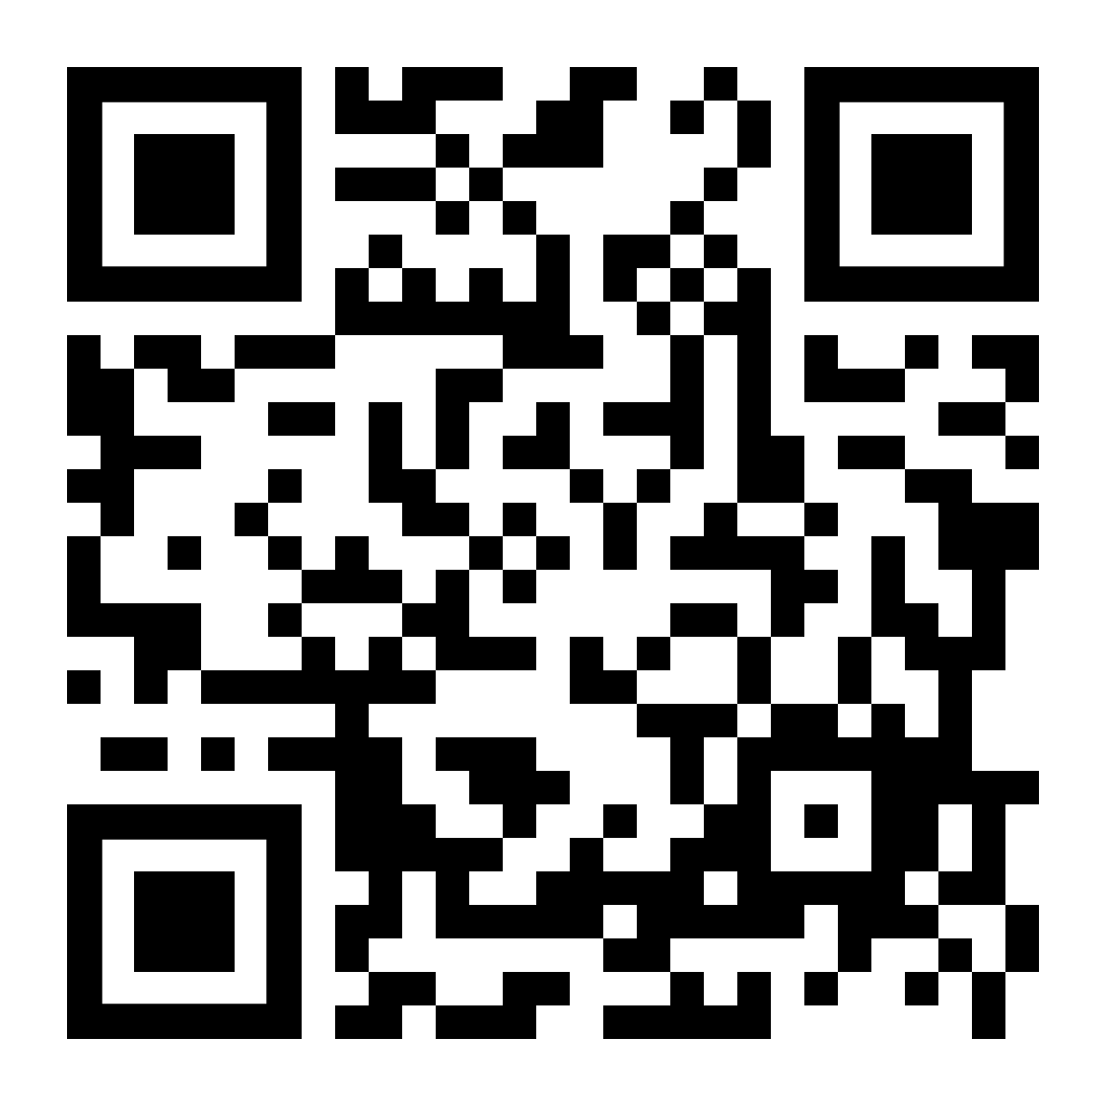
GSA General Body Meeting
Sign In!
February 14th, 2024

Slide 2
Agenda
Approval of Minutes
Officer Announcements
GSA/SOM Committee Announcements
Misc. Announcements

Slide 3
GBM Attendance Survey

Slide 4
Approval of the Minutes
Approving January 2024
Notes:
October and November

Slide 5
Officer Announcements
President (Rodney)
President Elect (Scarlett)
Director of Administration (Nirvani)
Director of Diversity, Inclusion, and Outreach (Ashley)
Director of Finance (Estefan)
Director of Social and Community Affairs (Mark)
Director of Media and Public Relations (Juliane)
Director of Student Involvement and Student Groups (Edna)
Director of Policy & Strategic Initiatives (Nick)

Slide 6
New Leave of Absence Policy
New Leave of Absence Policy Effective 01/22/2024
Changes the leave of absence approval process
Does not apply to students who are actively on an LOA
Supersedes previous school/division based policies for LOA
SOM Grad Students will retain their health insurance for up to 12 months

Slide 7
Voluntary Leave of Absence
1. In order to request a Voluntary LOA, Covered Students must consult first with either their academic advisors and/or Dean as well as financial aid advisors and international student services advisors, as applicable.
2. After consulting with appropriate school officials, Covered Students must submit the standardized University Leave Request Form – and any additional information required by the relevant school– to be reviewed by the Dean.
3. The relevant school’s policy on tuition and fees refunds will apply to the Covered Student.
4. International Covered Students must notify the Office of International Services (“OIS”) of their LOA so that OIS can appropriately advise regarding visa implications.
5. Covered Students in receipt of financial aid must consult with the Office of Financial Aid to discuss the impact of an LOA on their financial aid.

Slide 8
Required Leave of Absence
In rare instances, the University may require a student to take a Required LOA. These instances may occur in circumstances where a Covered Student presents an imminent threat of harm to the Covered Student, another Covered Student(s) and/or any member of the University Community, and/or when a Covered Student experiences health conditions that cannot be addressed under the scope of reasonable accommodations and require a level of care that exceeds what the University can appropriately provide. In situations that meet the criteria below, and in which a student has not chosen to request a medical Voluntary LOA, the University may require an LOA pending an Individualized Assessment of the Covered Student.

Slide 9
New Student Vaccination Policy
Effective for all incoming students.
Mandatory vaccination requirements are as follows:
1. Non-Clinical Students except those at SON:
Vaccines required prior to arrival on campus:
• MMR vaccine/titers
• TDaP vaccine (Tetanus, Diphtheria, and Acellular Pertussis)
• Varicella vaccine/titers/history
• Tuberculosis screening (if applicable)
• Meningococcal vaccine required by state law only for on-campus students
COVID-19 Vaccine
Vaccines required annually as an ongoing enrollment requirement:
• Influenza vaccine*
Both Clinical Students and Non-Clinical Students at SOM will continue to follow Johns Hopkins Medicine vaccination policies for COVID-19 and influenza.

Slide 10
Important Surveys

Slide 11
Mentoring Survey
Sent out by Office of Assessment and Evaluation
Each Student Receives an individual link
Takes approximately 10 minutes to complete
Completely anonymous
All students required to completer survey
Deadline to respond is March 15

Slide 13
Officer Announcements
President (Rodney)
President Elect (Scarlett)
Director of Administration (Nirvani)
Director of Diversity, Inclusion, and Outreach (Ashley)
Director of Finance (Estefan)
Director of Social and Community Affairs (Mark)
Director of Media and Public Relations (Juliane)
Director of Student Involvement and Student Groups (Edna)
Director of Policy & Strategic Initiatives (Nick)

Slide 14
GSA Student Spotlight
Purpose: recognize outstanding graduate students for their academic and community-based achievements
Can nominate yourself, or a peer
Didn’t win? Renominate as many times as you would like
Winners will receive a $25 gift card
Info and links to enter can be found on:
Our website: https://jhu.campusgroups.com/gsa/home/
All-grad email notifications
GSA Newsletter
Our social media channels – follow us!

Slide 15
February 2024 GSA Student Spotlight Winners
Katie Irwin
Sydney Shannon
Neuroscience
Biomedical Engineering
Recently, Katie’s study identifying a novel biomarker for TDP-43 dysfunction measurable in patient biofluids was published! (doi: 10.1038/s41591-023-02788-5). Neurodegenerative diseases such as ALS include pathology of TDP-43 in patient samples but no cure or useful biomarkers yet exist. This biomarker is detectable in both CSF and blood and there is future potential for it to diagnose people with TDP-43-related diseases early!
In the Fall term, I was awarded the NIH Ruth L. Kirschstein Predoctoral Individual National Research Service Award (F31 award) for my proposal entitled "Tri-Signal Artificial Antigen Presenting Cells for Cancer Immunotherapy". I worked really really hard on this grant application for almost 6 months, so it felt very rewarding to get it!

Slide 16
Officer Announcements
President (Rodney)
President Elect (Scarlett)
Director of Administration (Nirvani)
Director of Diversity, Inclusion, and Outreach (Ashley)
Director of Finance (Estefan)
Director of Social and Community Affairs (Mark)
Director of Media and Public Relations (Juliane)
Director of Student Involvement and Student Groups (Edna)
Director of Policy & Strategic Initiatives (Nick)

Slide 17
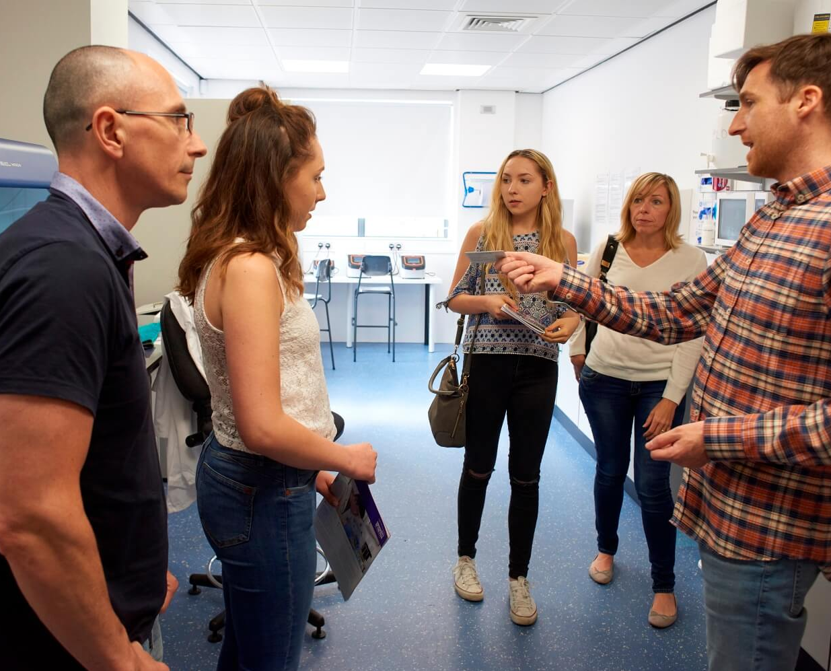
Second Look/
Accepted Applicants' Visit
Thursday, March 26th (virtually)
All accepted PhD applicants will be invited
University-wide event
- In partnership with the Schools of Nursing, Public Health, Krieger School of Arts and Sciences, the Whiting School of Engineering, the School of Education and the Vivien Thomas Scholars Initiative
Keynote speaker: Dr. Robert Drummond
(SOM MD/PhD alum)
Agenda will be shared with program managers in early March

Slide 18
Cross-Institutional Student Advisory Committee
A university-wide advisory body for undergraduate and graduate students
To discuss academic and co-curricular matters of broad interest to the university community
Next meeting date: 2/28
- Please send your suggestions/advice/questions to ychen401@jhmi.edu by 2/23 (Fri)

Slide 19
Officer Announcements
President (Rodney)
President Elect (Scarlett)
Director of Administration (Nirvani)
Director of Diversity, Inclusion, and Outreach (Ashley)
Director of Finance (Estefan)
Director of Social and Community Affairs (Mark)
Director of Media and Public Relations (Juliane)
Director of Student Involvement and Student Groups (Edna)
Director of Policy & Strategic Initiatives (Nick)

Slide 20
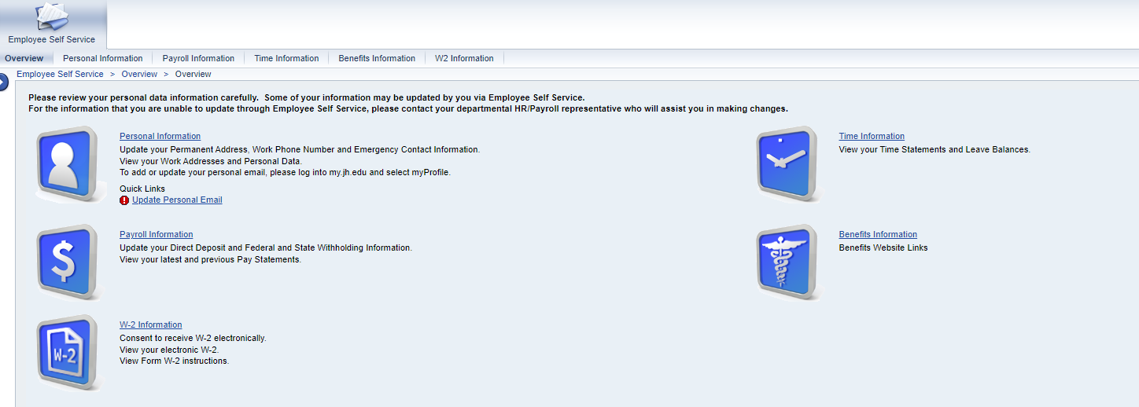
2023 W2 Tax Forms now available
Now available on ESS

Slide 21
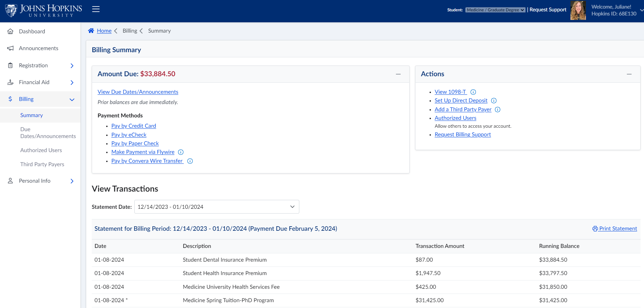
2023 1098T Tax Forms
Now available on SIS

Slide 22
Officer Announcements
President (Rodney)
President Elect (Scarlett)
Director of Administration (Nirvani)
Director of Diversity, Inclusion, and Outreach (Ashley)
Director of Finance (Estefan)
Director of Social and Community Affairs (Mark)
Director of Media and Public Relations (Juliane)
Director of Student Involvement and Student Groups (Edna)
Director of Policy & Strategic Initiatives (Nick)

Slide 23
The Moonflower Gala
Exclusive to GSA-affliated students!
April 19th, 2024
6:00 PM to 10:00 PM
Dress code: Formal
Venue: Rita Rossi Colwell Center
Limited ticket availability | 250 tickets
$30 / ticket / Limit: 2 Tickets / person
Allowed to bring (1) additional guest (can be non-affliated)

Slide 24
Officer Announcements
President (Rodney)
President Elect (Scarlett)
Director of Administration (Nirvani)
Director of Diversity, Inclusion, and Outreach (Ashley)
Director of Finance (Estefan)
Director of Social and Community Affairs (Mark)
Director of Media and Public Relations (Juliane)
Director of Student Involvement and Student Groups (Edna)
Director of Policy & Strategic Initiatives (Nick)

Slide 25
Officer Announcements
President (Rodney)
President Elect (Scarlett)
Director of Administration (Nirvani)
Director of Diversity, Inclusion, and Outreach (Ashley)
Director of Finance (Estefan)
Director of Social and Community Affairs (Mark)
Director of Media and Public Relations (Juliane)
Director of Student Involvement and Student Groups (Edna)
Director of Policy & Strategic Initiatives (Nick)

Slide 26
Officer Announcements
President (Rodney)
President Elect (Scarlett)
Director of Administration (Nirvani)
Director of Diversity, Inclusion, and Outreach (Ashley)
Director of Finance (Estefan)
Director of Social and Community Affairs (Mark)
Director of Media and Public Relations (Juliane)
Director of Student Involvement and Student Groups (Edna)
Director of Policy & Strategic Initiatives (Nick)

Slide 27
Announcements
SOM Committees
Program Reps/Student Groups
Misc.

Slide 28
THANK YOU!
@jhmi.gsa
Johns Hopkins Medicine GSA
@jhmi_gsa
jhu.campusgroups.com/gsa

