Slide 1
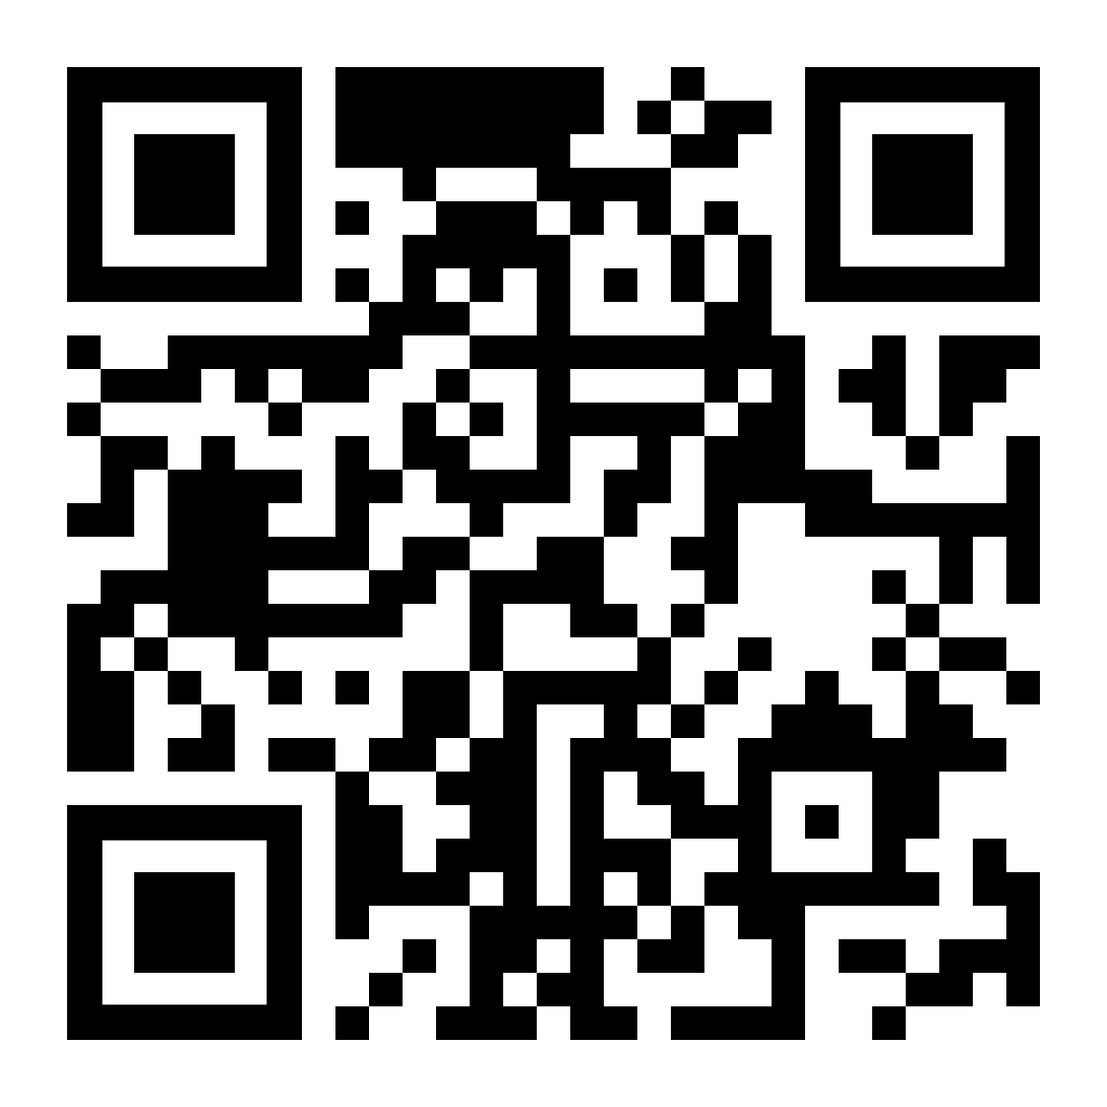
GSA General Body Meeting
Sign In!
January 17th, 2024

Slide 2
Agenda
Approval of Minutes
Presentation- Dr. Doug Dluzen, Director of PDCO
Officer Announcements
GSA/SOM Committee Announcements
Misc. Announcements

Slide 3
GBM Attendance Survey

Slide 4
Approval of the Minutes
Approving December 2023
Notes:
October and November

Slide 5
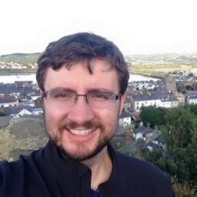
Dr. Doug Dluzen (He/Him)
Director, Professional Development and Careers Office
Email: sabine@jhu.edu
Notes:
October and November

Slide 6
Officer Announcements
President (Rodney)
President Elect (Scarlett)
Director of Administration (Nirvani)
Director of Diversity, Inclusion, and Outreach (Ashley)
Director of Finance (Estefan)
Director of Social and Community Affairs (Mark)
Director of Media and Public Relations (Juliane)
Director of Student Involvement and Student Groups (Edna)
Director of Policy & Strategic Initiatives (Nick)

Slide 7
Officer Announcements
President (Rodney)
President Elect (Scarlett)
Director of Administration (Nirvani)
Director of Diversity, Inclusion, and Outreach (Ashley)
Director of Finance (Estefan)
Director of Social and Community Affairs (Mark)
Director of Media and Public Relations (Juliane)
Director of Student Involvement and Student Groups (Edna)
Director of Policy & Strategic Initiatives (Nick)

Slide 8
GSA Student Spotlight
Purpose: recognize outstanding graduate students for their academic and community-based achievements
Can nominate yourself, or a peer
Didn’t win? Renominate as many times as you would like
Winners will receive a $25 gift card
Info and links to enter can be found on:
Our website: https://jhu.campusgroups.com/gsa/home/
All-grad email notifications
GSA Newsletter
Our social media channels – follow us!

Slide 9
January 2024 GSA Student Spotlight Winners
Afrooz Razi
Atika Syeda
Human Genetics
Neuroscience
Afrooz Razi has had outstanding academic achievements during the past year including 1 first author publication alongside 2 middle author publications. She has presented her work in multiple conferences such as American Society of Human Genetics (ASHG), Bioconductor Conference (BioC), Human and mammalian genetics and genomics: The 64th McKusick short course, and Johns Hopkins Single Cell Symposium. She has developed her mentoring and teaching skills by directly mentoring 1 master student and becoming a Teaching Assistant for a graduate level course. In addition, she has been actively involved in diversifying the Bioconductor community by being a co-organizer at R-Ladies Baltimore.
I recently published a paper in Nature Neuroscience on Facemap, a tool using deep neural networks to link mouse facial movements to brain activity. Facemap accurately tracks 13 key points on a mouse's face, representing behaviors like whisking and grooming. Facemap outperforms previous methods, predicting twice as much neural activity in the visual cortex. Facemap is user-friendly and freely available on Github for other researchers offering an advancement in understanding brain-wide signals. More details can be found on: https://www.janelia.org/news/reading-the-mouse-mind-from-its-face-new-tool-decodes-neural-activity-using-facial-movements

Slide 10
Officer Announcements
President (Rodney)
President Elect (Scarlett)
Director of Administration (Nirvani)
Director of Diversity, Inclusion, and Outreach (Ashley)
Director of Finance (Estefan)
Director of Social and Community Affairs (Mark)
Director of Media and Public Relations (Juliane)
Director of Student Involvement and Student Groups (Edna)
Director of Policy & Strategic Initiatives (Nick)

Slide 11
Officer Announcements
President (Rodney)
President Elect (Scarlett)
Director of Administration (Nirvani)
Director of Diversity, Inclusion, and Outreach (Ashley)
Director of Finance (Estefan)
Director of Social and Community Affairs (Mark)
Director of Media and Public Relations (Juliane)
Director of Student Involvement and Student Groups (Edna)
Director of Policy & Strategic Initiatives (Nick)

Slide 12
Travel Awards have come and gone...for now.
We (Finance Committee) had finished receiving this period's round of applications, and we are currently deciding the winners.
The next Travel Awards period will be for April 1st and will extend up to June 30th.
Link to website is here
Questions?

Slide 13
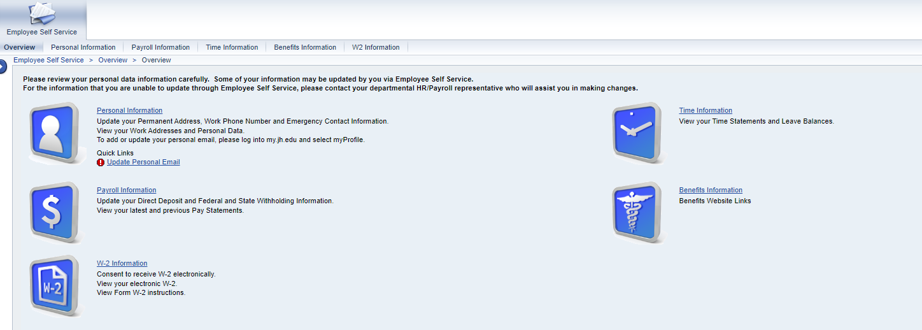
2023 W2 Tax Forms now available
If you signed up for electronic W2 delivery, they are available on ESS starting from 1/11/2024

Slide 14
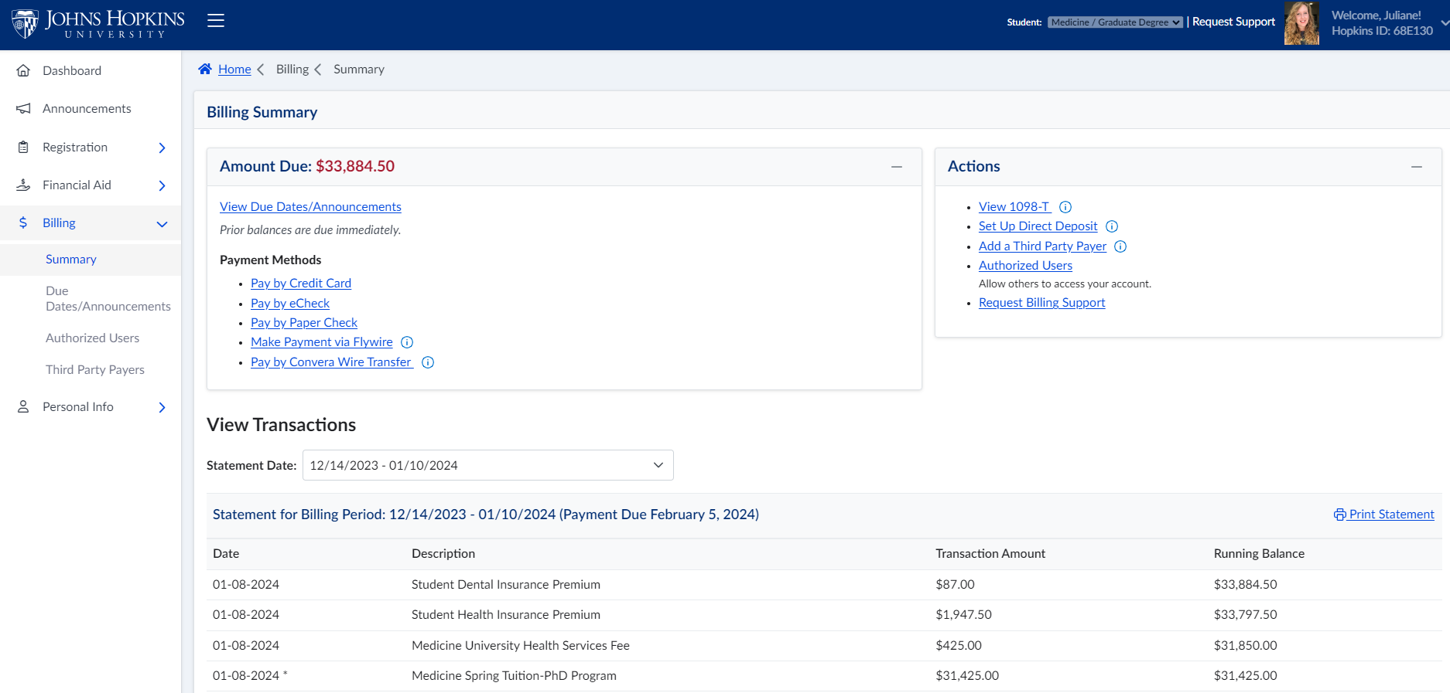
2023 1098T Tax Forms not yet available...but...
Coming soon! Can be found on SIS when available

Slide 15
Welch Library Advertisement!
I am helping the Welch library better develop its communications with the SOM student body.
We have plans in store for doing this
I am also gathering potential ideas and thoughts from everyone.
Have some ideas/want to voice some opinions? Please contact me at my student email: esanti1@jhmi.edu

Slide 16
Officer Announcements
President (Rodney)
President Elect (Scarlett)
Director of Administration (Nirvani)
Director of Diversity, Inclusion, and Outreach (Ashley)
Director of Finance (Estefan)
Director of Social and Community Affairs (Mark)
Director of Media and Public Relations (Juliane)
Director of Student Involvement and Student Groups (Edna)
Director of Policy & Strategic Initiatives (Nick)

Slide 17
Spring Formal Announcement
Plan ahead and get excited!
Will occur in the month of April
Limited ticket availability on HopkinsGroup
Ticket sales date and venue to be announced at a later date! whoa
GSA-exclusive event
Allowed to bring one (1) additional guest (can be non-Hopkins affiliated)
Volunteer sign-ups to be posted soon!

Slide 18
Valentines Cupid Social
Is that up dog in the air?
February 14th, 2024 | Wednesday
12:00 PM – 1:00 PM
GSA Student Lounge
Free food, crafts, and fun ❤︎
GSA-exclusive and limited availability
Sign up on HopkinsGroup starting February 1st!

Slide 19
Officer Announcements
President (Rodney)
President Elect (Scarlett)
Director of Administration (Nirvani)
Director of Diversity, Inclusion, and Outreach (Ashley)
Director of Finance (Estefan)
Director of Social and Community Affairs (Mark)
Director of Media and Public Relations (Juliane)
Director of Student Involvement and Student Groups (Edna)
Director of Policy & Strategic Initiatives (Nick)

Slide 20
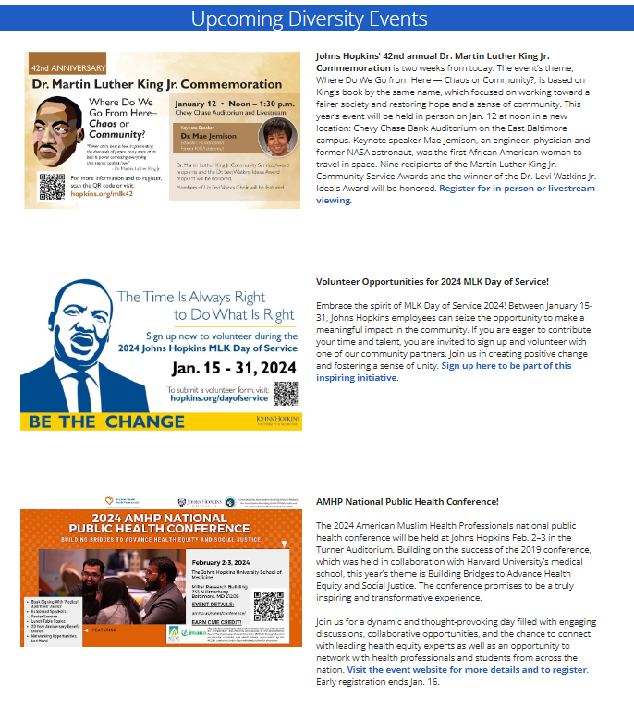
Website Updates- NEW! Diversity Page

Slide 21
Objectives for the Semester
Set up equipment inventory on Hopkins Groups to make equipment borrowing more streamlined for student groups
Make more of an active presence on X(Twitter) as some of the student body prefer to get their information through this platform.
Take more photos of students at our events to share on our socials!
Make sure each page of the GSA Website is fully up to date before leaving office in June

Slide 22
Officer Announcements
President (Rodney)
President Elect (Scarlett)
Director of Administration (Nirvani)
Director of Diversity, Inclusion, and Outreach (Ashley)
Director of Finance (Estefan)
Director of Social and Community Affairs (Mark)
Director of Media and Public Relations (Juliane)
Director of Student Involvement and Student Groups (Edna)
Director of Policy & Strategic Initiatives (Nick)

Slide 23
Officer Announcements
President (Rodney)
President Elect (Scarlett)
Director of Administration (Nirvani)
Director of Diversity, Inclusion, and Outreach (Ashley)
Director of Finance (Estefan)
Director of Social and Community Affairs (Mark)
Director of Media and Public Relations (Juliane)
Director of Student Involvement and Student Groups (Edna)
Director of Policy & Strategic Initiatives (Nick)

Slide 24
Announcements
SOM Committees
Program Reps/Student Groups
Misc.

Slide 25
THANK YOU!
@jhmi.gsa
Johns Hopkins Medicine GSA
@jhmi_gsa
jhu.campusgroups.com/gsa

