Slide 1
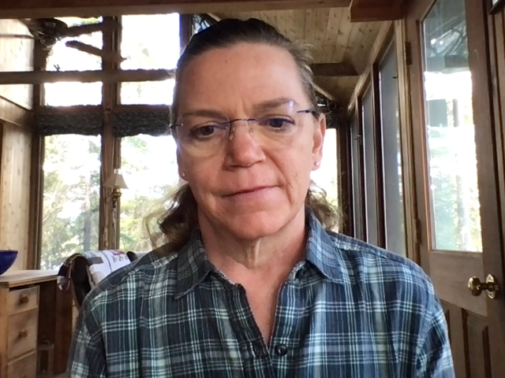
Accounting Analysis I - ACCY 501
Margaret Evans, Instructor
mem12@Illinois.edu
Notes:
Hi everyone! I’m Margaret Evans, instructor for ACCY 501, Accounting analysis 1. This is the first of a two course sequence that cover how economic entities, or companies, collect, process, and communicate accounting information to their various stakeholders,(such as managers, stockholders, and creditors).

Slide 2
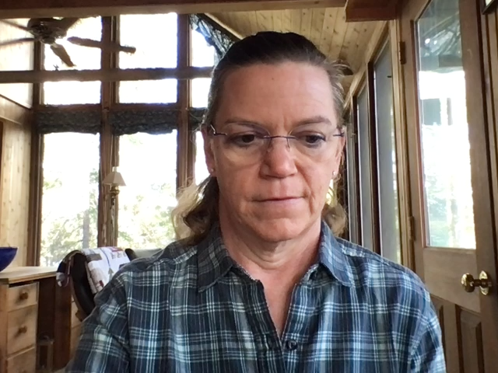
Course Description
Understand Financial Statements: Balance Sheet, Income Statement, and Cash Flow Statement.
Measurement of cash, receivables, and allowances for bad debts.
Measure Cost of Goods Sold
Define, classify and explain the nature of long-lived productive assets
Define and classify investments
Classify cash flow statement items in the operating, investing, and financing activities.
Notes:
This course focuses on accounting concepts, principles, and theory related to measurement of assets, income, and the disclosure of additional information that might assist those using the financial reports. We will cover how to classify items for each of the financial statements: balance sheet, income statement, and cash flow statement.
We cover the measurement of cash, receivables, and allowances for bad debts as well as Cost of Goods Sold. You will learn how to define and classify long-lived assets and investments.
This course will help you understand how Cost of Goods Sold is measured and work through some decision-making scenarios. We work through defining and classifying long-lived productive assets and interpreting the fixed asset turnover ratio.
Completing both ACCY 501 and 502 will give you a good understanding of the theoretical and technical aspects of financial reporting methods for assets, liabilities, and stockholders’ equity. ACCY 501 focuses mainly on assets, 502 focuses on liabilities and stockholders’ equity.

Slide 3
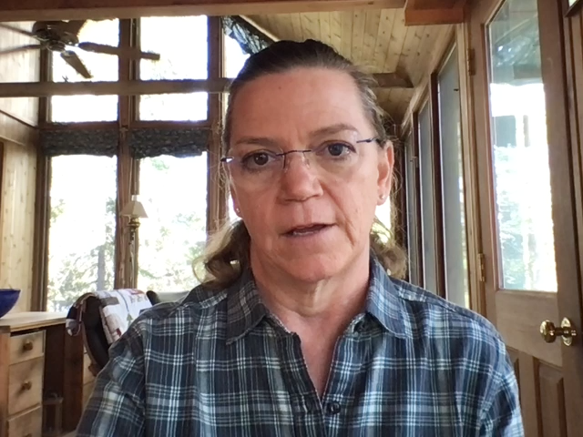
Topics Covered
Brief review of the Accounting Process
Balance Sheet and Financial Disclosures
Income Statement
Statement of Cash Flows
Time Value of Money Concepts
Revenue Recognition
Cash and Receivables
Inventories, Property Plant and Equipment, Intangible Assets
Investments
Notes:
So, in ACCY 501 the specific topics we cover include a very brief review of the accounting process. Each of the financial statements are covered in detail specifically related to assets. We cover the time value of money, revenue recognition, how cash and receivables are accounted for by accountants. Then move onto the measurement and accounting for inventories, Property Plant and Equipment, Intangible assets, and investments.

Slide 4

Elements of the Course
Class – Tuesdays and Thursdays 3:30 – 4:50 pm.
Weekly homework assignments
Individual case assignments
Team case assignments
Midterm exam
Final exam
Notes:
The elements of the course include; weekly homework assignments, weekly CPA questions, an individual case assignment, team case assignments, as well as a midterm and final exam. We use the Intermediate Accounting textbook used in both ACCY 501 and 502 and case materials from Harvard Business Publishing.
This is a great course if you are interested in learning more about the accounting principles behind the financial statements provided by companies and how to utilize this information.
Please feel free to email me with any further questions about the course.
Hope to see you in class this Fall! Enjoy the rest of your summer! Thank you!

