Slide 1
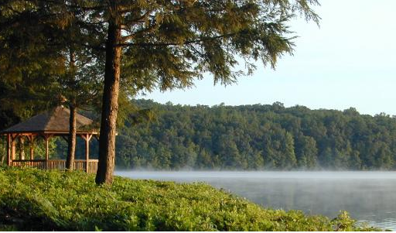
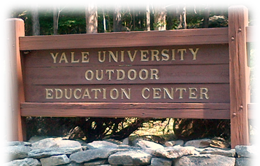
Welcome to the Yale Outdoor Education Center
297 Upper Pattagansett Rd, East Lyme, CT 06333

Slide 2
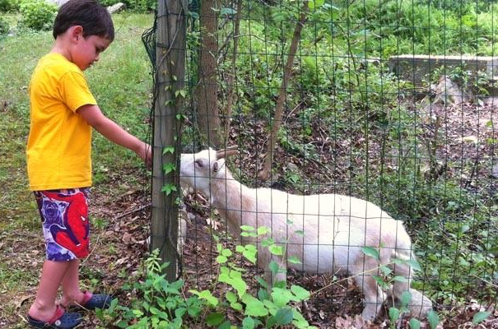
Background Information:
Founded by Edward C. Migdalski in 1968
Enjoyable for couples, families, and groups
Quiet wooded space and lake, relaxing or active retreat from workdays and school
Great introduction to nature and the outdoors
All experience and comfort levels welcome
Waterfront activities onsite
Groups must reserve in advance

Slide 3
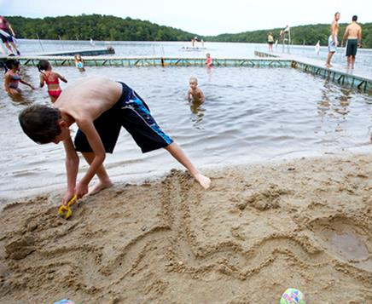
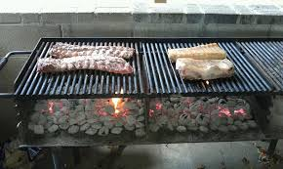
Offerings
Swimming, sand beach
Boating: canoes, kayaks, paddleboards, & rowboats
Remote hiking trail (see staff for map and info.)
Walking path
Picnic and grilling areas
Pavilion, dining hall, cabins, & campsites for rent
Games
Basketball, outdoor volleyball, tetherball, cornhole
Fishing
Catch-&-release preferred. Need CT license, tackle, & bait

Slide 4
Guidelines
Hours: 9:30 a.m.- 6:30 p.m. (Closed Mondays)
The front gate is closed before and after hours
All day-only visitors must depart by 6:30 p.m.
Please park behind the pavilion
Check in with staff required
For your safety, stay out of the woods
Speed limit: 8 mph. No motorcycles
No pets or drones allowed
Please be respectful to staff and other guests
We love our local wildlife, and so will you
Please do not harass or try to catch them!

Slide 5
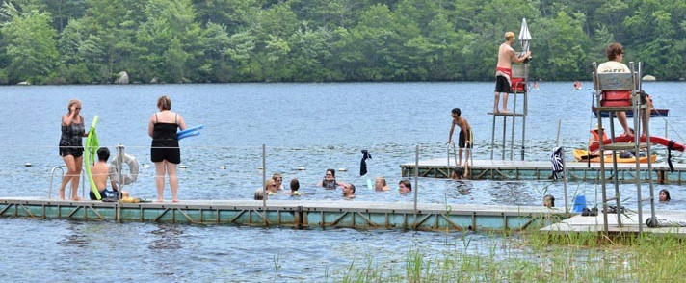
Waterfront—Swim Area
Open from 10a.m.-12p.m., 1p.m.-5p.m. (5:30p.m. weekends)
Swimming/boating only when lifeguards on duty
H-Shaped Floating Swim Dock
Shallow end for non-swimmers, all ages
Deep end for experienced swimmers only
Children and weak swimmers must pass swim test to use deep end

Slide 6
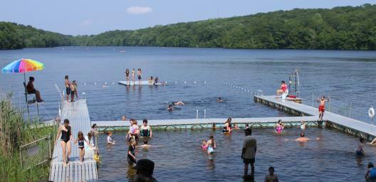
Basic Swim Area Safety Rules
Stay within float lines
No pushing, running, or horseplay
Keep food, drinks, chairs, and any non-swimming objects off dock
No swimming under docks
Always supervise your children
Do not throw rocks, pebbles, or sand

Slide 7
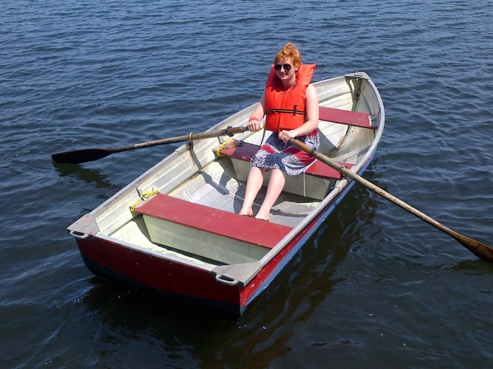
Boating Information
Canoes
2-3 passengers
Medium difficulty
Low stability
Rowboats
1-4 passengers, size dependent
May bring children/infants
Non-swimmers allowed
High stability
High difficulty, especially in wind
Kayaks
1 and 2 passenger
Medium stability
Low difficulty
Standup Paddleboards
1 passenger
Low stability
Medium difficulty

Slide 8
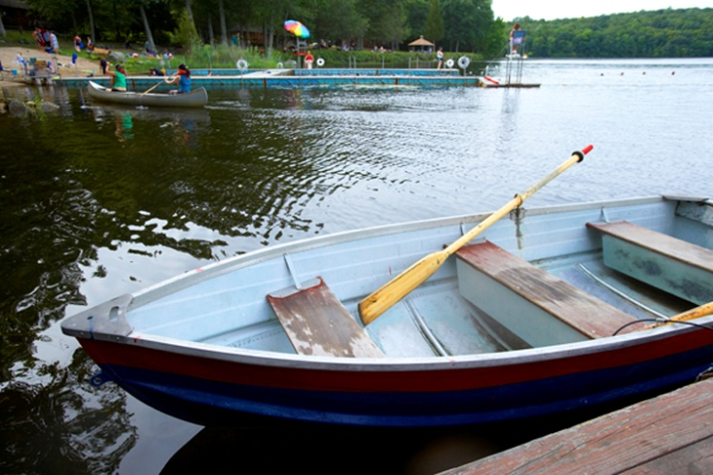
Basic Boating Safety
Wait for a staff member to assist you
Need proper and correct equipment (paddles, oars, lifejackets)
Paddlecraft can tip when entering or exiting
Please stay in your boat!
Depart paddlecraft only at beach or boat dock
Do not switch seats with other passengers—flipping hazard!
Always stay within sight of beach and staff
Return to shore immediately if lightening or thunder
Read signs and speak to staff for more guidance

Slide 9
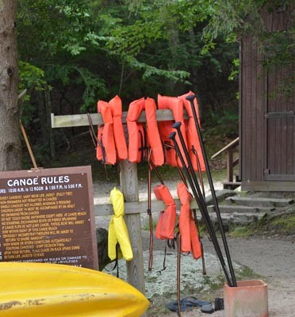
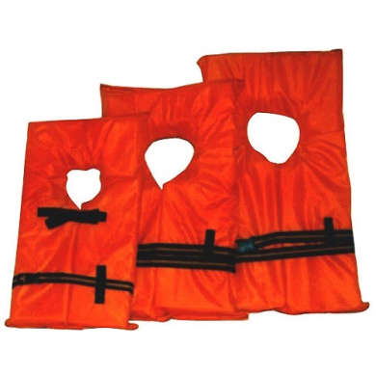
Basic Life Jacket Safety
Could save your life!
Always wear when on boats/paddlecraft
Must be securely fastened
Must wear proper size
Small – Children: less than 50lbs (23Kg)
Medium – Children: 50-90lbs (23-41Kg)
Large – Adults: over 90lbs (41Kg)
Extra Large – Adults: over 90lbs (41Kg)
We provide the personal floatation devices

Slide 10
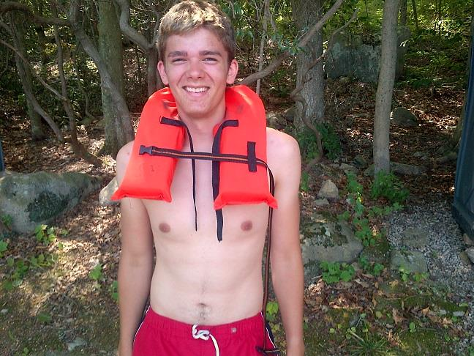
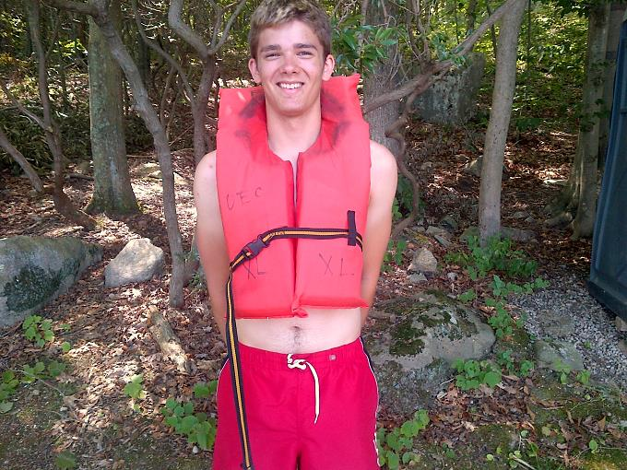
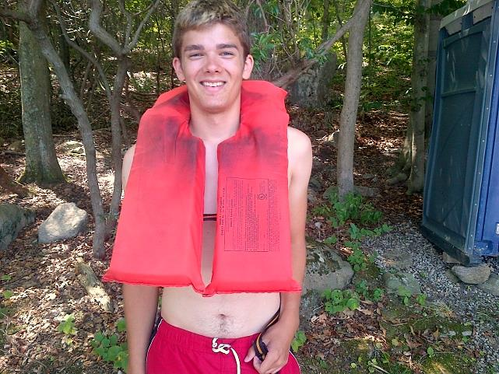
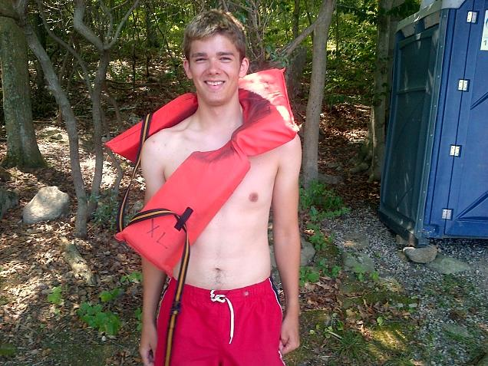
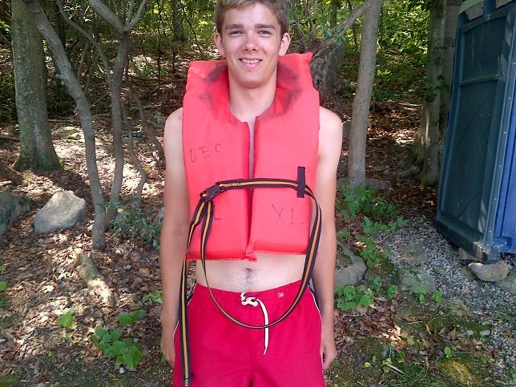
Basic Life Jacket Use
There are many ways to wear and fit a “life jacket” (personal flotation device/PFD), but only one way is correct….
Can you spot the right one?

Slide 11
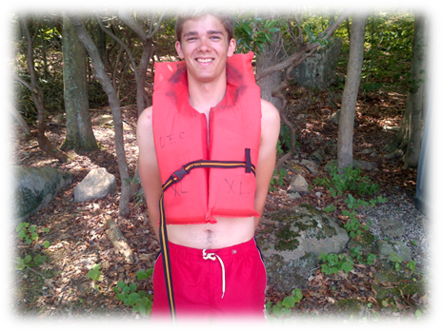
Basic Life Jacket Use
This is the correct way:
Strap under arms and around back
Buckle on the outside
Snugly secured and appropriately sized
Keep it on your body— it can’t help if it’s off!

Slide 12
Outdoor Precautions
Anyone can burn! Use sunscreen
Apply 20 minutes before swimming or sun exposure
If you walk in tall grass or wooded area/hiking trail:
Wear long pants tucked into socks
Apply tick and mosquito repellent (insects can carry diseases)
Check for ticks at the end of the day
Avoid poison ivy, which has groups of three, pointed, shiny leaves
For more information on ticks and tick diseases:
cdc.gov/ticks/avoid/on_people.html

Slide 13
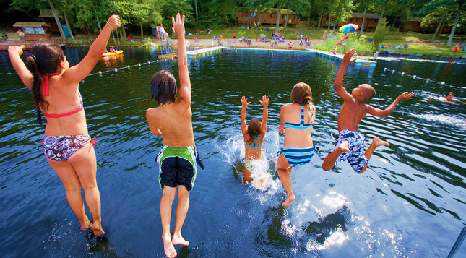
Thank you for visiting. We hope you enjoy your outdoor adventure!
For more YOEC policies and information, please see our website:
sportsandrecreation.yale.edu/outdoor-education-center-0

