Slide 1
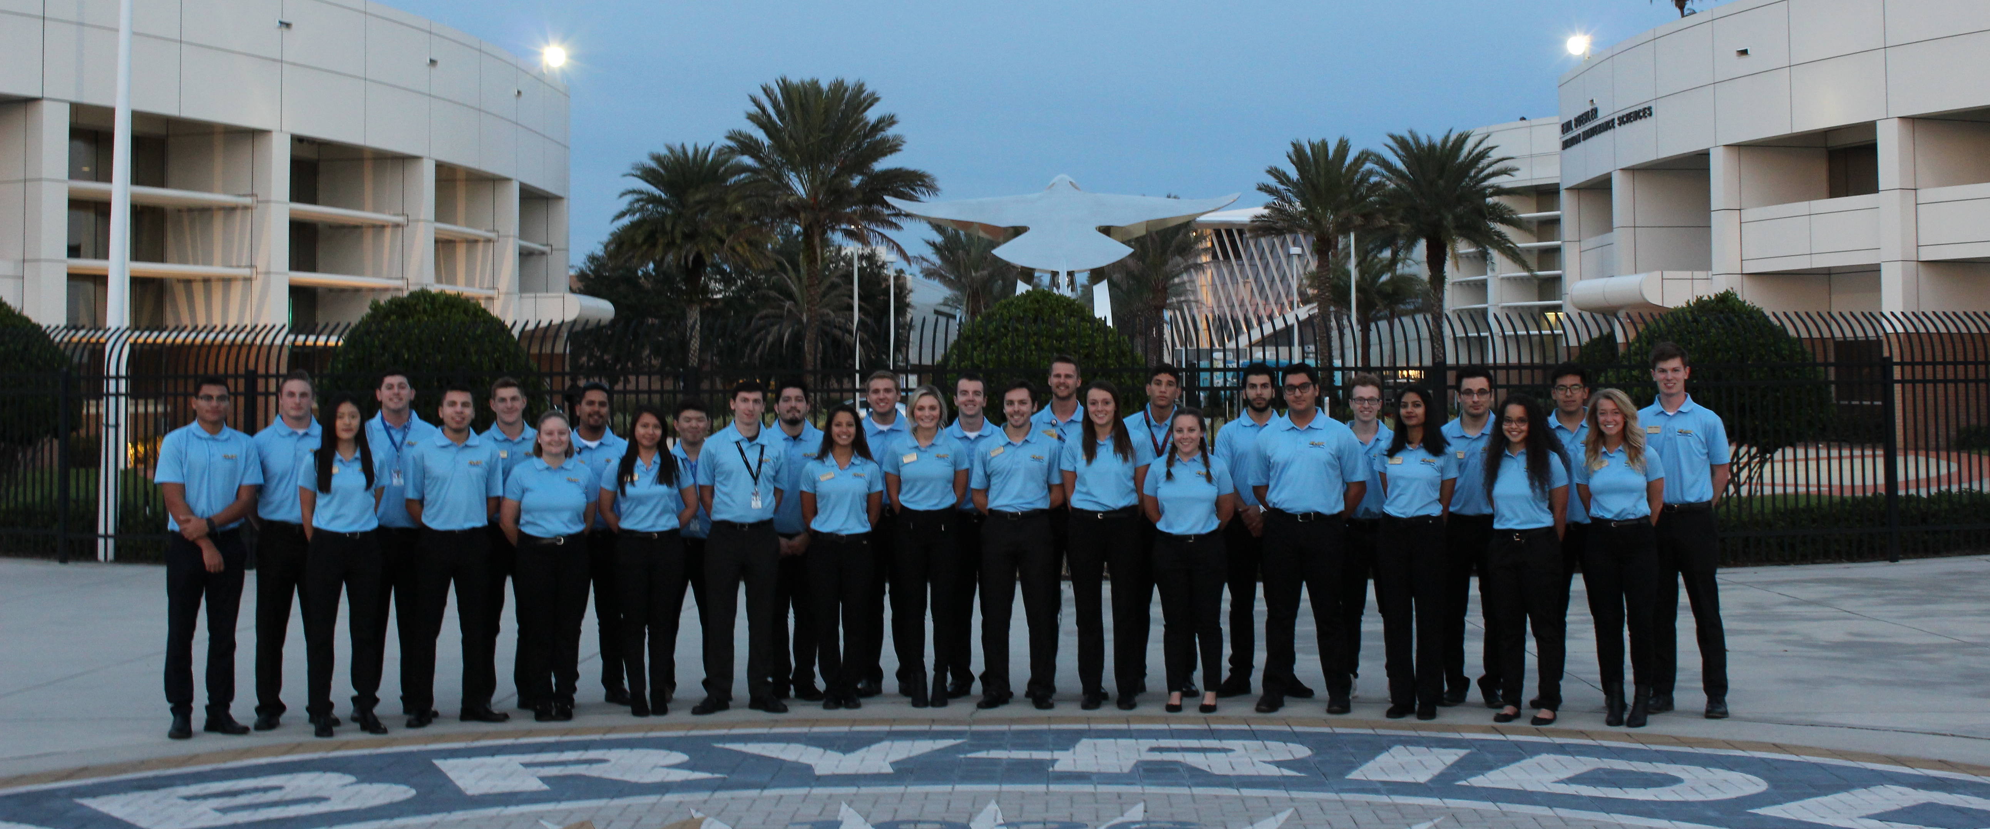
Flight Line Assimilation Program Orientation
Summer B

Slide 2
What is FLAP
Student lead organization to aid in the transition to flight training at ERAU
Mentorship program for any questions or concerns students may have
Weekly/bi-weekly Hangar Talks to provide more information
“The Flight Line Assimilation Program’s mission is to prepare new students for day-to-day life in the Embry-Riddle Flight Department; through the introduction of Embry-Riddle’s Procedures, Safety Culture, and Structure, The Flight Line Assimilation Program intends to mitigate stress and smooth the transition process for students with prior flight training.”

Slide 3
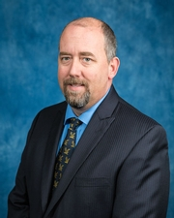
Flight Department Overview
Ivan Grau
Chief Flight Instructor
Oversees all flight training courses at ERAU
Office 214A
Ken Byrnes
Chairman of the Flight Department
Oversees and runs Flight Department
Office 213N

Slide 4
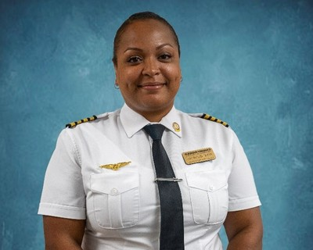
Flight Department Overview
Paul Cairns
Assistant Chief Flight Instructor/Head of Standards
Aids Ivan and oversees all curriculum changes and check rides at ERAU
Office 213F
René Clemens
Assistant Chief Flight Instructor
Aids Ivan in overseeing all flight training
Office 214B

Slide 5
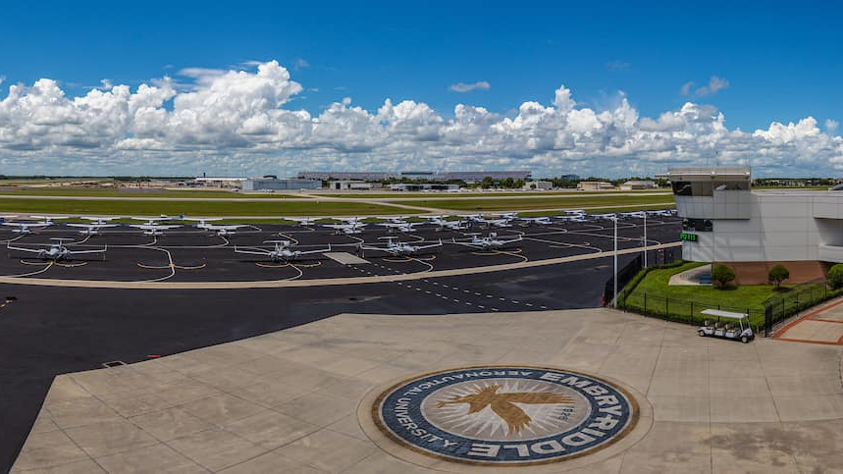
Flight Department Overview
Flight Scheduling Office 115
Leigh Walker- In charge of scheduling each student
Brian Herget- Pairs students and instructors and course enrollments
Jamie Cox- ETA Administrator

Slide 6
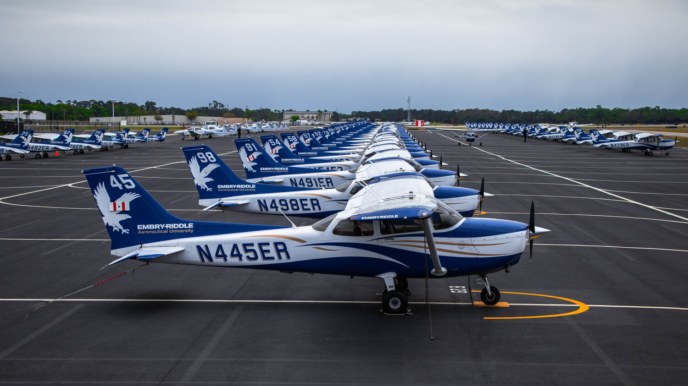
Flight Department Overview
Flight Supervisor
Oversees all flight operations at ERAU
Tracks all flights using ADS-B
Briefs and dispatches all solo flight operations

Slide 7
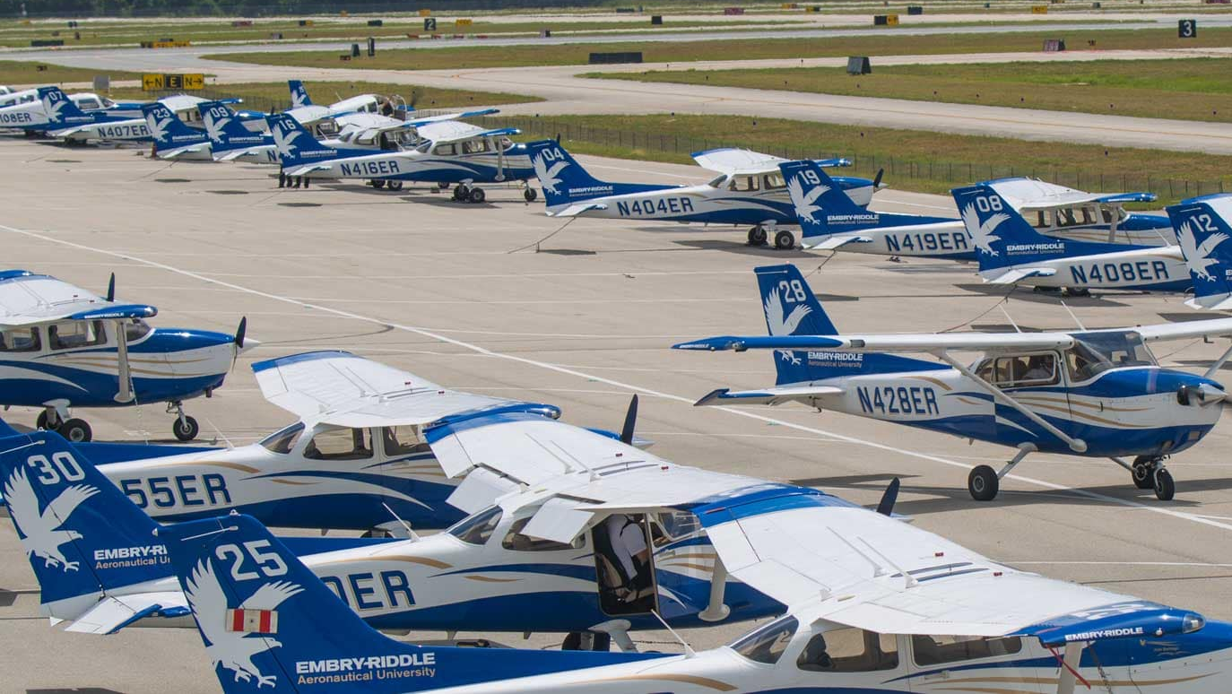
Flight Department Overview
Team Managers
Oversee Students progress through flight training
Team 1- Rich Garner, Office 213G
Team 2- Dan Thompson, Office 213A
Team 3- Nicole Hester, Office 213 D
Team 4- Victor Fraticelli, Office 213H
Team 5- Suzette DeGraw, Office 213B
Team 6- Anna Battison, Office 213C
Team 7- Oliver Kroos, Office 213E
Specialized TM- Don McCann, Office 210

Slide 8
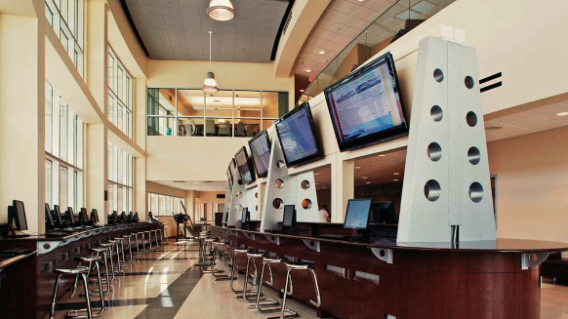
Flight Data and Certification
Oversee all documents students must have to fly
Government Issued ID
Medical
Pilot Certificate
Must see them with original copies before beginning flight training
Students must update records if a new document is obtained. This allows all records to be current

Slide 9
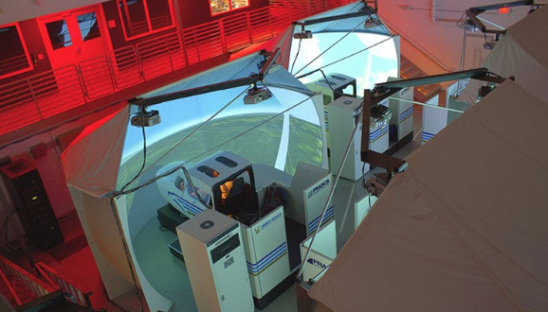
Flight Block
This is your class time
Orals, Sims, Flights
3-hour block of time
If you are assigned MWF 0750, you may not always have an activity
You are only required to show up if you are scheduled!
For the next week, do not show up until you are contacted by your flight instructor

Slide 10
ETA
Scheduling Software used for flight schedules
Activities will be posted by instructors on the schedule
Will show you where to show up and when
Will show you what you need to prepare, and what to study
Must check every night after 1700 for the next days schedule
A FLAP mentor will now walk you through ETA and how to use

Slide 11
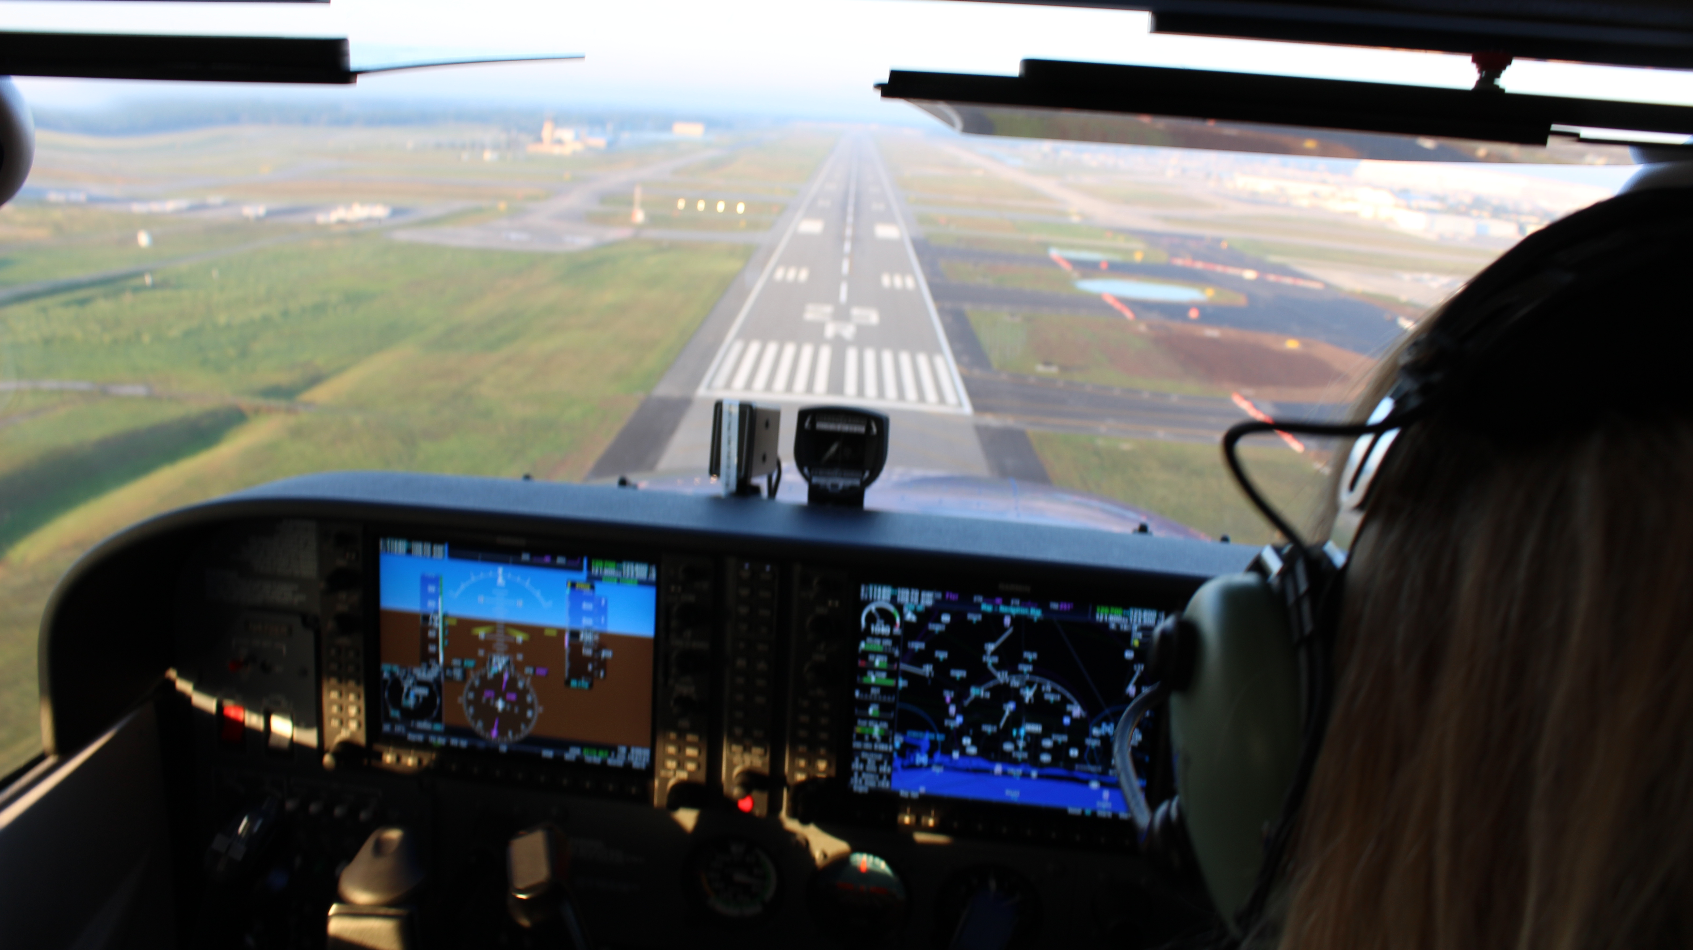
What’s Needed to Fly
Ramp Badge
Government Issued ID
Pilot Cert.-New Student pilots will start this process after the first PA
Medical-At least a 2nd class
Logbook-
FOM-Current digital version
SOPM-Current digital version
Checklist*
IFG*
PIM-Paper or digital. “owners Manual” for C172S
Sectional*
Sunglasses
Headset
Water
Kneeboard**
Flashlight**
Foogles/Hood**
iPad
* can be digital using ForeFlight. During private pilot solos, MUST have paper version to fly
** optional. Only required for some flights

Slide 12
ERAU Flight Documents
Each student is required to be familiar with these documents
Flight Operations Manual (FOM)
Rules for IP’s and students to follow
Standard Operating Procedures and Maneuvers (SOPM)
How ERAU does maneuvers in the C172S
Allows for any instructor to fly with any Student
C172 Checklist
Only approved checklist used at ERAU
ERAU Uses a do/verify checklist. Flows must be memorized by each student’s pre-solo flight

Slide 13
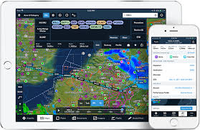
ForeFlight
ERAU is transitioning to Electronic Flight Bags (EFB) for training
iPad’s with ForeFlight are the only approved EFB at ERAU
While using ForeFlight, all GPS data must be turned off
Students will receive a discount by following the link in the FOM
FOM 11.8

Slide 14
FOM-Scheduling
All students and Instructors are required to check ETA after 1700 each night
Time Limits
Orals-2.0
Sims-1.1
Flights 2.3
Students are required to check in before or at start time, failure to do so will result in a no show
Will result in a fine charged to your flight account
Even if the weather is bad, students can face a no show if they have not communicated with their IP
We recommend to check in
10-15 minutes early for Oral and Sim Activities
45-60 minutes early for flight activities

Slide 15
FOM-Grounds/Holds
Medical Ground
Students may medically ground themselves when they are sick, but must follow the proper procedure
Must inform IP AT LEAST 30 minutes prior to start time
Must fill out Medical Ground Form on ETA
Must call/email Health Services immediately. Health Services will then inform you if you must be seen by a nurse or Dr
Vacation Hold
If a student is leaving for an extended period of time, they must file a vacation hold
Must fill out form on ETA, and advise IP they are leaving
Students are only allowed a certain number of hold days per course, consult the FOM for your course
Financial Hold
If at any time a student needs to be placed on hold for financial reasons, they must see their TM

Slide 16
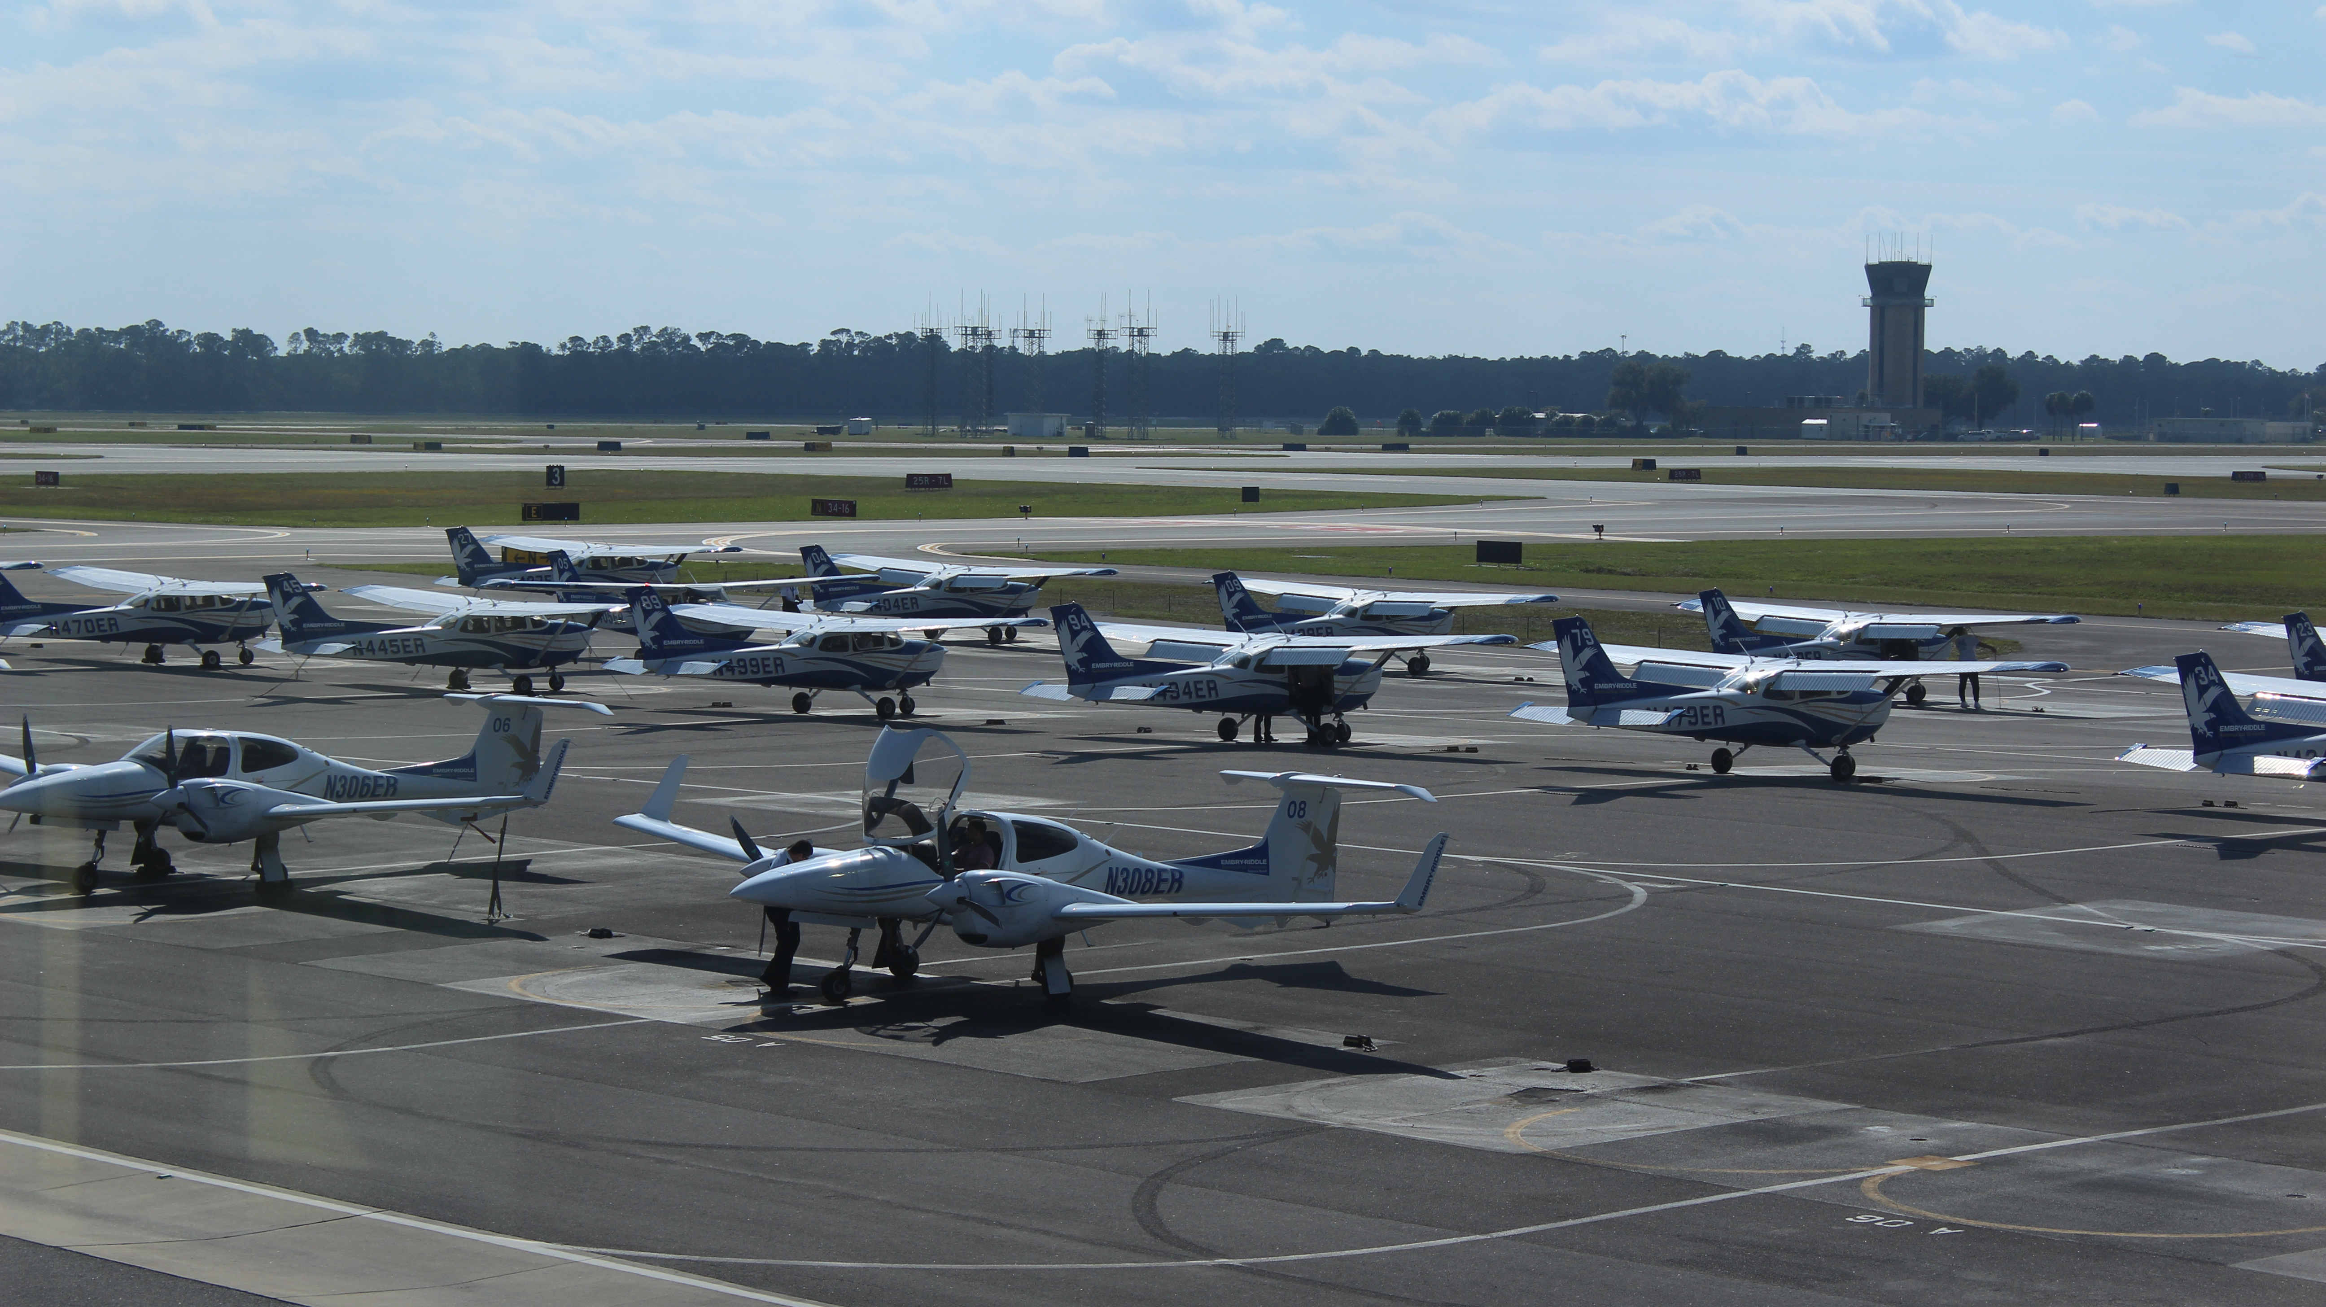
FOM-Ramp Operations
No cell phone usage on the ramp
No music on the ramp or in flight
No running on the ramp, must walk tails of all airplanes to avoid the propeller area
Drug testing may occur at any time, must complete drug testing to remove hold
ERAU Observes a zero-tolerance alcohol policy for students under 21.
Students over 21 may not drink 12 hours prior to any flight
Students must follow dress code for flights
Closed toed shoes
Socks that cover ankles
Pants that cover ankles
At least T-shirt length sleeves

Slide 17
COVID-19
Everyday, students will be required to pass a wellness check
Face masks must always be worn in the Flight Department
Aircraft must be sanitized before flight
Check-In Process
Aircraft Sanitation

Slide 18
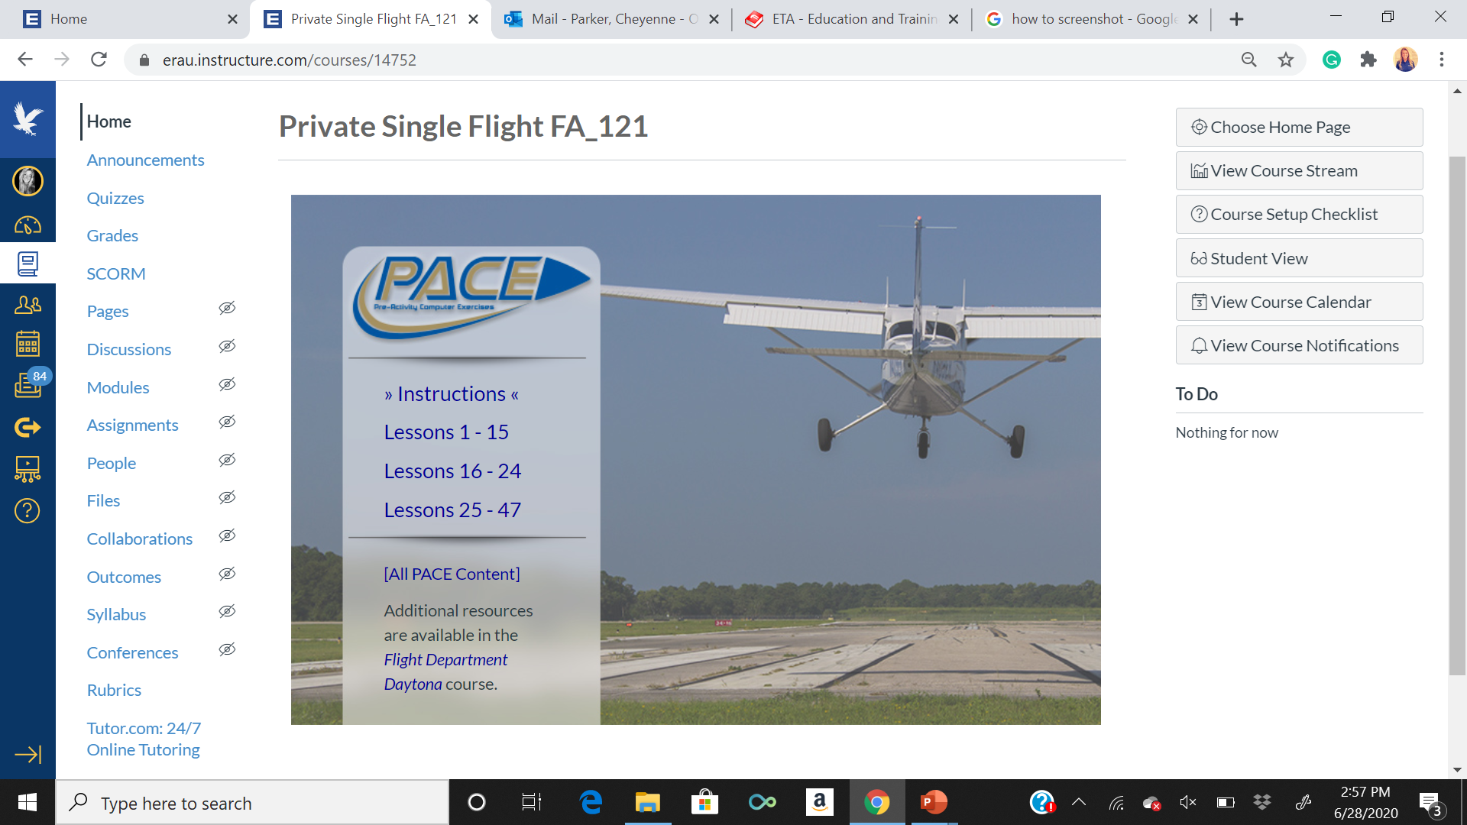
PACE
PACE Modules must be completed before each scheduled activity
Will show you what to review, what to do for HW, and assess you.
If these activities are not, students may face a no-show

Slide 19
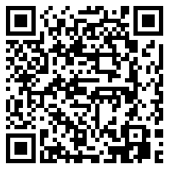
FLAP mentors are here to help anyone at anytime.
Sign Up: Bit.ly/FLAPSPR20

